Slide 1
INTRODUCTION TO DATA & SAMPLING
S.KALAI SELVI ,
GUEST LECTURE,
CPA COLLEGE,
BODINAYAKANUR

Slide 2
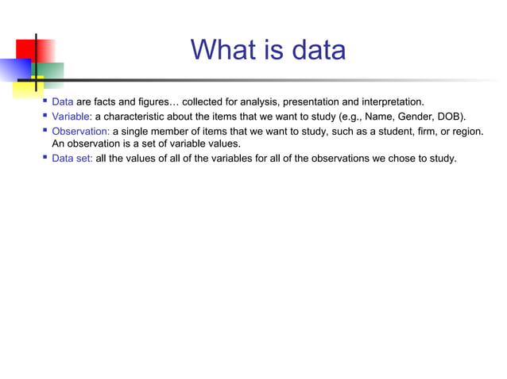

Slide 3
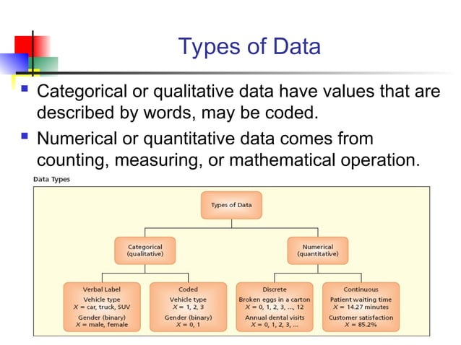

Slide 4
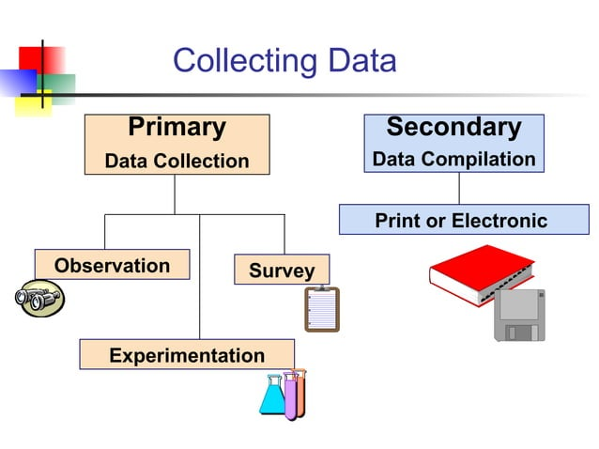

Slide 5
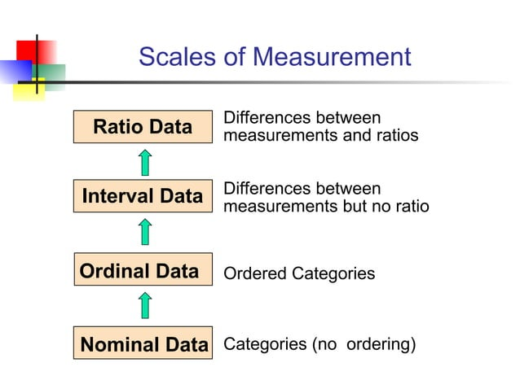

Slide 6
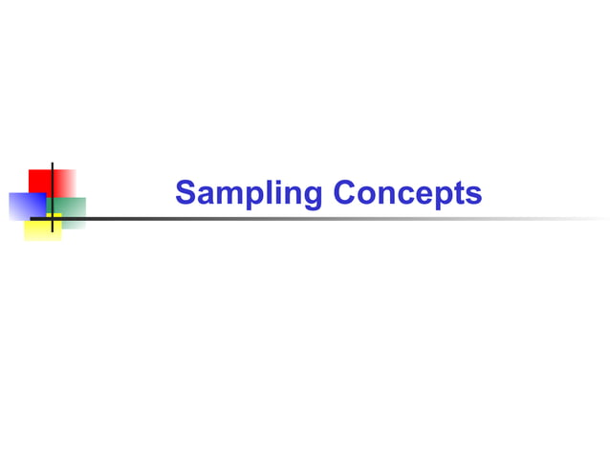

Slide 7
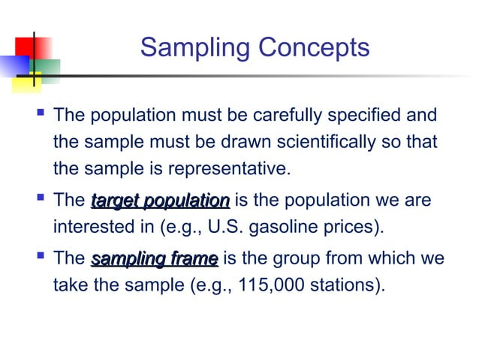

Slide 8
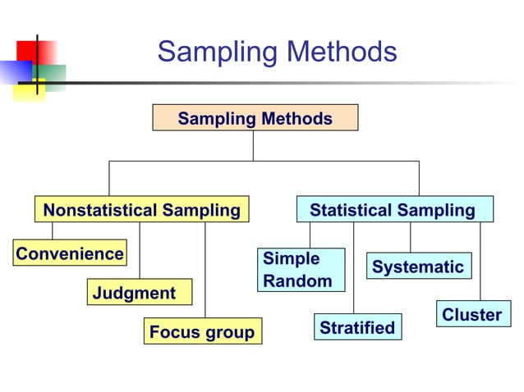

Slide 9
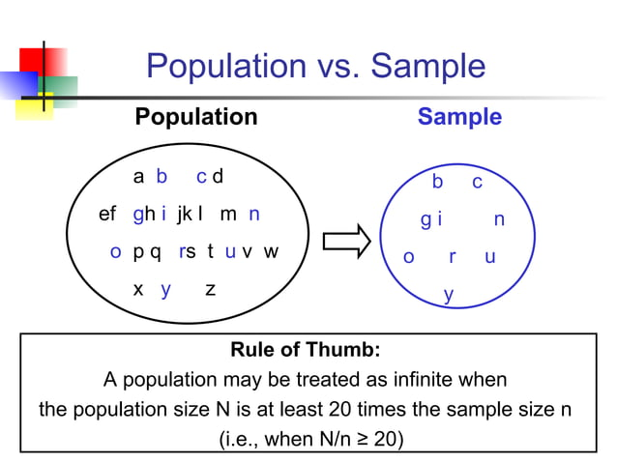

Slide 10
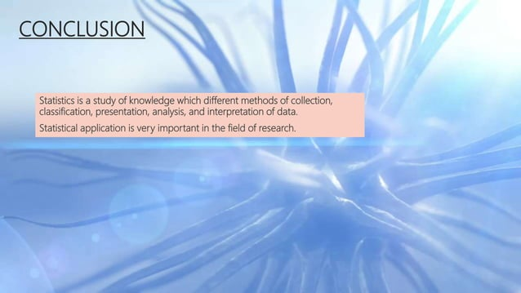

Slide 11
THANK YOU

