Slide 1
X-ray diffraction
Dr. B. Kavitha
Assistant Professor
PG and Research Department of Chemistry
C.P.A. College, Bodinayakanur

Slide 2
X-ray diffraction (XRD)
X-Ray diffraction is a versatile, non-destructive analytical method for identification and quantitative determination of various forms, known as ‘Phases’ of compounds present in powder and solid samples.
Diffraction occurs as waves interact with a regular structure whose repeat distance is about the same as the wavelength.
The phenomenon is common in the natural world, and occurs across a broad range of scales.
For example, light can be diffracted angstroms, about the wavelength of the light. It happens that X-Ray have wavelength on the order of a few angstroms, the same as typical inter atomic distance in crystalline solids. That means X-Rays can be diffracted from minerals which, by definition, are crystalline and have regularly repeating atomic structures.
When certain geometric requirements are met, X-Ray scattered from a crystalline solid can constructively interfere, producing a diffracted beam. In 1912, W.L.Bragg recognized a predictable relationship among several factors.

Slide 3
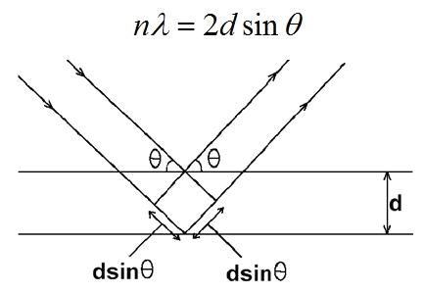
Bragg’s law
When a chromatic intense beam of light falls on a parallel lattice plane of crystal, the incident beam reflected secularly from various planes of crystal. In this case, the phenomenon of reflection is known as crystal diffraction of scattering.
Diffraction is essentially a scattering phenomenon in which large number of atoms co-operate
X-ray diffraction pattern

Slide 4
The distance between similar atomic planes in a mineral (the inter atomic spacing) which we call the d – spacing and measure in angstroms.
The angle of diffraction which we call the theta angle and measure in degrees. For practical reasons the diffractometer measure an angle twice that of the theta angle. Not surprisingly, we call the measured angle ‘2-theta’.
The wavelength of the incident X-Radiation, symbolized by the Greek letter lambda and, in our case, equal to 1.54 angstrom.
nλ = 2d sinθ
λ – Wavelength of X-ray
d – Interplanar spacing
θ – Diffraction angle
n = 0, 1, 2, 3…

Slide 5
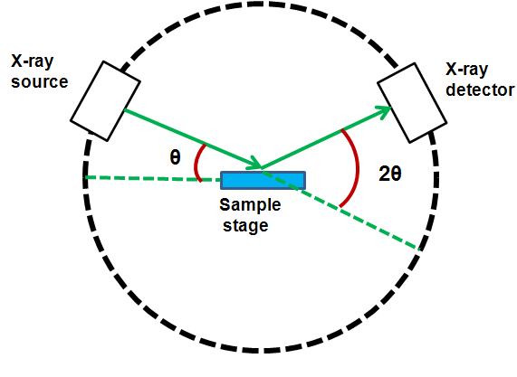
Instrumentation
A powder X - ray diffractometer consists of a X - ray source (usually a X - ray tube), a sample stage, a detector and provision to change angle θ
The X - ray is focused on the sample at some angle θ, while the detector opposite to the source reads the intensity of the X - ray that receives at
2θ away from the source path. The incident angle is the increased over time while the detector angle always remains 2θ above the source path.

Slide 6
X - ray Tubes
The most common source of X - rays is an X - ray tube. The tube is evacuated and contains a copper block with a metal target anode and a tungsten filament cathode with a high voltage is applied between them.
The filament is heated by a separate circuit, and the large potential difference between the cathode and anode electrons at the metal target. The accelerated electrons knock core electrons out of the metal, and electrons in the outer orbitals drop down to fill the vacancies and thereby, emitting X-rays.
The X-rays exit the tube through a beryllium window. Due to massive amounts of heat being produced in this process, the copper block must usually be water cooled.

Slide 7
X- ray detectors
Most modern equipment do use transducers that produce an electrical signal when exposed to radiation.
These detectors are often used as photon counters, so intensities are determined by the number of counts in a certain period of time.
Scintillation Counters
In a scintillation counter, phosphor is placed in front of a photomultiplier tube. When X - rays strike on the phosphor, it produces flashes of light, which are detected by the photomultiplier tubes.

Slide 8
      Gas-Filled Transducers
A gas-filled transducer consists of a metal chamber filled with an inert gas, with the walls of the chamber as a cathode and a long anode in the center of the chamber.
When X - rays enters the chamber, its energy ionizes many molecules of the gas. The free electrons then migrate towards the anode and the cations migrate towards the cathode.
The electrons that reach the anode cause current to flow, which can be detected. The sensitivity and dead time (when the transducer will not respond to radiation) both depend on the voltage of the transducer is operated at.
At high voltage, the transducer is very sensitive but it has a long dead time, whereas at low voltage, the transducer has a short dead time but low sensitivity

Slide 9
      Semiconductor Transducers
A semiconductor transducer has a gold coated p-type semiconductor layered on lithium containing semiconductor intrinsic zone, followed by an n-type semiconductor on the other side of the intrinsic zone.
The semiconductor is usually composed of silicon and germanium but germanium is used if the radiation wavelength is very short.
The n - type semiconductor is coated by an aluminum contact, which is connected to a pre-amplifier. The entire crystal has a voltage applied across it.
When X - ray strikes the crystal, it elevates many electrons in the semiconductor into the conduction band, which causes a pulse of current

Slide 10
Applications
The X - ray diffraction is a good tool to study the nature of the crystalline substances. In crystals, the ions or molecules are arranged in well-defined positions in planes in three dimensions.
The impinging X - rays are reflected by each crystal plane. So the planes can not be same or identical for any two chemical substances, this technique provides vital information regarding the arrangement of atoms and the spacing in between them and also to find out the chemical compositions of crystalline substances.
The sample under study can be of either a thin layer of crystal or in a powder form. Since, the power of a diffracted beam depends on the quantity of the corresponding crystalline substance. It is also possible to carry out quantitative determinations.

Slide 11
Thank You

