Slide 1
Thermodynamic efficiency (or) Carnot Theorem
Dr. B. Kavitha
Assistant Professor
PG and Research Department of Chemistry
C.P.A. College, Bodinayakanur

Slide 2
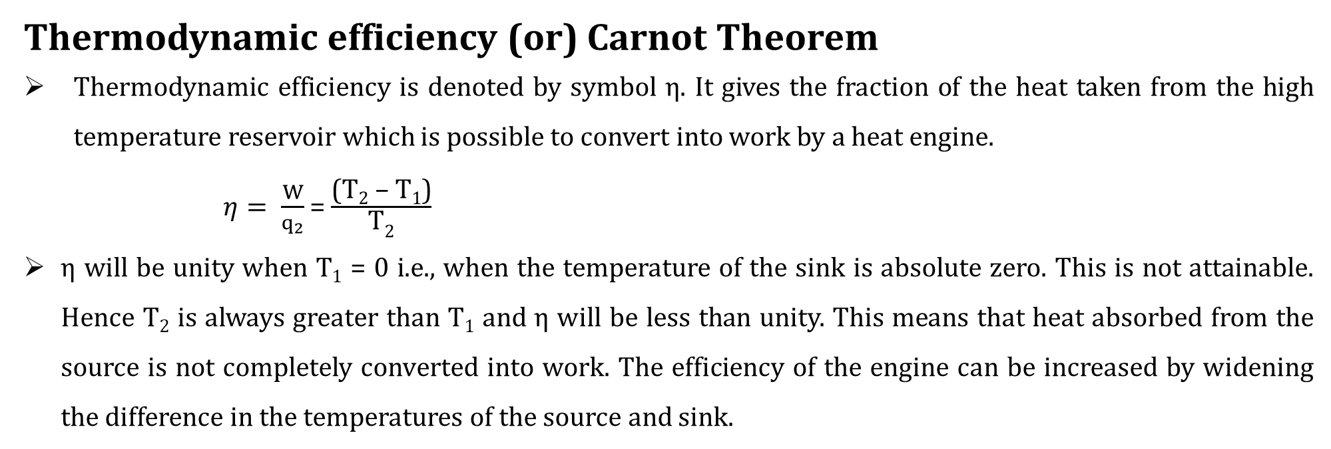
Thermodynamic efficiency (or) Carnot Theorem
Thermodynamic efficiency is denoted by symbol η. It gives the fraction of the heat taken from the high temperature reservoir which is possible to convert into work by a heat engine.
$η= \frac{W}{q_{2}}$ = $\frac{\text{(}\text{T}\text{2}\text{ – }\text{T}\text{1}\text{)}}{\text{T}\text{2}}$
η will be unity when T₁ = 0 i.e., when the temperature of the sink is absolute zero. This is not attainable. Hence T₂ is always greater than T₁ and η will be less than unity. This means that heat absorbed from the source is not completely converted into work. The efficiency of the engine can be increased by widening the difference in the temperatures of the source and sink.
Carnot theorem
The efficiency of a reversible heat engine depends only upon the temperatures of the source and sink and is independent of the nature of the working substance. In other words, all reversible heat engine working between the same temperatures have the same efficiency. This is known as Carnot theorem.

Slide 3
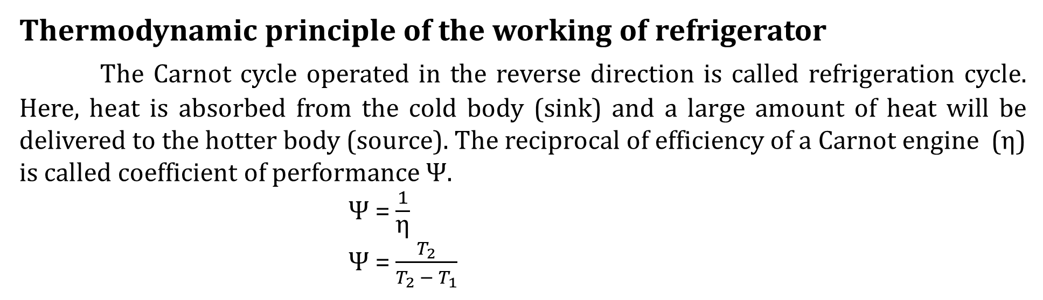
Thermodynamic principle of the working of refrigerator
The Carnot cycle operated in the reverse direction is called refrigeration cycle. Here, heat is absorbed from the cold body (sink) and a large amount of heat will be delivered to the hotter body (source). The reciprocal of efficiency of a Carnot engine (η) is called coefficient of performance Ψ.
Ψ = $\frac{1}{\text{η}}$
Ψ = $\frac{T_{2}}{T_{2 }− T_{1}}$
Concept of Entropy
Entropy is a measure of randomness or disorder of the molecules of the system. The symbol of entropy is S. The entropy of a system depends only on the initial and final state of the system.
Then the change in entropy for any process is given by
ΔS = S_{final} – S_{initial}
When S_{final} > S_{initial,} ΔS = +ve

Slide 4
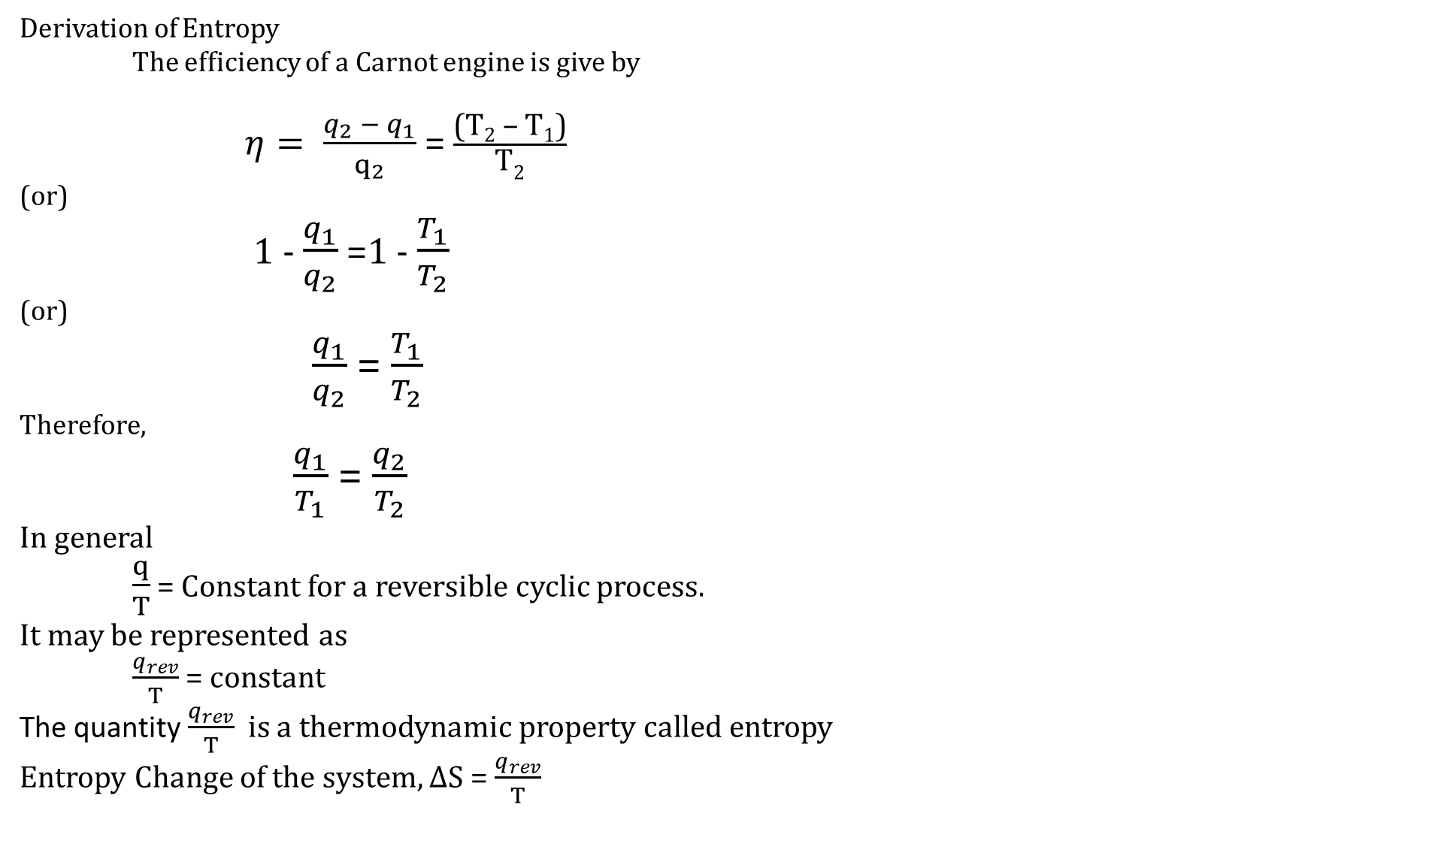
Derivation of Entropy
The efficiency of a Carnot engine is give by
$η= \frac{q_{2} − q_{1}}{q_{2}}$ = $\frac{\text{(}\text{T}\text{2}\text{ – }\text{T}\text{1}\text{)}}{\text{T}\text{2}}$
(or)
1 - $\frac{q_{1}}{q_{2}}$ =1 - $\frac{T_{1}}{T_{2}}$
(or)
$\frac{q_{1}}{q_{2}}$ = $\frac{T_{1}}{T_{2}}$
Therefore,
$\frac{q_{1}}{T_{1}}$ = $\frac{q_{2}}{T_{2}}$
In general
$\frac{q}{T}$ = Constant for a reversible cyclic process.
It may be represented as
$\frac{q_{rev}}{T}$ = constant
The quantity $\frac{q_{rev}}{T}$ is a thermodynamic property called entropy
Entropy Change of the system, ΔS = $\frac{q_{rev}}{T}$

Slide 5
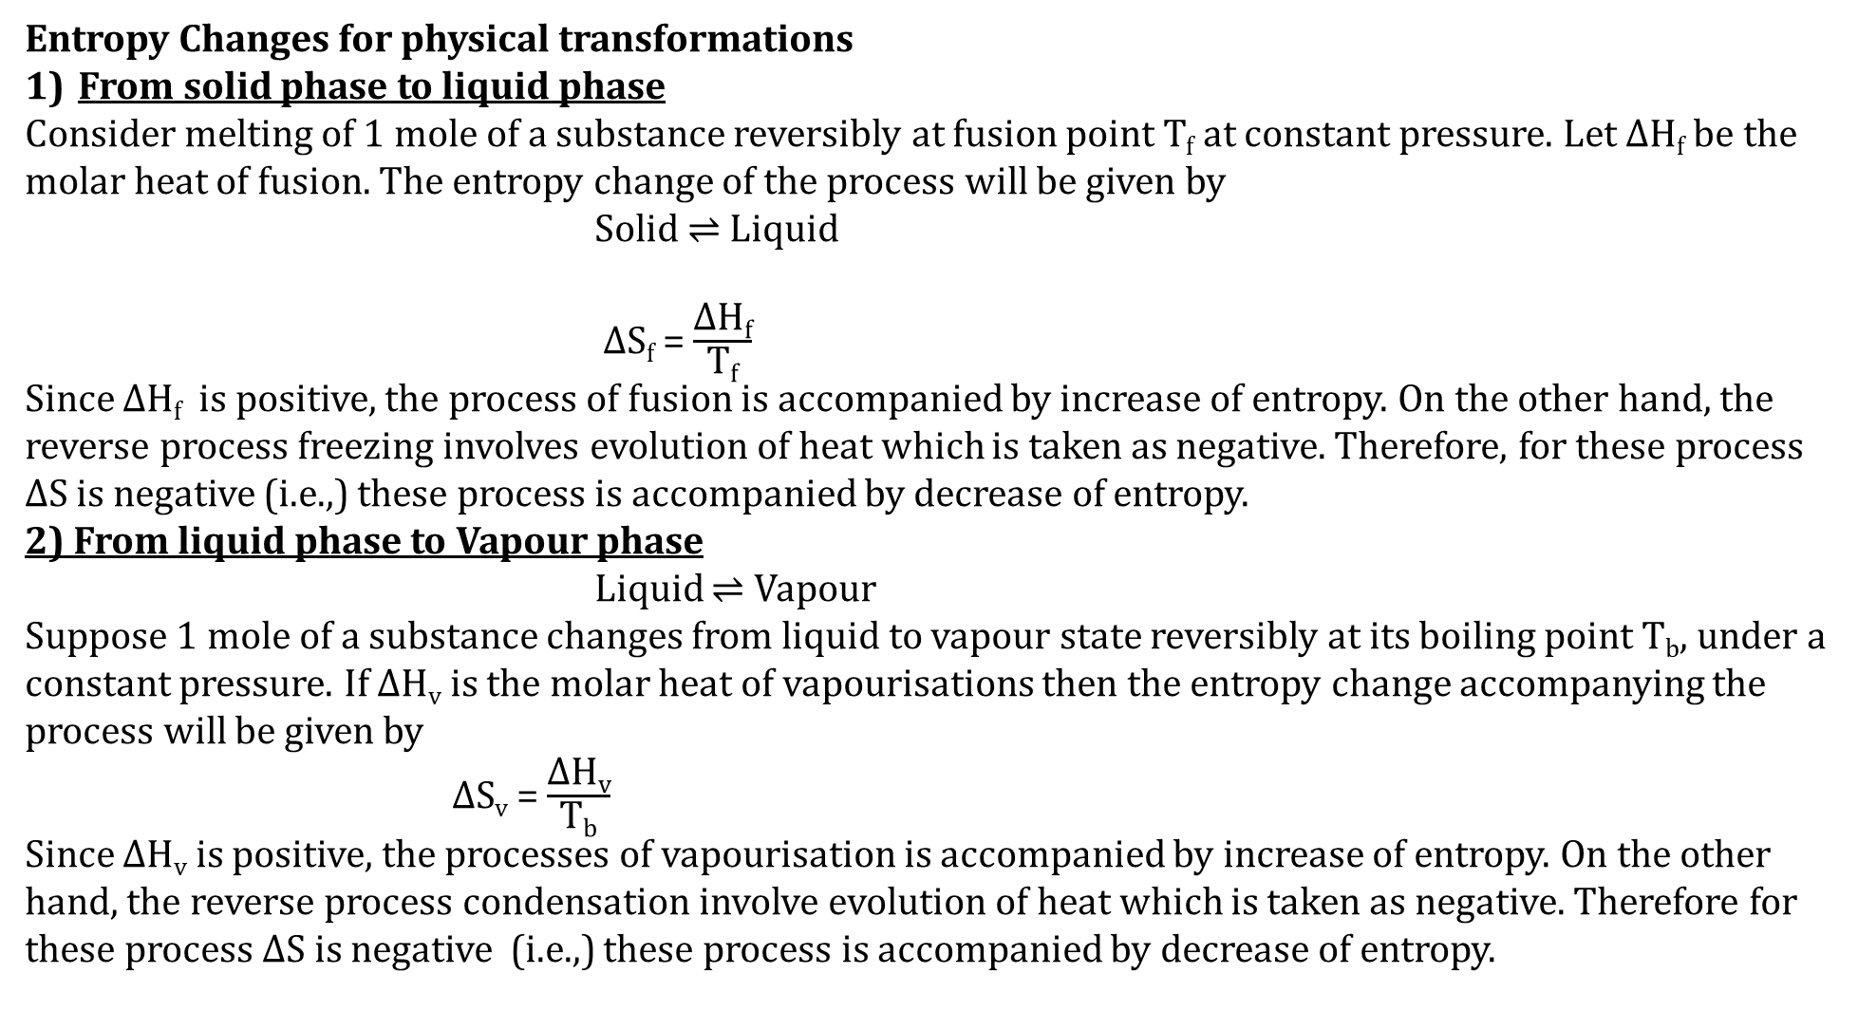
Entropy Changes for physical transformations
From solid phase to liquid phase
Consider melting of 1 mole of a substance reversibly at fusion point T_{f} at constant pressure. Let ΔH_{f} be the molar heat of fusion. The entropy change of the process will be given by
Solid $⇌$ Liquid
ΔS_{f} = $\frac{\text{Δ}\text{H}\text{f}}{\text{T}\text{f}}$
Since ΔH_{f} is positive, the process of fusion is accompanied by increase of entropy. On the other hand, the reverse process freezing involves evolution of heat which is taken as negative. Therefore, for these process ΔS is negative (i.e.,) these process is accompanied by decrease of entropy.
2) From liquid phase to Vapour phase
Liquid $⇌$ Vapour
Suppose 1 mole of a substance changes from liquid to vapour state reversibly at its boiling point T_{b}, under a constant pressure. If ΔH_{v} is the molar heat of vapourisations then the entropy change accompanying the process will be given by
ΔS_{v} = $\frac{\text{Δ}\text{H}\text{v}}{\text{T}\text{b}}$
Since ΔH_{v} is positive, the processes of vapourisation is accompanied by increase of entropy. On the other hand, the reverse process condensation involve evolution of heat which is taken as negative. Therefore for these process ΔS is negative (i.e.,) these process is accompanied by decrease of entropy.

Slide 6
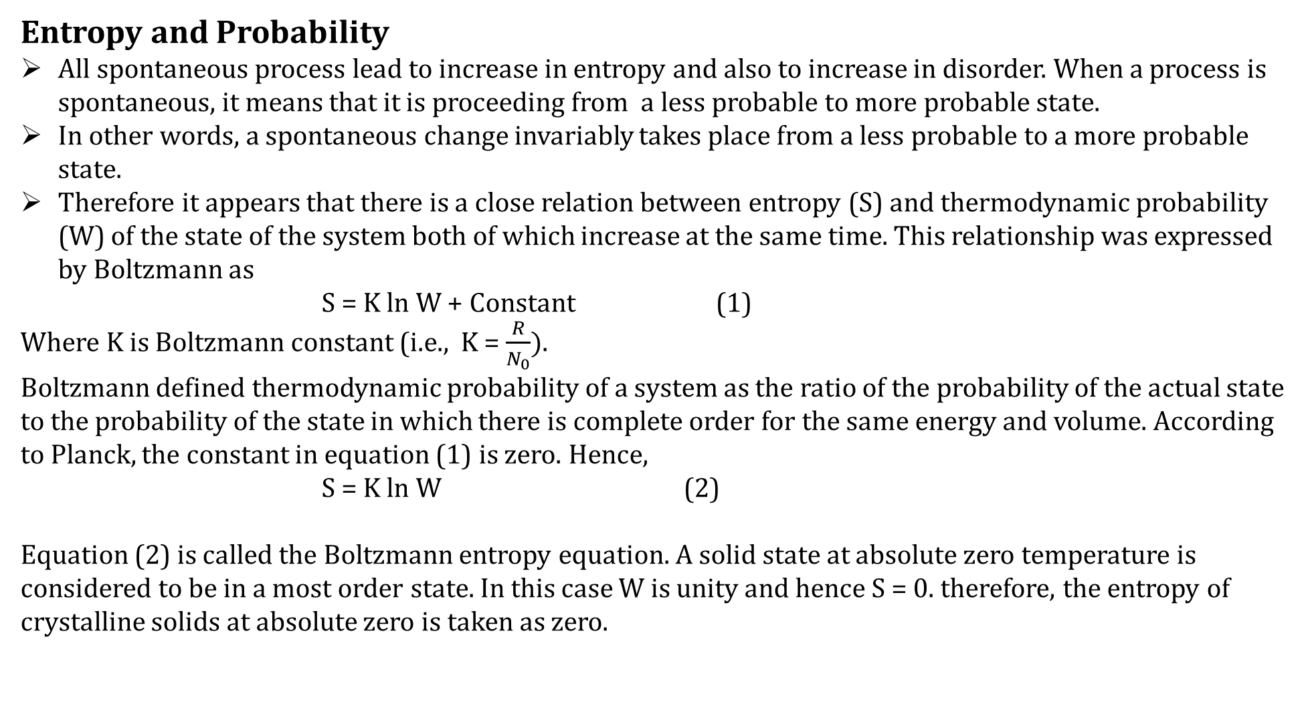
Entropy and Probability
All spontaneous process lead to increase in entropy and also to increase in disorder. When a process is spontaneous, it means that it is proceeding from a less probable to more probable state.
In other words, a spontaneous change invariably takes place from a less probable to a more probable state.
Therefore it appears that there is a close relation between entropy (S) and thermodynamic probability (W) of the state of the system both of which increase at the same time. This relationship was expressed by Boltzmann as
S = K ln W + Constant (1)
Where K is Boltzmann constant (i.e., K = $\frac{R}{N_{0}}).$
Boltzmann defined thermodynamic probability of a system as the ratio of the probability of the actual state to the probability of the state in which there is complete order for the same energy and volume. According to Planck, the constant in equation (1) is zero. Hence,
S = K ln W (2)
Equation (2) is called the Boltzmann entropy equation. A solid state at absolute zero temperature is considered to be in a most order state. In this case W is unity and hence S = 0. therefore, the entropy of crystalline solids at absolute zero is taken as zero.

Slide 7
Thank you

