Slide 1
TESTS OF DIVISIBLITY(APTITUDE)
M.Poochelvi
Assistant professor
Department Of Mathematics[SF]
Cpa college
\

Slide 2
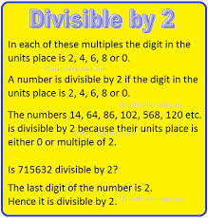
Divisiblity by 2

Slide 3
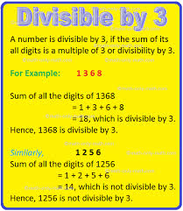
Divisiblity by 3

Slide 4
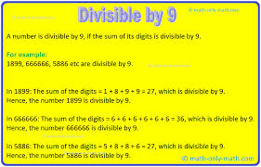
Divisiblity by 9

Slide 5
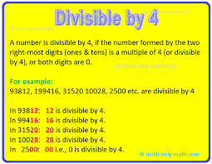
Divisiblity by 4

Slide 6
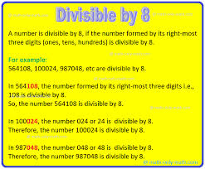
Divisiblity by 8

Slide 7
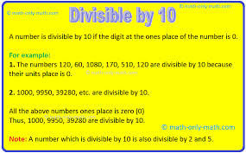
Divisiblity by 10

Slide 8
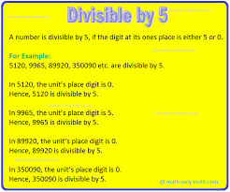
Divisiblity by 5

Slide 9
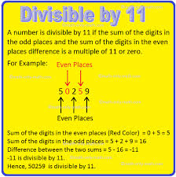
Divisiblity by 11

Slide 10
              Thank you

