Slide 1
Synthesis of Nanomaterials
Dr. B. Kavitha
Assistant Professor
PG and Research Department of Chemistry
C.P.A. College, Bodinayakanur

Slide 2
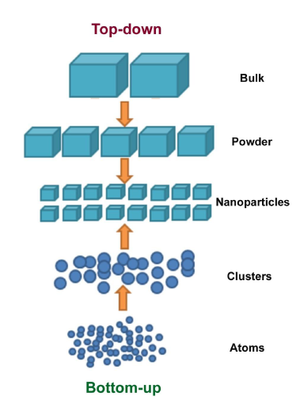
Synthesis of Nanomaterials
There are several processes to create nanomaterials. Two main approaches are used in nanotechnology.
Top-down approach
Top down approach refers to slicing or successive cutting of a bulk material to get nanosized particle. This approach has following processes:- (Ball milling, Photolithography, Etching, Sputtering.) However, it is synthetically too expensive (and not industrially scalable) to arrange such small units into their desired positions by hand. The biggest problem with top-down approach is the imperfection of the surface structure. The conventional top-down techniques such as lithography can cause significant crystallographic damage to the processed patterns and additional defects may be introduced even during the etching steps
Bottom-up approach
Bottom up approach refers to the buildup of a material from the bottom: atom by atom, molecule by molecule or cluster by cluster. This approach has following processes:- (Chemical precipitation, Sol-gel, Solvothermal, Hydrothermal). Materials chemists are largely focused on “bottom-up” techniques that afford the self-assembly of nanoscale species.

Slide 3
  Various techniques used for Synthesis of nanoparticles
Nowadays, the attention of many scientists is focused on the development of new methods for synthesis and stabilization of nanoparticles.
Moreover, special attention is paid to monodispersed and stable particles formation. Different metals, metal oxides, sulfides, polymers, core-shell and composite nanoparticles can be prepared using a number of synthetic techniques, which are broadly classified into two categories, namely, physical methods and chemical methods.
Chemical techniques
Chemical vapor deposition vapor-phase synthesis:
Hydrothermal synthesis
Sol-gel technique
Sonochemical technique
Microemulsion technique

Slide 4
Chemical vapor deposition
Chemical vapor decomposition is a chemical process used to produce high-purity, high-performance solid materials. The process is often used in the semiconductor industry to produce thin films.
In a typical CVD process, the wafer (substrate) is exposed to one or more volatile precursors, which react and/or decompose on the substrate surface to produce the desired deposit.
Frequently, volatile by-products are also produced, which are removed by gas flow through the reaction chamber
Vapor-phase synthesis
In vapor-phase synthesis of nanoparticles, the formation of nanoparticles takes place in gas phase. In this synthesis technique the condensation of atoms and molecules is carried out.
The vapor phase synthesis is not new and many multinational companies have been using flame reactors for decades for producing large quantities of nanoparticles.
The flame reactors were used for forming various nanoparticles such as carbon black and titanium dioxide

Slide 5
Hydrothermal synthesis
Hydrothermal synthesis can be defined as a method of synthesis of single crystals which depends on the solubility of minerals in hot water under high pressure.
The crystal growth is performed in an apparatus consisting of a steel pressure vessel called autoclave, in which a nutrient is supplied along with water. A gradient of temperature is maintained at the opposite ends of the growth chamber so that the hotter end dissolves the nutrient and the cooler end causes seeds to take additional growth.
Possible advantages of the hydrothermal method over the other types of crystal growth include the ability to create crystalline phases which are not stable at the melting point.
Also, materials which have a high vapour pressure near their melting points can also be grown by the hydrothermal method. The method is also particularly suitable for the growth of large good-quality crystals while maintaining good control over their composition.
Chemical Precipitation Certain soluble inorganic materials can be removed by the addition of suitable reagents to convert the soluble impurities into insoluble precipitates. These precipitates can be flocculated and removed by sedimentation.
The extent of removal depends on the solubility of the product and this is usually controlled by factors such as pH and temperature. Chemicals precipitation can be used in industrial wastewater treatment

Slide 6
The solid-state process is the more common and widely used method for production of micron-sized particles.
In solid state synthesis of nanoparticles generally heat treatment followed by milling is carried out to get an average particle size of 100nm or less.
Mechanical milling is one of the most preferred and earliest techniques to produce metallic microcrystalline powder. People claims to get a nanoparticle of very small size of up to 30nm particle size by using media milling of very small size of 200 micro meters.
There are other commonly preferred milling methods used by different researchers includes dry milling and ball milling techniques.

Slide 7
Micro emulsion Technique
This is a new technique, which allows preparation of ultrafine metal particles within the size range 5 nm<particle diameter <50 nm.
The rate of particle nucleation is a function of the percolation degree of micro emulsion droplets. Besides a short introduction into some aspects of the micro emulsion types and formation, we mainly focus on the kinetics of metallic particle formation.
Effects of stabilizer (emulsifier) type and concentration and the type of continuous phase, reducing agent and additive on the particle formation are summarized and evaluated.
The influence of several other parameters such as temperature, the incident light, the nature of metal salts and reaction conditions are also reviewed.
These results indicate that the nature of the stabilizer emulsifier, the surface activity of additives and the colloidal stability of micro emulsion droplets play decisive role on the particle size and distribution during the preparation of metal particles

Slide 8
Sonochemical Technique
In this technique, nanoparticles are prepared by irradiating the aqueous or organic dispersion of precursor materials using an ultrasonic probe at room temperature. The size of the particles obtained in this method mainly depends on the solution concentration and the time of sonication.

Slide 9
Thank You

