Slide 1
S.P.SUBHA
Guest lecturer in commerce
C.P.A College
Bodinayakanur

Slide 2
SUBSIDIARY BOOKS

Slide 3
Subsidiary Books are books of Original Entry. They are also known as Day Book or special journals.
We record transactions of similar nature are in Subsidiary Books.
They are helpful in overcoming the limitations of journal book or journal entries

Slide 4
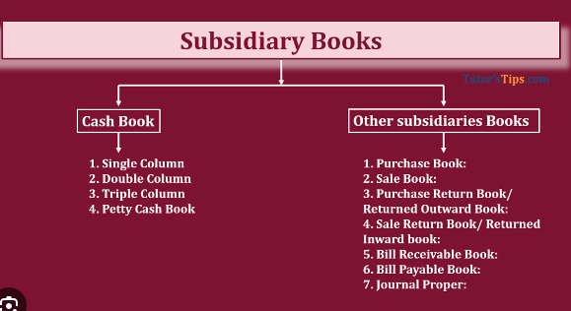

Slide 5
Advantages
Automatic classification of transaction
Facilitates division of work
Identification of Error
Internal Check system
Ease in transfer
Helpful in Decision Making
Convenience While Posting

Slide 6
Purchases Day Book – Purchases Day Book is a book for recording credit purchase of goods only. Cash purchase or assets purchased on credit are not entered in this book

Slide 7
. Sales Day Book – Sales Day Book is a book for recording credit sales of goods only. Assets sold or cash sales are not recorded in this book.

Slide 8
Purchases Returns Book – Purchases Returns Book is a book for recording the goods returned to the suppliers when purchased on credit.

Slide 9
Cash Book – Cash Book is a book for recoding all receipts and payments of cash.
Single Column Cash Book: This is also known as a Simple Cash Book. This cash book will only record cash

Slide 10
Three column cash book
A three-column cash book or treble column cash book is one in which there are three columns on each side- debit and credit side. One is used to record cash transactions, the second is used to record bank transactions and the third is used to record discounts received and paid.

Slide 11
