Slide 1
INVESTMENT
Dr. G. Thangadurai
Assistant Professor
PG & Research Department of Commerce
CPA College, Bodinayakanur

Slide 2
investment
The word “investment” can be defined in many ways according to different theories and principles. It is a term that can be used in a number of contexts.
Generally, investment is the application of money for earning more money.

Slide 3
Economist
According to economics, investment is the utilization of resources in order to increase income or production output in the future.

Slide 4
Example
An amount deposited into a bank or machinery that is purchased in anticipation of earning income in the long run is both examples of investments.
Although there is a general broad definition to the term investment, it carries slightly different meanings to different industrial sectors.

Slide 5
Finance
According to finance, the practice of investment refers to the buying of a financial product or any valued item with anticipation that positive returns will be received in the future. The most important feature of financial investments is that they carry high market liquidity

Slide 6
Business
According to business theories, investment is that activity in which a manufacturer buys a physical asset, for example, stock or production equipment, in expectation that this will help the business to prosper in the long run.

Slide 7
Types of Investments
Stocks
Bonds
Investment Funds
Bank Products
Options
Annuities

Slide 8
Retirement
Saving for Education
Alternative and Complex Products
Commodity Futures
Security Futures
Insurance

Slide 9
Elements / Nature of investment
1.Return
2. Risk
3. Safety
4. Liquidity
5. Time

Slide 10
Main objectives
Capital Appreciation
Current Income
Capital Preservation
Speculation

Slide 11
Secondary objectives
Tax Minimization:
Marketability/Liquidity:

Slide 12
Factors Favourable for Investment:
i. Legal Safeguards:
ii. A Stable Currency:
iii. Existence of Financial Institutions and Services:
iv. Form of Business Organization:
v. Choice of Investment:
vi. Risk-Less Vs. Risky Investments:

Slide 13
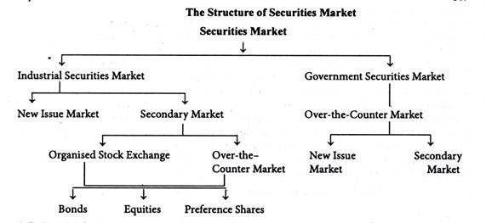

Slide 14
