Slide 1
LINEAR PROGRAMMING PROBLEM
M.POOCHELVI
ASSISTANT PROFESSOR
DEPARTMENT OF MATHEMATICS[SF]
Cpa college

Slide 2
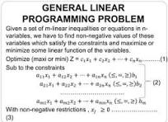

Slide 3
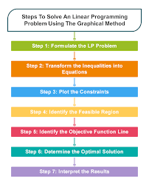

Slide 4
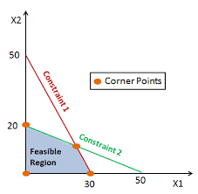
Feasible region

Slide 5
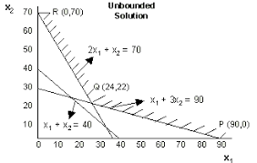

Slide 6
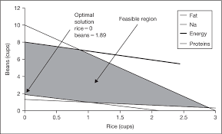
Optimal solution example

Slide 7
Thank you

