Slide 1
Dr. S. SENTHIL KUMAR
Assistant Professor &Head,
Department of Economics
Cardamom Planters’ Association College Bodinayakanur

Slide 2
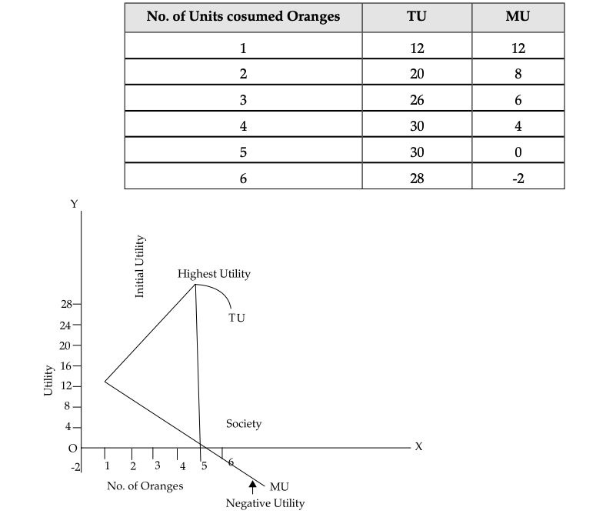
Law of diminishing marginal utility

Slide 3
Thank you

