Slide 2
Operation Research and Its Application
M.Poochelvi
Assistant Professor
Department Of Mathematics[SF]

Slide 3
INtroduction of Graph Theory
M.Poochelvi
Assistant Professor
Department Of Mathematics[SF]

Slide 4
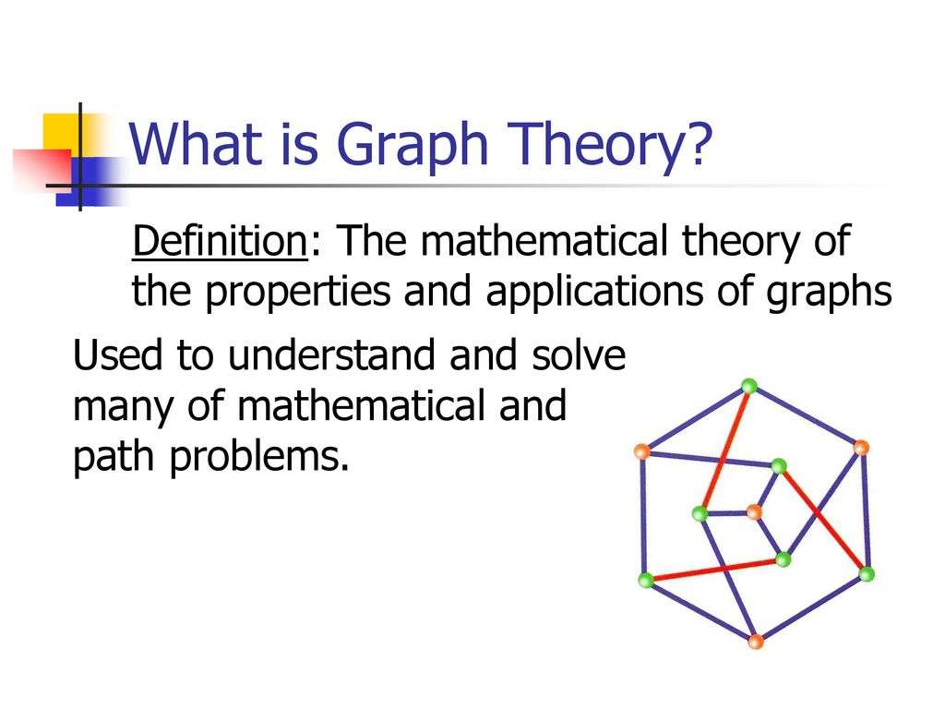

Slide 8
Thank you

