Slide 1
Industrial Economics
Unit-I
Prepared
By
Dr.D.Hema

Slide 2
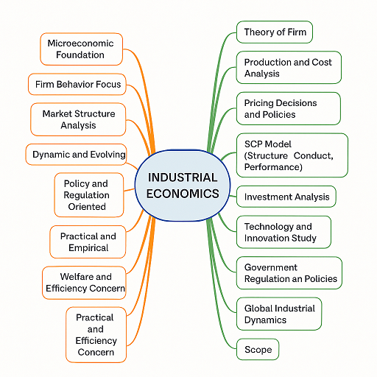
Mind Map

Slide 3
What is industrial economics
Industrial Economics = Study of how businesses behave + how industries are structured + how governments regulate industries.

Slide 4
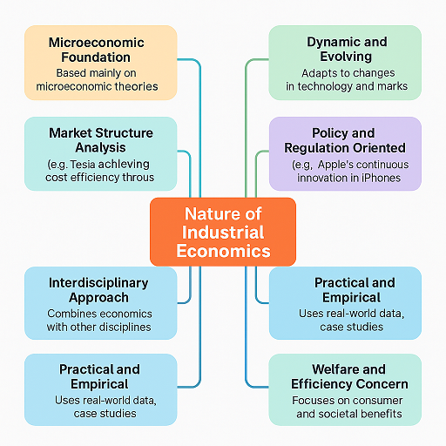
Nature of industrial economics

Slide 5
Thank you

