Slide 1
GENE MANIPULATION TECHNIQUES:
DNA ISOLATION
Dr. KRISHNAKUMAR J
HEAD & Assistant Professor
Department of botany
Cardamom Planters’ Association college
Pankajam nagar
Bodinayakannur -625 538

Slide 2
Introduction on Gene Manipulation
Genetic engineering, also called genetic modification or genetic manipulation, is the direct manipulation of an organism's genes using biotechnology.
It is a set of technologies used to change the genetic makeup of cells, including the transfer of genes within and across species boundaries to produce improved or novel organisms.

Slide 3
New DNA is obtained by either isolating and copying the genetic material of interest using recombinant DNA methods or by artificially synthesising the DNA.
A construct is usually created and used to insert this DNA into the host organism.
The first recombinant DNA molecule was made by Paul Berg in 1972 by combining DNA from the monkey virus SV40 with the lambda virus

Slide 4
As well as inserting genes, the process can be used to remove, or "knock out", genes.
The new DNA can be inserted randomly, or targeted to a specific part of the genome.

Slide 5
Isolation of DNA

Slide 6
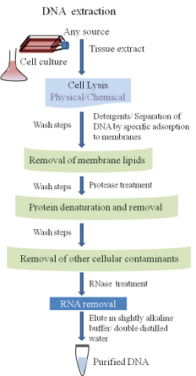

Slide 7
Isolation of DNA:
DNA is recovered from cells by the gentlest possible method of cell rupture to prevent DNA from fragmenting by mechanical cut off.
This is usually in the presence of EDTA which chelate the Mg²⁺ needed for enzymes that degrade DNA, termed deoxyribonucleases (DNases).

Slide 8
Ideally, cell walls, if present, should be digested enzymatically (e.g., lysozyme treatment of bacteria), and the cell membrane should be solubilized using detergent.
If physical disruption is necessary, it should be kept to a minimum and should involve cutting and squashing of cells, rather than the use of cut off forces.

Slide 9
Cell disruption and most subsequent steps should be performed at 4°C using glassware and solutions that have been autoclaved to destroy DNase activity.

Slide 10
After release of nucleic acid from cell, RNA can be removed by treatment with ribonucleases (RNase) that have been heat treated to remove any DNase contaminants as RNase is stable to heat because of its di-sulphite bonds, which ensure rapid renaturation of molecule on cooling.

Slide 11
The other major contaminant, protein, is removed by shaking the solution gently with water saturated phenol, or with a phenol/chloroform mixture, subsequently after proteinase K treatment, either of which denatures proteins, not nucleic acids.

Slide 12
Centrifugation of the mix formed by this mixing, produces a lower organic phase and upper aqueous phase separated by interface of denatured proteins.
The aqueous phase is recovered and deproteinised repeatedly until no more material is seen in interface.

Slide 13
Finally the deproteinised DNA preparation is mixed with two volumes of absolute alcohol, and DNA pellet is re-dissolved in a buffer containing EDTA to inactivate any DNase present.
The solution can be stored for at least a month at 4°C.
DNA can also be stored frozen but repeated freezing and thawing tends to damage long DNA molecules by cut off.

Slide 14
If DNA from cell organelle or viral particle is needed, it is better to isolate the cell organelle or viral particle first as recovery of DNA from a mixture of DNA is difficult.
Where high degree of purity is required, DNA may be subjected to density gradient ultra-centrifugation through caesium chloride, which is particularly useful for the preparation of plasmid DNA

Slide 15
Contaminants may also be identified by scanning ultraviolet spectrophotometry from 200- 300 nm.
A ratio of absorbance at 260 nm to that at 280 nm of approximately 1.8 indicates that the sample is free from protein contamination which absorbs strongly at 280 nm

