Slide 1
FUNARIA
Dr. C. GOPI
Associate Professor & Head
Department of Botany
CARDAMOM PLANTERS’ ASSOCIATION COLLEGE
(Estd. Year 1974 :: Re-accredited with ‘B’ Grade with a CGPA of 2.85 :: AISHE C36486 :: Affiliated to Madurai Kamaraj University)
Pankajam Nagar, Bodinayakanur - 625513, Theni District, Tamilnadu.
E-mail : drcgopi@gmail.com; web site: https://cpacollege.org/department/botany/about

Slide 2
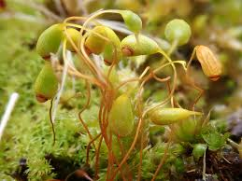
Kingdom | Plantae
Division | Bryophyta
Class | Bryopsida
Order | Funariales
Family | Funariaceae
Genus | Funaria

Slide 3
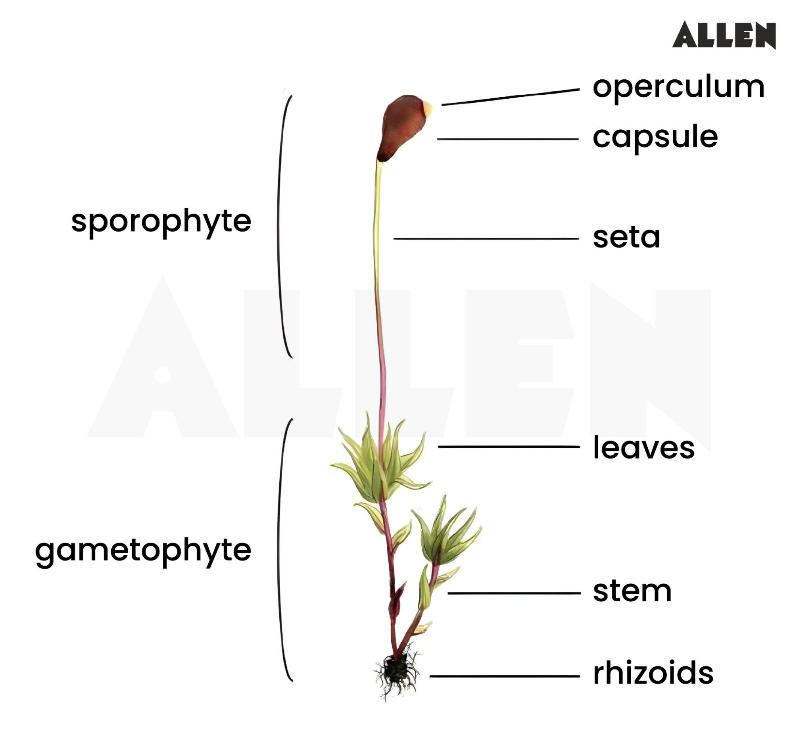
General characteristics of Funaria
Funaria is commonly found in terrestrial habitats, it usually grows in moist shady places such as damp soil, shady banks. They are cosmopolitan, found everywhere from arctic to tropic regions.
Gametophyte phase : This phase in the life cycle of funaria consists of two growth stages namely the Juvenile stage represented by primary protonema and the leafy stage which represents the leafy gametophyte.
The adult gametophyte (haploid) is differentiated into rhizoids, axis or ‘stem’ and ‘leaves’. Rhizoids arise from the base of the axis.
Axis or stem is green, erect, upright and branched, each branch arise below the leaf. Rhizoids are multicellular, branched with oblique septa which arise from the basal part of the stem which is brown. They perform some function of roots such as anchorage and absorption of water and solutes from the soil.
Leaves are sessile, oblong-ovate with entire margin, pointed apex and are arranged spirally on the branches and ‘stem’. Each ‘leaf’ is traversed by a single mid rib. Vascular bundles are absent in them.
The gametophytic plant body of funaria is monecious, male (antheridium) and female archegonium) reproductive organs are borne on the same plant. Antheridia are borne on the main shoot of the plant.
The female branch develops as a side shoot, which grows more vigorously and becomes longer than the male branches. Both antheridium and archegonium are borne on the top of branches respectively.

