Slide 1


ITAL
MARKETING
M.SARANYADEVI,
Assistant Professor,
Department of Commerce,
C.P.A College.

Slide 2
Contents
What is Digital Marketing..
Why Use Digital Marketing .
Advantages of Digital Marketing.
T7C’s of Digital marketing.
Digital Marketing Strategies. Digital Marketing Measurement. Conclusion.
Reference

Slide 3









What is Digital Marketing ?
Digital marketing is promotion of products or brands via one or more forms of electronic media through Internet.

Slide 4
Why use Digital Marketing ?
Reaching the right audience
II To engage with your audience
II To motivate your audience to take action Efficient spending on your campaign
II Return on investment (ROI)

Slide 5
Traditional Vs. Digital
Reach | Limited to Area | Global
Targeting | Not Specific | Very Specific
Price | Very Expensive | Not Expensive
ROI | Not Guaranteed | Guaranteed

Slide 6
Digital Marketing Strategies
SEO
SEM
SMO/SMM(Social Media Optimization)
Email Marketing. Affiliate Marketing Pay per click.
Google My Business Listing

Slide 7
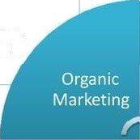
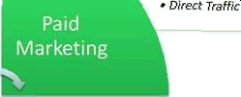

Direcr Traffic
SEO
SOCiał Media
Inbound Marketing
Ema‹l Marketing
PaY Per Click
display Ads
Video cds
Social łvledia
Email Marketing
O8IVI
Analytics
Ads in Mobile

Slide 8
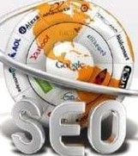
Search Engine optimization
“SEO is process of optimizing a website to get listed in the Google search engine result page On the top of the first page."

Slide 9
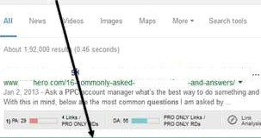

Search Engine Optimization
GD gle ape i• lervix quasTions
6 Cnmmon Iy A .ec PPC SuesIions (Anrt Answers I | PPC
2’^{d} Position

Slide 10
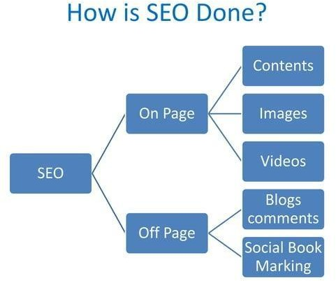

Slide 11
Search Engine Marketing
“Search engine marketing (SEM) is a form of Internet marketing that involves the promotion of websites by increasing their visibility in search engine results pages (SERPs) primarily through paid advertising.”
Search engine marketing's greatest strength is that it offers advertisers the opportunity to put their ads in front of motivated customers who are ready to buy at the precise moment they're ready to make a purchase.

Slide 12
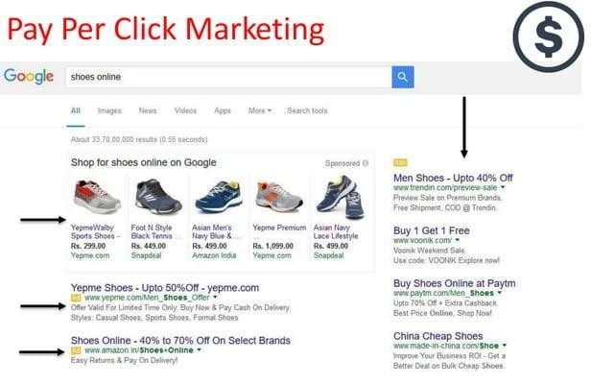

Slide 13
How to Do PPC ?
PPC can be implemented using these Programs
— Google AdWords
Bing Ads
. 18⁰/ousers click on Paid Ads
Very Fast and EffectiveMarketing

Slide 14
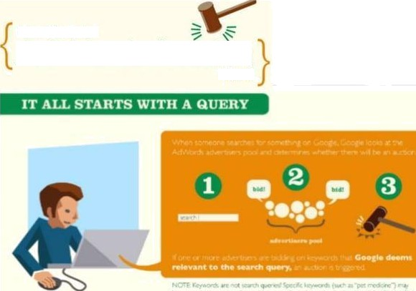
AdWords Auction
HD Does th

Slide 15
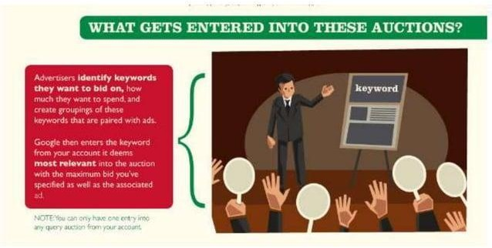

Slide 16



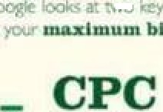



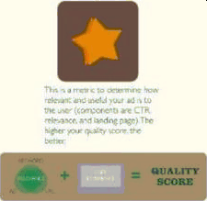

.,.yr*...œ₋,,m.,..,.,...w..C.'
.- .«.=
ADRANA
X

Slide 17
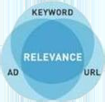

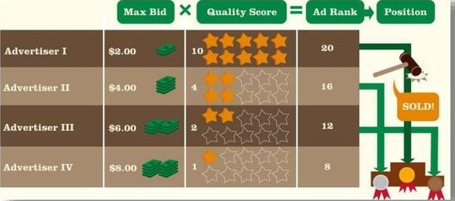
QUALITY
SCORE

Slide 18

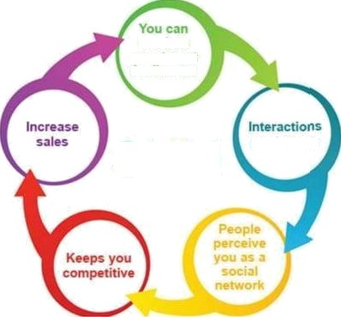
Social Media Marketing

Slide 19
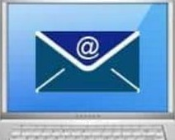
Cost Effecëve
Wider Audience
Measurable
Flexible
Effective
nvenient

Slide 20

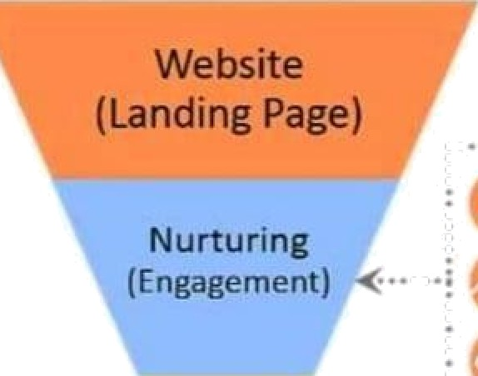
w Content
Marketing
Strategic

Slide 21
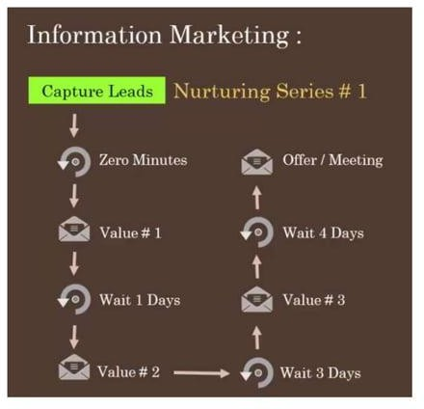

Slide 22


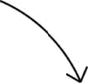


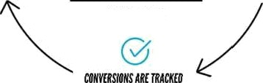
Afiiliate Marketing
HOW DOES
WORK?

Slide 23
Google My Business Listing
Adding Your Business on Google My Business
Go to Google My Business. Click "Get on Google"
Enter Your Business Name and Address in the Search Box.
?Select or Add Your Business. Click on your business listing if it appears among the
suggested matches.
ñVerify Your Business.
Confirm your 8usiness.

Slide 24
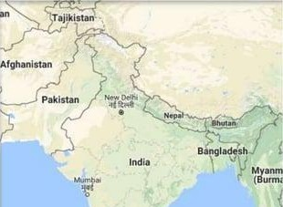

Business name
Country / Region
Streel address
Pincode
Caego'>
1 V7ebsile

Slide 25
Conclusion
The study started with the aim to analyses the different issues related to the digital marketing. Based on the discussion it has been found that in case of the digital marketing the most important aspect is to connect with the users. The ladder Df engagement has shown the approaches to attach with the customers. The studv has also revealed that in order to utilise the digital marl‹eting in an effective way, the companies are required to design an effective platform.

Slide 26
Reference
https://www.webtrainingsacademy/reviews
https: du as com
https://www.wordstream.com
Other Links
Blog: https://beautyradha.blogspot.in/
Site : https•//beâutybuzzdotcom.wordpress.com/

