Slide 1
Thermodynamic derivation of the relation between the depression of freezing point and concentration of the solution
Dr. B. Kavitha
Assistant Professor
PG and Research Department of Chemistry
C.P.A. College, Bodinayakanur

Slide 2
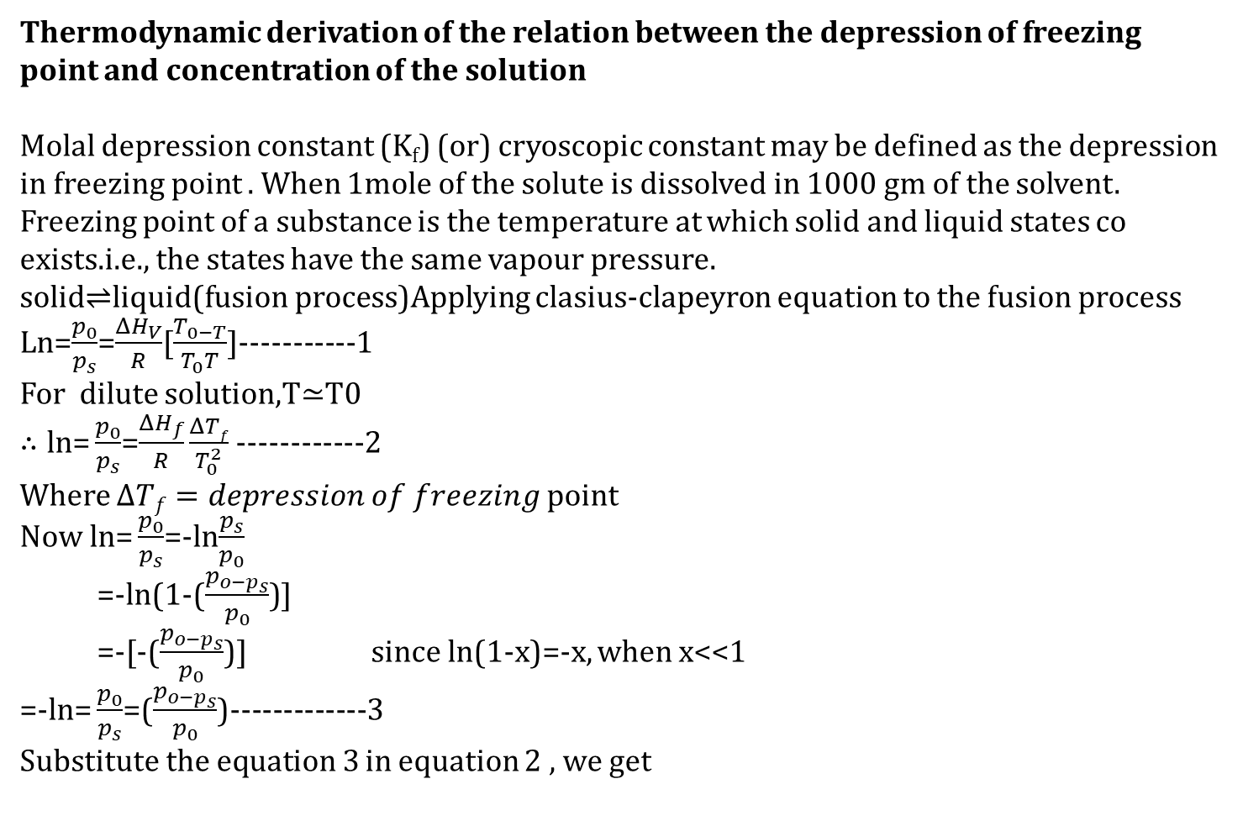
Thermodynamic derivation of the relation between the depression of freezing point and concentration of the solution
Molal depression constant (K_{f}) (or) cryoscopic constant may be defined as the depression in freezing point . When 1mole of the solute is dissolved in 1000 gm of the solvent.
Freezing point of a substance is the temperature at which solid and liquid states co exists.i.e., the states have the same vapour pressure.
solid$⇌$liquid(fusion process)Applying clasius-clapeyron equation to the fusion process
Ln=$\frac{p_{0}}{p_{s}}$=$\frac{ΔH_{V}}{R}$[$\frac{T_{0−T}}{T_{0}T}$]-----------1
For dilute solution,T$≃$T0
$∴ln\text{=}\frac{p_{0}}{p_{s}}$=$\frac{ΔH_{f}}{R}\frac{ΔTf}{T_{0}^{2}}$ ------------2
Where $ΔTf=depression of freezing$ point
Now $ln\text{=}\frac{p_{0}}{p_{s}}$=-ln$\frac{p_{s}}{p_{0}}$
=-ln(1-($\frac{p_{o−p_{s}}}{p_{0}}$)]
=-[-($\frac{p_{o−p_{s}}}{p_{0}}$)] since ln(1-x)=-x, when x<<1
=-$ln\text{=}\frac{p_{0}}{p_{s}}$=($\frac{p_{o−p_{s}}}{p_{0}}$)-------------3
Substitute the equation 3 in equation 2 , we get

Slide 3
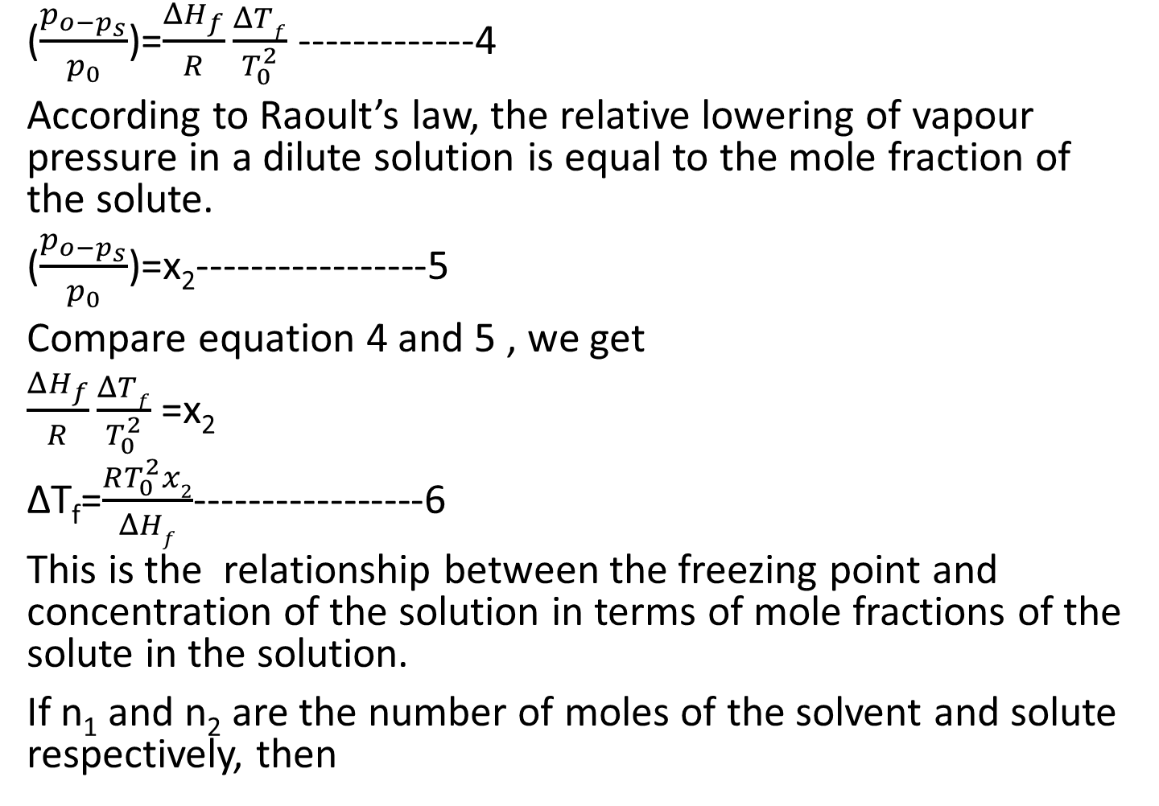
($\frac{p_{o−p_{s}}}{p_{0}}$)=$\frac{ΔH_{f}}{R}\frac{ΔTf}{T_{0}^{2}}$ -------------4
According to Raoult’s law, the relative lowering of vapour pressure in a dilute solution is equal to the mole fraction of the solute.
($\frac{p_{o−p_{s}}}{p_{0}}$)=x₂-----------------5
Compare equation 4 and 5 , we get
$\frac{ΔH_{f}}{R}\frac{ΔTf}{T_{0}^{2}}$ =x₂
ΔT_{f}=$\frac{RT_{0}^{2}x2}{ΔHf}$-----------------6
This is the relationship between the freezing point and concentration of the solution in terms of mole fractions of the solute in the solution.
If n₁ and n₂ are the number of moles of the solvent and solute respectively, then

Slide 4
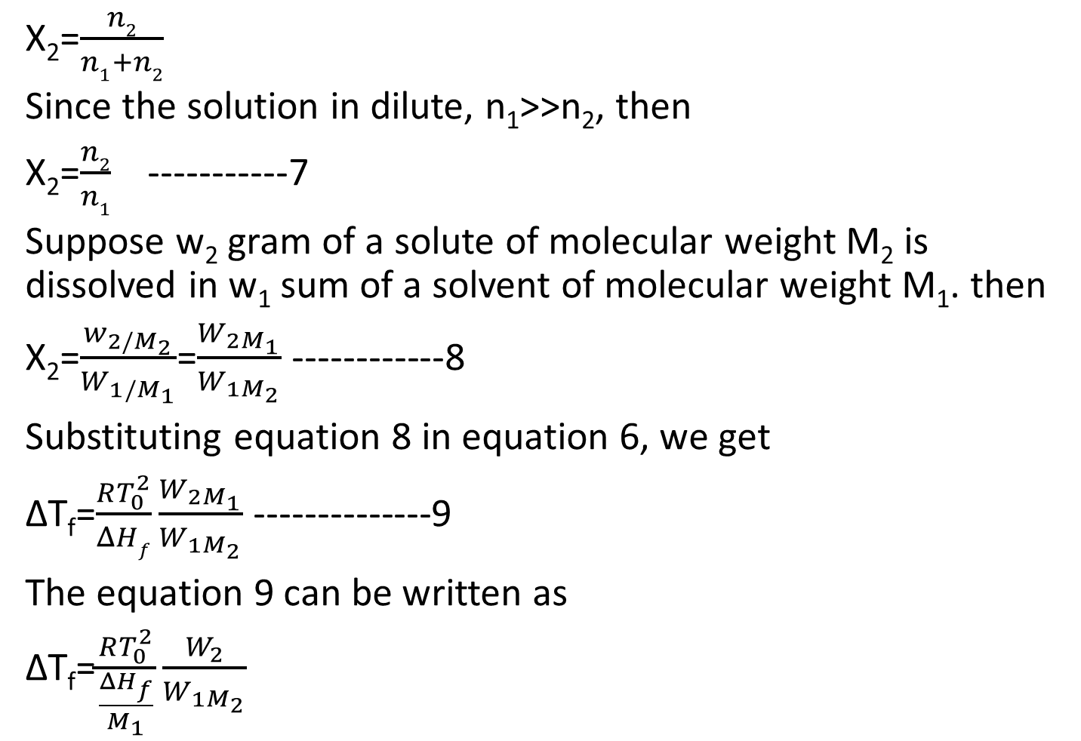
X₂=$\frac{n2}{n1+n2}$
Since the solution in dilute, n₁>>n₂, then
X₂=$\frac{n2}{n1}$-----------7
Suppose w₂ gram of a solute of molecular weight M₂ is dissolved in w₁ sum of a solvent of molecular weight M₁. then
X₂=$\frac{w_{2/M_{2}}}{W_{1/M_{1}}}$=$\frac{W_{2M_{1}}}{W_{1M_{2}}}$ ------------8
Substituting equation 8 in equation 6, we get
ΔT_{f}=$\frac{RT_{0}^{2}}{ΔHf}\frac{W_{2M_{1}}}{W_{1M_{2}}}$ --------------9
The equation 9 can be written as
ΔT_{f}=$\frac{RT_{0}^{2}}{\frac{ΔH_{f}}{M_{1}}}\frac{W_{2}}{W_{1M_{2}}}$

Slide 5
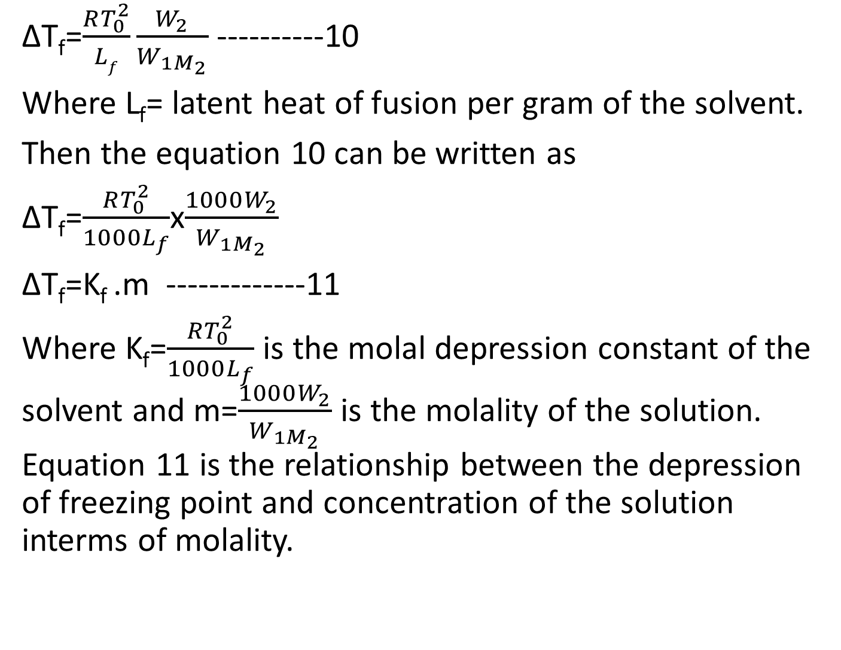
ΔT_{f}=$\frac{RT_{0}^{2}}{Lf}\frac{W_{2}}{W_{1M_{2}}}$ ----------10
Where L_{f}= latent heat of fusion per gram of the solvent.
Then the equation 10 can be written as
ΔT_{f}=$\frac{RT_{0}^{2}}{1000L_{f}}$x$\frac{1000W_{2}}{W_{1M_{2}}}$
ΔT_{f}=K_{f} .m -------------11
Where K_{f}=$\frac{RT_{0}^{2}}{1000L_{f}}$ is the molal depression constant of the solvent and m=$\frac{1000W_{2}}{W_{1M_{2}}}$ is the molality of the solution. Equation 11 is the relationship between the depression of freezing point and concentration of the solution interms of molality.

Slide 6
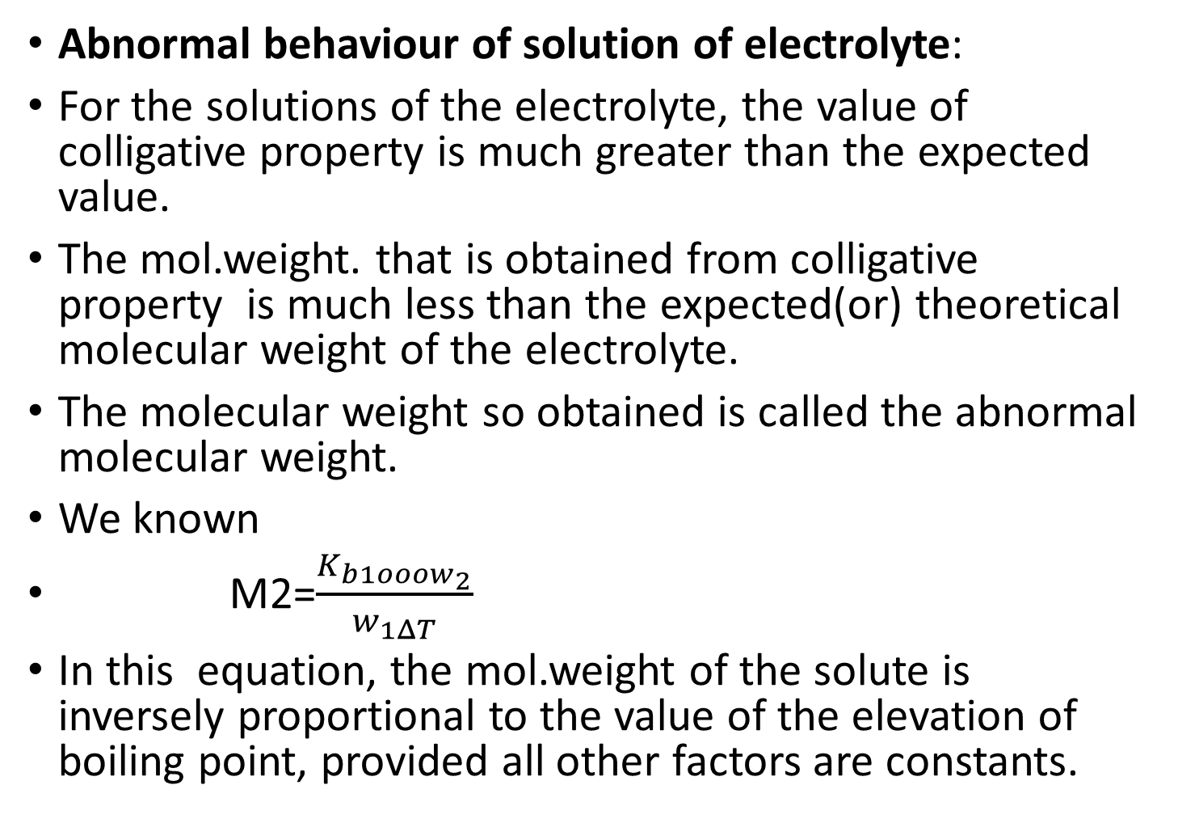
Abnormal behaviour of solution of electrolyte:
For the solutions of the electrolyte, the value of colligative property is much greater than the expected value.
The mol.weight. that is obtained from colligative property is much less than the expected(or) theoretical molecular weight of the electrolyte.
The molecular weight so obtained is called the abnormal molecular weight.
We known
M2=$\frac{K_{b1ooow_{2}}}{w_{1ΔT}}$
In this equation, the mol.weight of the solute is inversely proportional to the value of the elevation of boiling point, provided all other factors are constants.

Slide 7
For example,
The expected molecular weight of NaCl is 58.5. In dilute solution the molecular weight NaCl obtained from any colligative property is about 1/2x58.5=29.25. i.e., half the expected (or)theorical molecular weight.

Slide 8
Thank You

