Slide 1
Normalization in DBMS
Presented by: V.Sharmiladevi
Subject: Database Management System

Slide 2
Introduction to Normalization
Normalization is the process of organizing data in a database by breaking it down into smaller, more manageable chunks. The goal is to eliminate redundancy and ensure data integrity.
Purpose of Normalization: The purpose of normalization is not just to make your database look neat and tidy (although that's a nice bonus). It's to ensure that your database is efficient, scalable, and easy to maintain.
By normalizing your database, you can enjoy a multitude of benefits.
It improves data integrity by reducing the chances of data inconsistencies.
It also minimizes data redundancy, which not only saves storage space but also makes data updates easier.
Additionally, normalization improves query performance, making it faster to retrieve and manipulate data.

Slide 3
Objectives of Normalization
1. Remove data redundancy
2. Avoid anomalies
3. Ensure data consistency
4. Organize data efficiently

Slide 4
Anomalies in DB Design
1. Insertion Anomaly
2. Update Anomaly
3. Deletion Anomaly

Slide 5
Steps of Normalization
Normalization proceeds through stages called normal forms:
1NF → 2NF → 3NF → BCNF → 4NF → 5NF

Slide 6
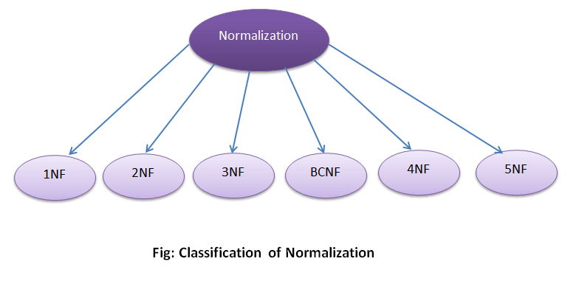
Steps of Normalization

Slide 7
First Normal Form (1NF)
The first normal form eliminates redundant data in horizontal rows. We ensure that there is a primary key and no repeating groups or arrays, i.e., every column contains only atomic (indivisible) values.
Applying 1NF involves breaking down larger tables into smaller entities and defining primary keys for unique identification. Every attribute should contain only atomic values to be in 1NF.

Slide 8
1NF Example
Table before 1NF: Multiple values in a cell
Table after 1NF: All attributes hold atomic values

Slide 9
Second Normal Form (2NF)
2NF is achieved when your table is in 1NF and all non-prime attributes are fully dependent on the primary key. In other words, it eliminates partial dependencies.
To accomplish 2NF, you need to extract subsets of data that apply to multiple rows, and place them into distinct tables. Make sure there isn't any partial dependency of any attribute on the primary key.

Slide 10
Second Normal Form (2NF)

Slide 11
2NF Example
Before 2NF: Non-key attributes depend on part of composite key
After 2NF: Dependencies removed

Slide 12
Third Normal Form (3NF)
3NF is mainly concerned with eliminating transitive dependencies from a table, i.e., if X depends on Y and Y depends on Z, then X is transitively dependent on Z.
For 3NF, create separate tables for sets of values that relate to a specific entity. Remove columns that are not dependent upon the primary key, thereby ensuring that only direct dependencies remain.

Slide 13
3NF Example
Before 3NF: Non-key attribute depends on another non-key attribute
After 3NF: Transitive dependency removed

Slide 14
Boyce-Codd Normal Form (BCNF)
Becoming a tad more complex, BCNF comes to play when there are multiple candidate keys in a table. It ensures that every determinant is a candidate key.
To implement BCNF, identify and isolate those dependencies where both sides are candidate keys. Then, place these dependencies in a separate table.

Slide 15
BCNF Example
Before BCNF: Non-trivial FD with non-superkey determinant
After BCNF: All determinants are superkeys

Slide 16
Fourth Normal Form (4NF)
4NF concerns itself with data structures containing multiple, overlapping sets of multi-valued facts.
To implement 4NF, you'll need to identify sets of multi-valued dependencies and separate them into new tables. Then, ensure that no database table instance contains a pair of multi-valued facts that are not directly related.

Slide 17
4NF Example
Before 4NF: Table has independent multi-valued facts
After 4NF: Multi-valued dependencies removed

Slide 18
Fifth Normal Form (5NF)
Known as the "project-join normal form," 5NF is achieved when every join dependency in a table is a consequence of the candidate keys.
Applying 5NF involves assessing your table structures for join dependencies that aren't a result of the candidate keys. Such dependencies should be resolved by splitting the table into two.

Slide 19
5NF Example
Before 5NF: Redundant data due to join dependencies
After 5NF: Fully decomposed with no redundancy

Slide 20
Advantages & Disadvantages
Advantages:
- Eliminates redundancy
- Improves data integrity
Disadvantages:
- Complex queries
- Performance overhead

Slide 21
Conclusion & Summary
Normalization improves database design by:
- Reducing redundancy
- Avoiding anomalies
- Ensuring consistency

