Slide 1
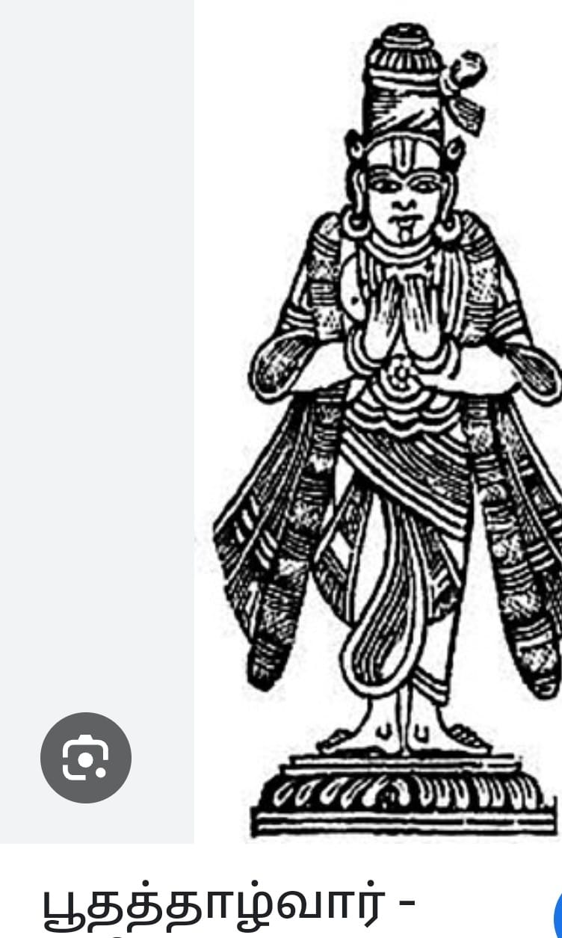
Kidth;.ny.myNkY>
jkpo;;;j;Jiwj;jiyth;>
Vy tptrhapfs; rq;ff; fy;Y}hp>
Nghbehaf;fD}h;

Slide 2
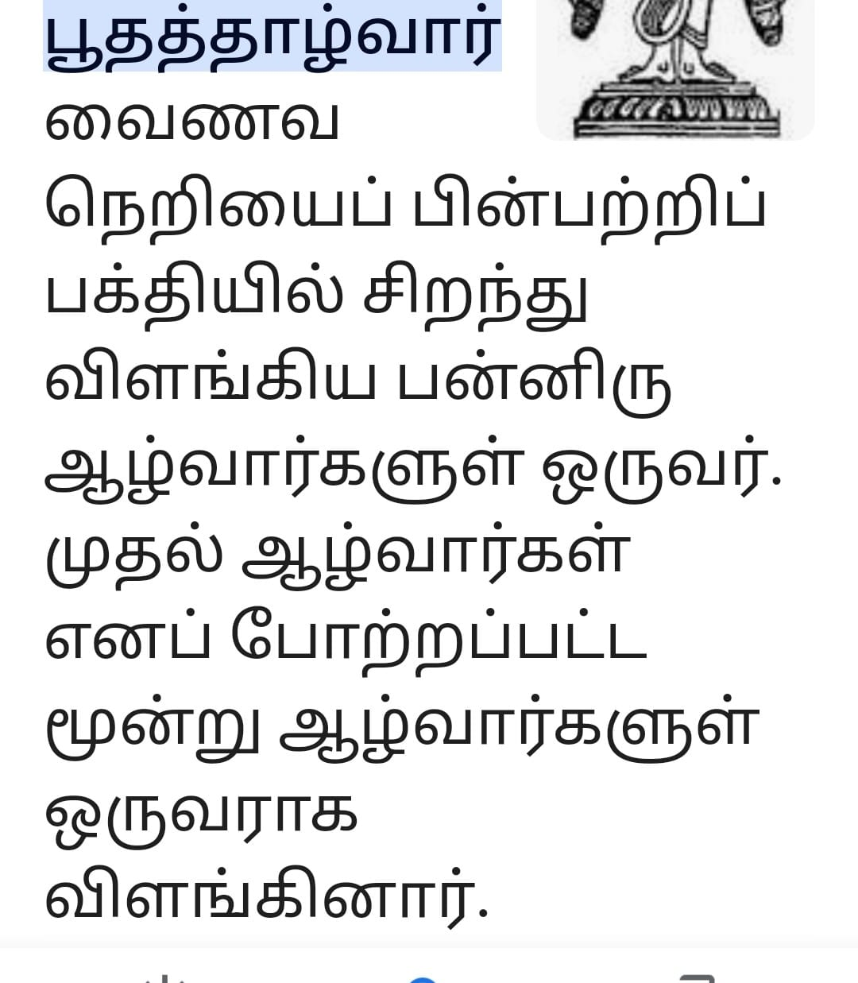

Slide 3
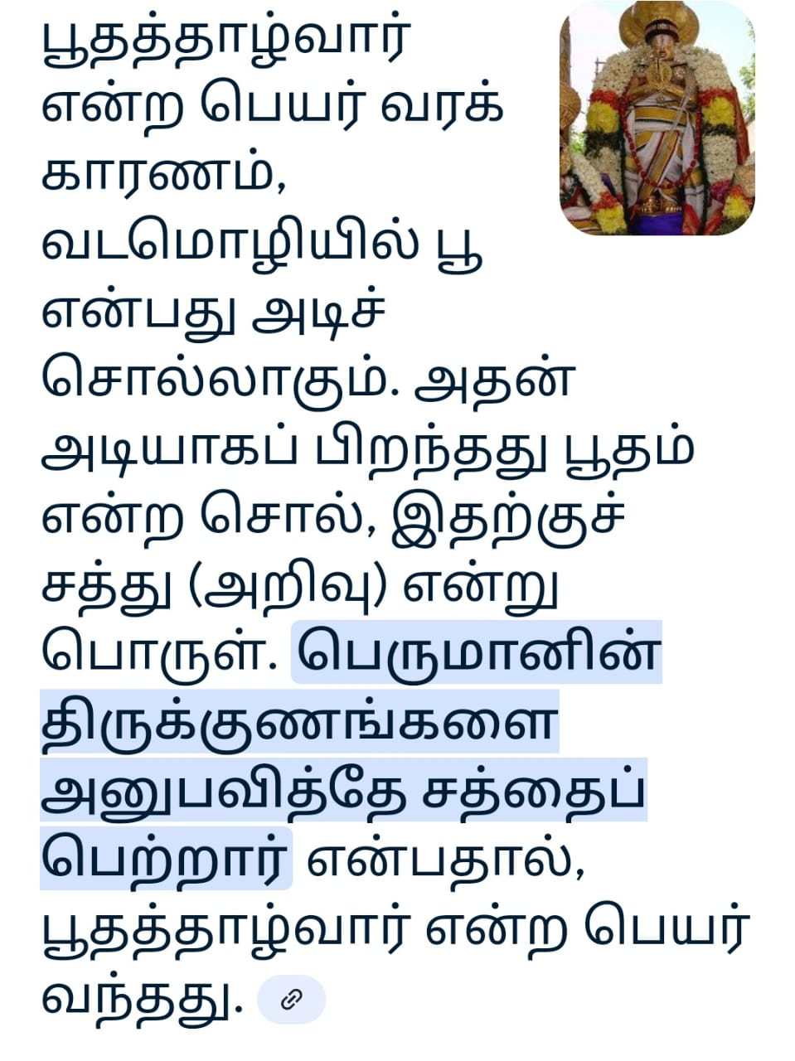

Slide 4
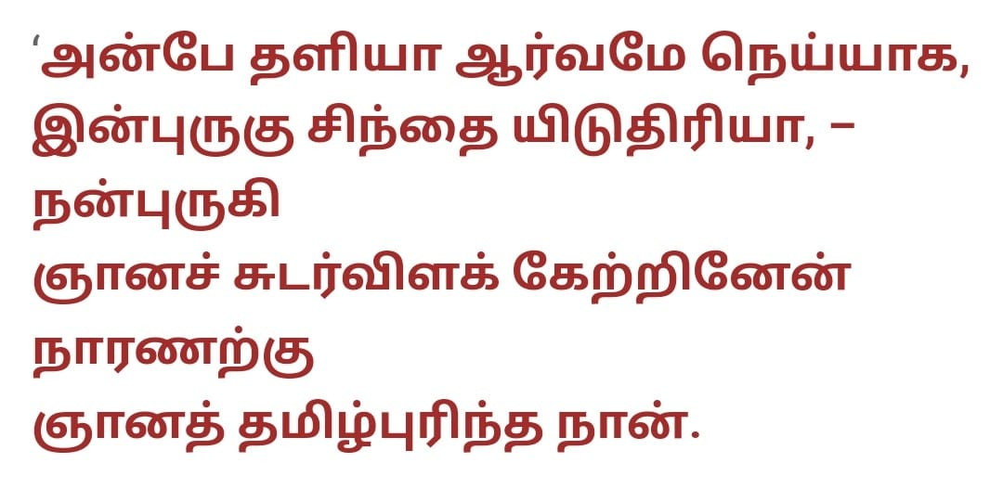

Slide 5
