Slide 1
First law of thermodynamics and Heat capacity of the system
Dr. B. Kavitha
Assistant Professor
PG and Research Department of Chemistry
C.P.A. College, Bodinayakanur

Slide 2
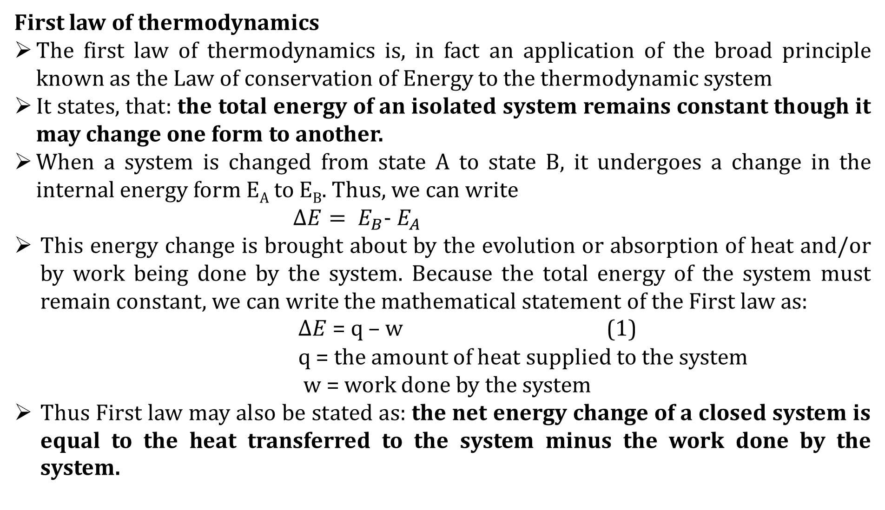
First law of thermodynamics
The first law of thermodynamics is, in fact an application of the broad principle known as the Law of conservation of Energy to the thermodynamic system
It states, that: the total energy of an isolated system remains constant though it may change one form to another.
When a system is changed from state A to state B, it undergoes a change in the internal energy form E_{A} to E_{B}. Thus, we can write
$∆E= E_{B}$- $E_{A}$
This energy change is brought about by the evolution or absorption of heat and/or by work being done by the system. Because the total energy of the system must remain constant, we can write the mathematical statement of the First law as:
$∆E$ = q – w (1)
q = the amount of heat supplied to the system
w = work done by the system
Thus First law may also be stated as: the net energy change of a closed system is equal to the heat transferred to the system minus the work done by the system.

Slide 3
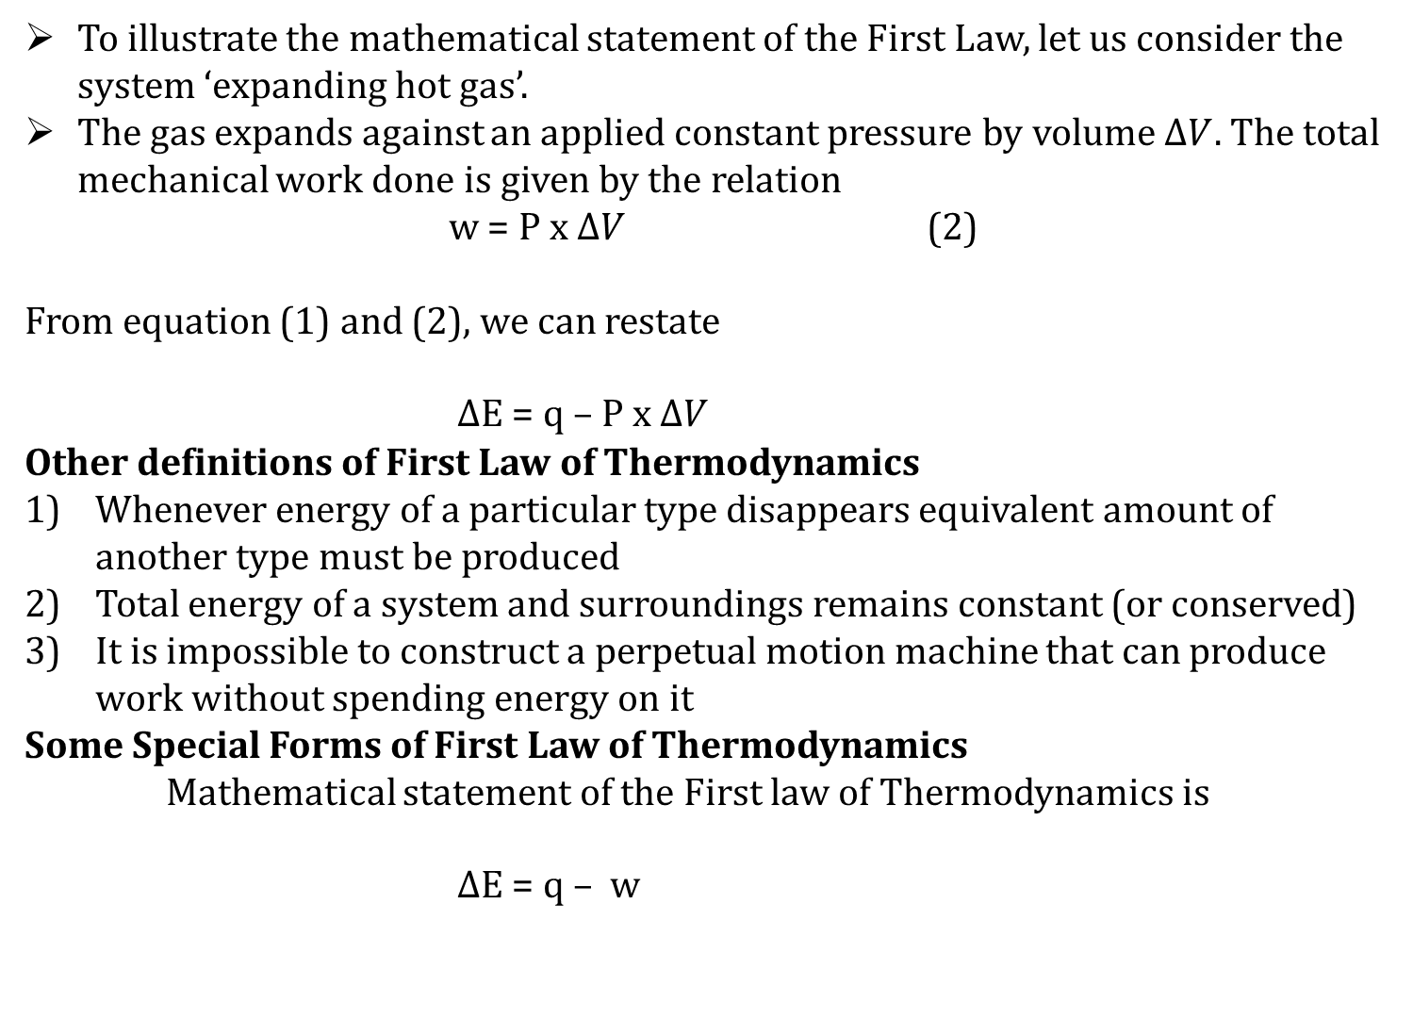
To illustrate the mathematical statement of the First Law, let us consider the system ‘expanding hot gas’.
The gas expands against an applied constant pressure by volume $∆V.$The total mechanical work done is given by the relation
w = P x $∆V$ (2)
From equation (1) and (2), we can restate
$∆$E = q – P x $∆V$
Other definitions of First Law of Thermodynamics
Whenever energy of a particular type disappears equivalent amount of another type must be produced
Total energy of a system and surroundings remains constant (or conserved)
It is impossible to construct a perpetual motion machine that can produce work without spending energy on it
Some Special Forms of First Law of Thermodynamics
Mathematical statement of the First law of Thermodynamics is
$∆$E = q – w

Slide 4
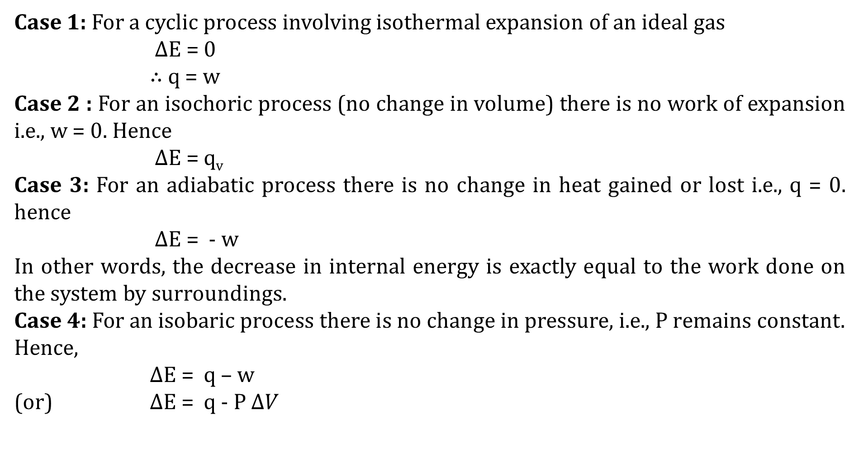
Case 1: For a cyclic process involving isothermal expansion of an ideal gas
$∆$E = 0
$∴$ q = w
Case 2 : For an isochoric process (no change in volume) there is no work of expansion i.e., w = 0. Hence
$∆$E = q_{v}
Case 3: For an adiabatic process there is no change in heat gained or lost i.e., q = 0. hence
$∆$E = - w
In other words, the decrease in internal energy is exactly equal to the work done on the system by surroundings.
Case 4: For an isobaric process there is no change in pressure, i.e., P remains constant. Hence,
$∆$E = q – w
(or) $∆$E = q - P $∆V$

Slide 5
Heat capacity of the system
Heat capacity of a system, between any two temperatures is defined as the quantity of heat required to raise the temperature of the system from the lower to the higher temperature divided by the temperature difference.
If the mass of the system is one gram, the heat capacity is called specific heat of the system. If, However, the mass of the system is one mole, as is generally the case in physical chemistry, then the heat capacity is termed as molar heat capacity.
It is usually denoted by C. thus, the molar heat capacity of a system between temperatures T₁ and T₂ will be expressed as
    C = q/(T₂ – T₁)
Since the heat capacity varies with temperature, hence the true molar heat capacity is defined by the differential equation
C = dq/dT
The molar heat capacity of a gaseous system, determined at constant volume, is different from that determined at constant pressure. In the former, no external work is done by the system or on the system (i.e., w = 0) since there is no change in volume.

Slide 6
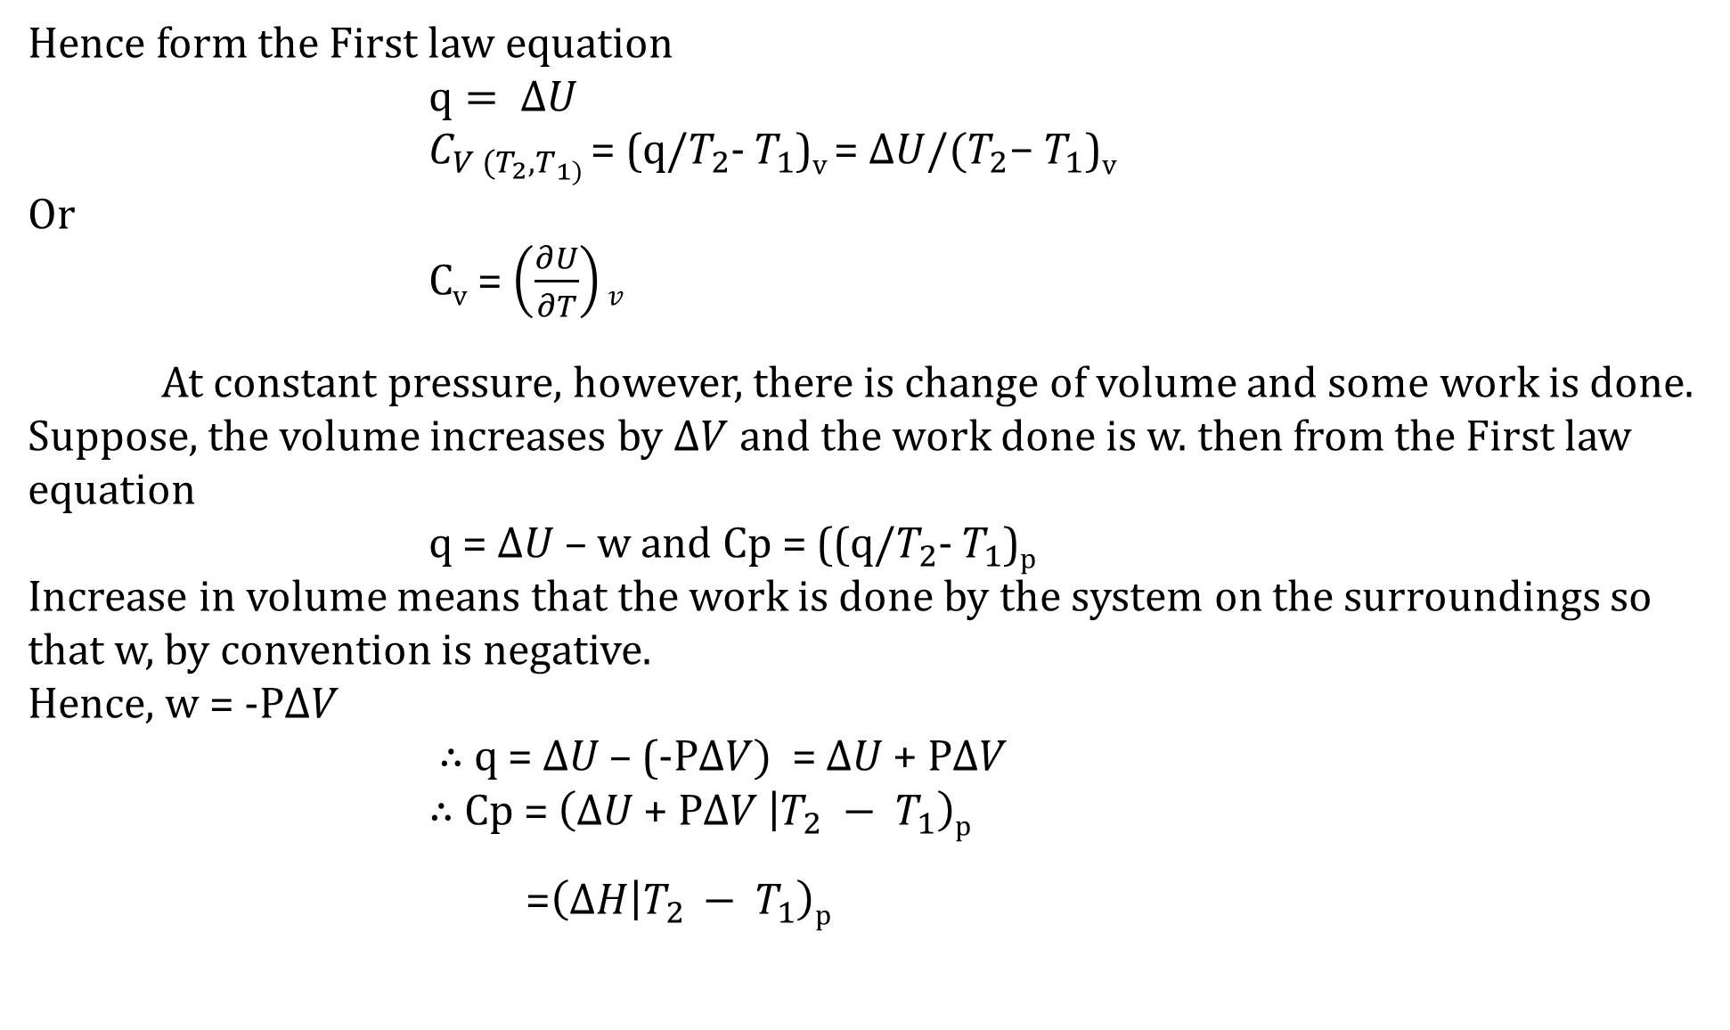
Hence form the First law equation
$q= ∆U$
$C_{V (T_{2},T_{1) }}$= (q/$T_{2}$- $T_{1}$)_{v} = $∆U/(T_{2}\text{− }T_{1}\text{)}\text{v}$
Or
C_{v} = $\left(\frac{∂U}{∂T}\right)v$
At constant pressure, however, there is change of volume and some work is done. Suppose, the volume increases by $∆V$ and the work done is w. then from the First law equation
q = $∆U$ – w and Cp = ((q/$T_{2}$- $T_{1}$)_{p}
Increase in volume means that the work is done by the system on the surroundings so that w, by convention is negative.
Hence, w = -P$∆V$
$∴$ q = $∆U$– (-P$∆V)$ = $∆U$+ P$∆V$
$∴$ Cp = $\left(∆U \text{+ }\text{P}∆V | T_{2} − T_{1}\right)$_{p}
=$\left(∆H | T_{2 }− T_{1}\right)$_{p}

Slide 7
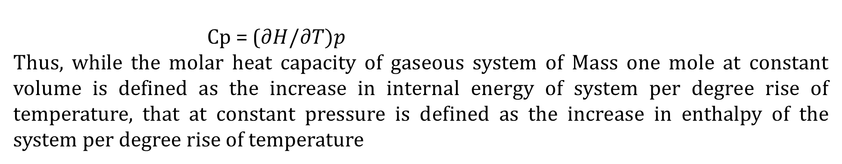
Cp = ($∂H/∂T)p$
Thus, while the molar heat capacity of gaseous system of Mass one mole at constant volume is defined as the increase in internal energy of system per degree rise of temperature, that at constant pressure is defined as the increase in enthalpy of the system per degree rise of temperature

Slide 8
Relation between C_{P} and C_{V} in gaseous systems
When a gas is heated at constant volume, no external work is done by the gas. In other words, all the heat supplied to the gas is used in increasing its internal energy.
Thus, if the temperature of one mole of gas is raised through 1⁰C (say from T to T + 1), the increase in its internal energy itself gives the molar heat capacity at constant volume. However, when a gas is heated at constant pressure, there will be increase in its volume, that is, the gas will expand and do some external work.
Therefore, some extra heat ( in addition to the heat required by it to increase the internal energy of its molecules) must be supplied to the gas to enable it to perform this external work.
Hence, the molar heat capacity of a gas at constant pressure must be greater than that at constant volume, i.e., C_{P} > C_{V .}
Thus, C_{P} – C_{V} = work done by one mole of the gas in expansion when heated through 1⁰C at constant pressure.

Slide 9
As we know, the work done by the gas in expansion at constant pressure is numerically given by
w = PΔV
For one mole of an ideal gas, PV = RT (1)
When the temperature is raised by 1⁰C from T to T + 1 so that the volume is V + ΔV, then
P(V + ΔV) = R(T + 1) (2)
PV + P ΔV = RT + R
Subtracting Eq. (1) from eq. (2), we have
PV + P ΔV – PV = RT + R - RT
P ΔV = R (3)
Thus, the work done by one mole of an ideal gas in expansion at constant pressure when heated through 1 ⁰C is equal to R. hence,
C_{P} – C_{V} = R (4)
Thus, the difference between the molar heat capacity of a gas at constant pressure (C_{P}) and at constant volume C_{V} is equal to the gas constant R.

Slide 10
Thank you

