Slide 1
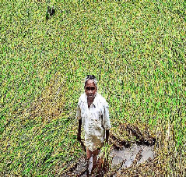
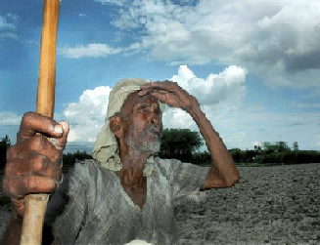
Climate Change
Dr.G.Ravindran
Assistant Professor of Chemistry
Cardamom Planters’ Association College Bodinayakanur.

Slide 2
Overview
Introduction
Causes of climate change
Effects of climate change
Dealing with climate change

Slide 3
Introduction
What is Climate?
Climate is commonly defined as the weather averaged over a long period at a given point. The standard averaging period is 30 years.
What is Climate changes?
Change of average temperature and rainfall in particular point is called Climate changes.

Slide 4
Earth Temperature balancing act
  Earth temperature depends on the balance between energy entering and leaving the planet system.
  When incoming energy from the sun is absorbed by the earth system, earth warms.
  When absorbed energy is released back into space, earth cool.

Slide 5
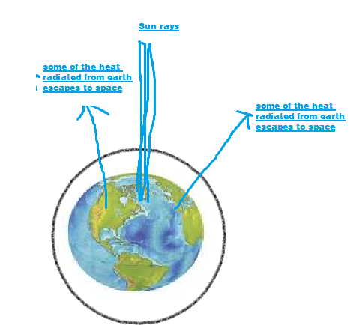

Slide 6
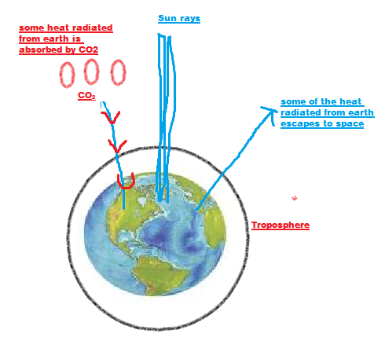
Causes of Climate Change
1. Green House effects

Slide 7
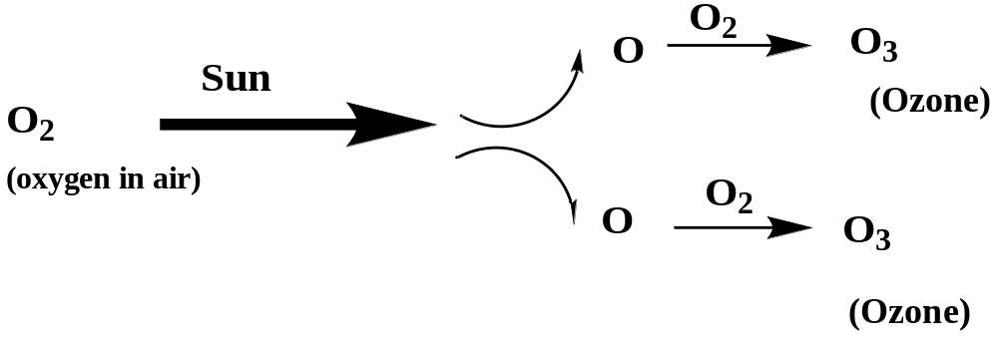
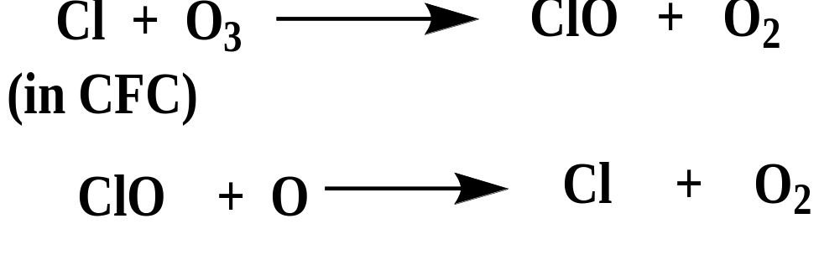
2. Ozone Hole
Formation of Ozone
Ozone Hole ( CFC- ChloroFluroCarbon effect)
when CFCs wander to the upper part of the troposphere, however reactions do occur highly energetic ultraviolet radiation (UV) splits up the CFC, releasing chlorine.

Slide 8
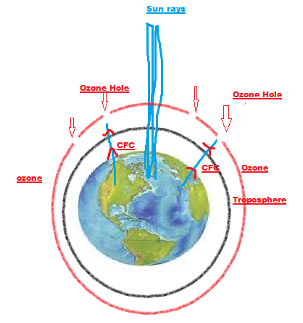

Slide 9
Effects of climate change
Melting of polar ice and oceanic expansion. This results in flooding of coastal areas, Some small islands may even vanish completely.
Major shifts in ecosystems and decreasing biodiversity.
Evaporation of water supplies, causing drinking water scarcity
Saltwater penetration of groundwater zones
More extreme weather, causing hotter and drier summers and colder winters
More contagious diseases because the environment is more positive for pathogens and some dangerous insects, such as the malaria, mosquito.

Slide 10
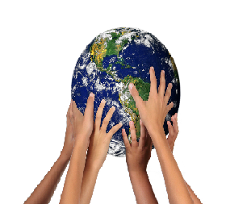
THANK YOU
We can take action

