Slide 1

Cardamom Planters’ Association College
Pankajam Nagar, Bodinayakanur
(2023-2024)
subject:Internet Application
Topic :Overview Internet
Presented by
N.Yuvapriya.,MCA
Dept. of.CS&IT

Slide 2
Learning Objectives
List several ways to communicate over the Internet, in addition to e-mail.
List several useful activities that can be performed via theWeb.
Discuss censorship and privacy and how they are related to
Internet use.

Slide 3
Overview
This chapter covers:
  The evolution of the Internet
  The Internet community
  Different options for connecting to the Internet
  Internet searching
  Common applications available via the Internet
  Societal issues that apply to Internet use

Slide 4
Evolution of the Internet
Internet
  Largest and most well-known computer network, linking
millions of computers all over the world
  The Internet has actually operated in one form or another for several decades
ARPANET
  The predecessor of the Internet
    Created in 1969 and named after the Advanced Research Projects Agency (ARPA), which sponsored its development
  Initially connected four supercomputers; eventually
evolved into today’s Internet

Slide 5
Evolution of the Internet
The World Wide Web
  The collection of Web pages available through the Internet
  Proposed by Tim Berners-Lee in 1989
  Originally only text-based content; release of the Mosaic browser in 1993 led to graphical content
  Web 2.0
    Wide variety of content available via Web pages today such as social networking, RSS, podcasts, blogs and wikis
  The World Wide Web and the Internet are not owned by any person, business, or organization

Slide 6
Evolution of the Internet
– Primary infrastructure that makes up the Internet backbone is typically owned by communications companies
Internet2
  Consortium of researchers, educators, and technology leaders from industry, government, and the international community
  Dedicated to the development of revolutionary Internet technologies
  Research and development tool, much of which is focused on speed

Slide 7
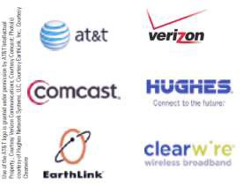
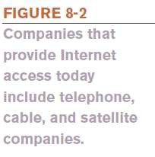
Evolution of the Internet
The Internet Community Today
  Users
    People who use the Internet
  Internet Service Providers (ISPs)
    Provide access to the Internet, typically for a fee
    Include most communication and media companies

Slide 8
Evolution of the Internet
Internet Content Providers
  Persons or organizations that provide Internet content
    Businesses, non-profit organizations, educational
institutions, individuals
Application Service Providers (ASPs) and Web Services
  Companies that manage and distribute Web-based software services over the Internet
    Cloud software, Software as a Service (SaaS), cloudware
    Often fee-based business software
  Web service: self-contained business application that operates over the Internet

Slide 9
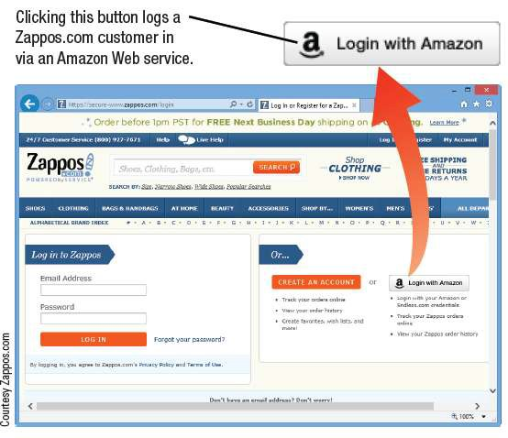
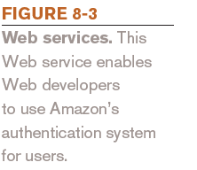
Evolution of the Internet
10

Slide 10
Evolution of the Internet
Infrastructure Companies
  Enterprises that own or operating the physical structure
of the Internet
  Conventional and mobile phone companies, cable companies, and satellite Internet providers
Hardware and Software Companies
  Provide the hardware and software used in conjunction with the Internet and Web

Slide 11
Evolution of the Internet
The Government and Other Organizations
  Some countries limit information and access
  FCC influences communications
  Internet Society (ISOC)
    Addresses issues impacting the future of the
internet
  Internet Corporation for Assigned Names and Numbers (ICANN)
    Domain and IP management
  World Wide Web Consortium (W3C)
    Protocols and standards, ensures interoperability

Slide 12
Types of Connection and Internet Access
Computer must be connected to the Internet to obtain access
Most connections today are broadband
Dial-up vs. Direct Connections
  Dial-up connections use standard phone lines
    Uses modem to dial-up ISP
    Inconvenient
    Slower, but cheaper
    Ties up phone lines
    Relatively secure from hackers

