Slide 1
Catalytic Activity
TM’s and their compounds effective and important catalysts
  Industrially and biologically!!
The “people in the know” believe
  catalysts provide reaction pathway with lower E_{A} than uncatalysed reaction (see CI 10.5)
Once again,
  availability of 3d and 4s e⁻
  ability to change OS
  among factors which make TM’s such good catalysts

Slide 2
Heterogeneous Catalysis
Catalyst in different phase from reactants
  Usually means solid TM catalyst with reactants in liquid or gas phases
TM’s can
  use the 3d and 4s e⁻ of atoms on metal surface to from weak bonds to the reactants.
  Once reaction has occurred on TM surface, these bonds can break to release products
Important example is hydrogenation of alkenes using Ni or Pt catalyst

Slide 3

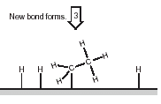
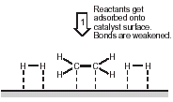
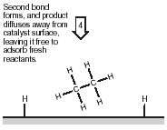
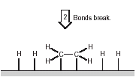
Heterogeneous Catalysis

Slide 4
Homogeneous Catalysis
Catalyst in same phase as reactants
  Usually means reaction takes place in aqueous phase
  Catalyst aqueous TM ion
Usually involves
  TM ion forming intermediate compound with ome or more of the reactants
  Intermediate then breaks down to form products

Slide 5
Suggested Mechanism
REACTANTS
H₂O₂ +
⁻O₂CCH(OH)CH(OH)C0₂⁻
Co²⁺ (pink)
INTERMEDIATE
containing
Co³⁺ (green)
Co²⁺ reduces
H₂O₂ & gets oxidised to Co³⁺
Co³⁺ oxidises 2,3-hydroxy- butanoate & gets reduced to Co²⁺
Regenerated
Catalyst
PRODUCTS
CO₂, methanoate, H₂O
Co²⁺ (pink)

