Slide 1
The World of Children's Studies
By Peter Hunt

Slide 2
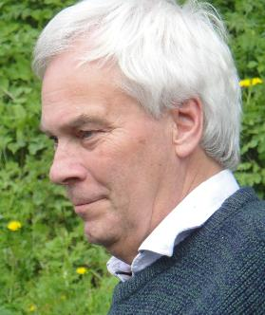
Introduction to Peter Hunt
**Background:** British scholar, Professor Emeritus in English and children's literature at Cardiff University.
**Pioneering Work:** Instrumental in establishing children's literature as an academic discipline.
Peter Hunt
Professor Emeritus

Slide 3
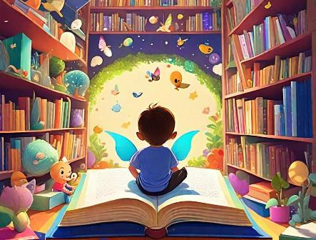
Childist Criticism
Definition: A theoretical approach focusing on understanding children's literature from the child's perspective.
Importance: Emphasizes the need to consider how children perceive texts rather than solely adult interpretations.

Slide 4
Historical Context
Evolution of Children's Literature- :
Early History: From oral traditions to printed texts.
Maturity (1860-1920): Expansion influenced by social changes and technological advancements.

Slide 5
Key Themes in Hunt's Work
Childhood Ideologies: Exploration of changing perceptions of childhood across different literary periods.
Author's Motivations: How authors' views on childhood shape their writing.

Slide 6
Genres of Children's Literature
Categories- :
Picture Books: Visual storytelling for young readers.
Traditional Literature: Folktales and fables conveying cultural values.
Contemporary Fiction: Modern narratives reflecting real-life experiences.

Slide 7
Educational Implications
Role of Literature- :
Moral Education: Stories that teach values and ethics.
Personal Development: Fostering creativity and emotional growth through reading.

Slide 8
Case Studies in Literature
Examples- :
****Louisa May Alcott's Little Women: Victorian ideals of childhood.
****Philip Pullman's Northern Lights: Fantasy as a reflection of childhood freedom and innocence.

Slide 9
Critique of Children's Literature
Contemporary Concerns- :
Commodification of childhood in literature.
The balance between nostalgia for innocence and the realities of modern childhood.

Slide 10
Conclusion
Significance of Hunt's Work:
Encourages a deeper understanding of children's literature through a child-centric lens.
Highlights the complex interplay between authors, texts, and young readers.

Slide 11
Thank You
Thank you for your attention!

