Slide 1
Van’t Hoff isotherm equation
Dr. B. Kavitha
Assistant Professor
PG and Research Department of Chemistry
C.P.A. College, Bodinayakanur

Slide 2
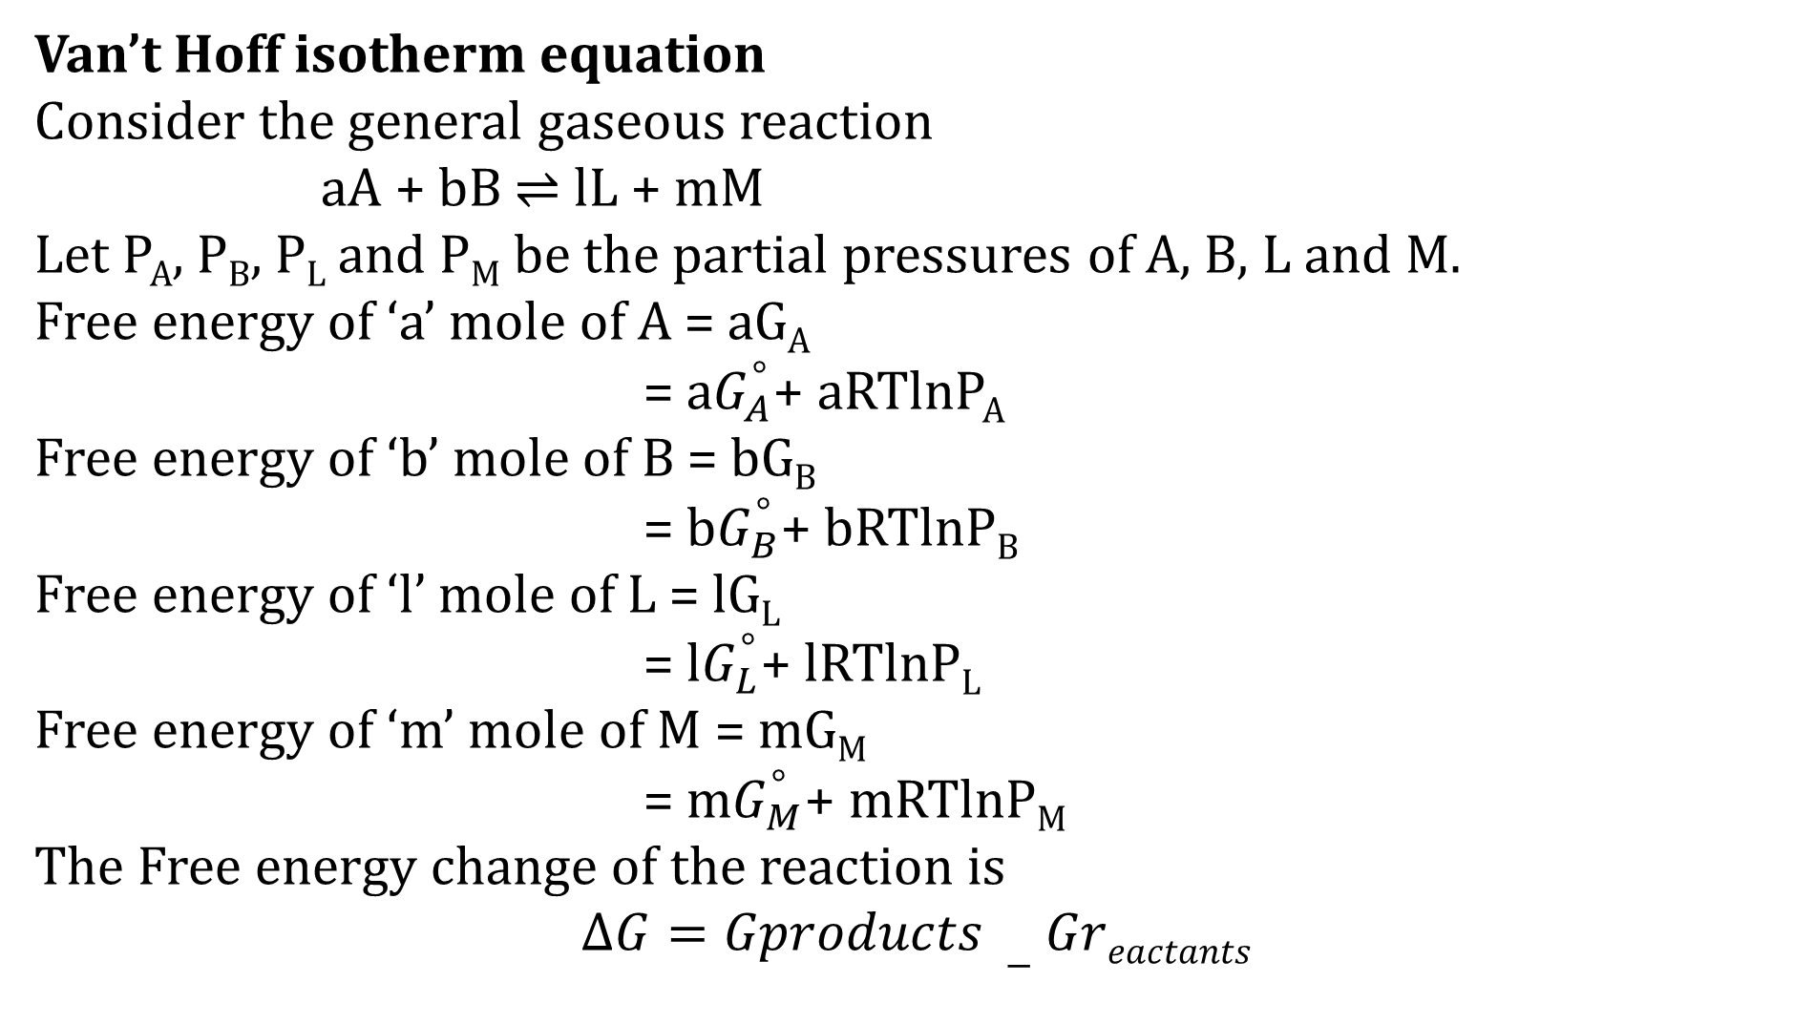
Van’t Hoff isotherm equation
Consider the general gaseous reaction
aA + bB $⇌$ lL + mM
Let P_{A}, P_{B}, P_{L} and P_{M} be the partial pressures of A, B, L and M.
Free energy of ‘a’ mole of A = aG_{A}
= a$G_{A}^{°}$+ aRTlnP_{A}
Free energy of ‘b’ mole of B = bG_{B}
= b$G_{B}^{°}$+ bRTlnP_{B}
Free energy of ‘l’ mole of L = lG_{L}
= l$G_{L}^{°}$+ lRTlnP_{L}
Free energy of ‘m’ mole of M = mG_{M}
= m$G_{M}^{°}$+ mRTlnP_{M}
The Free energy change of the reaction is
$$∆G=Gproducts −Greactants$$

Slide 3
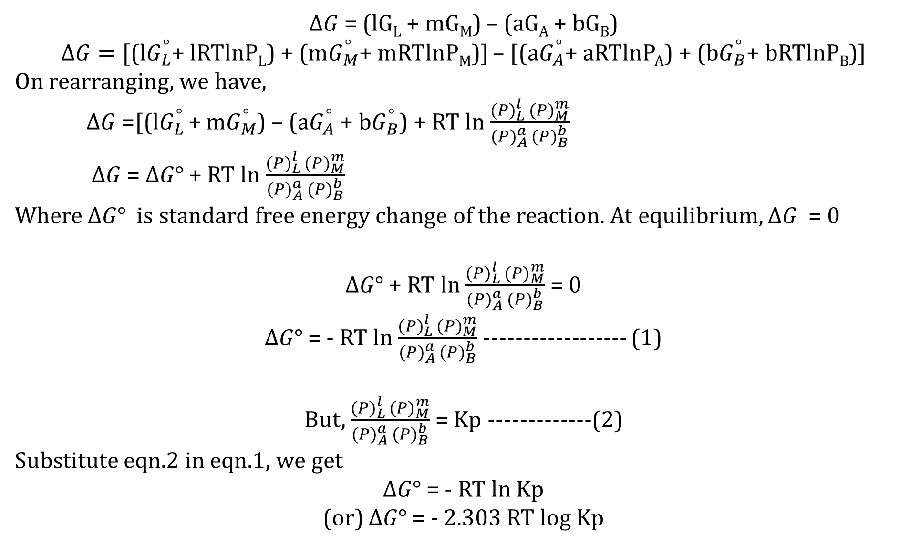
$∆G$ = (lG_{L} + mG_{M}) – (aG_{A} + bG_{B})
$∆G=[$(l$G_{L}^{°}$+ lRTlnP_{L}) + (m$G_{M}^{°}$+ mRTlnP_{M})] – [(a$G_{A}^{°}$+ aRTlnP_{A}) + (b$G_{B}^{°}$+ bRTlnP_{B})]
On rearranging, we have,
$∆G$ =[(l$G_{L }^{°}$+ m$G_{M}^{°}$) – (a$G_{A}^{°}$ + b$G_{B}^{°}$) + RT ln $\frac{{(P)}_{L }^{l}({P)}_{M}^{m}}{{(P)}_{A }^{a}({P)}_{B}^{b}}$
$∆G$ = $∆G°$ + RT ln $\frac{{(P)}_{L }^{l}({P)}_{M}^{m}}{{(P)}_{A }^{a}({P)}_{B}^{b}}$
Where $∆G°$ is standard free energy change of the reaction. At equilibrium, $∆G$ = 0
$∆G°$ + RT ln $\frac{{(P)}_{L }^{l}({P)}_{M}^{m}}{{(P)}_{A }^{a}({P)}_{B}^{b}}$ = 0
$∆G°$ = - RT ln $\frac{{(P)}_{L }^{l}({P)}_{M}^{m}}{{(P)}_{A }^{a}({P)}_{B}^{b}}$ ------------------ (1)
But, $\frac{{(P)}_{L }^{l}({P)}_{M}^{m}}{{(P)}_{A }^{a}({P)}_{B}^{b}}$ = Kp -------------(2)
Substitute eqn.2 in eqn.1, we get
$∆G°$ = - RT ln Kp
(or) $∆G°$ = - 2.303 RT log Kp

Slide 4
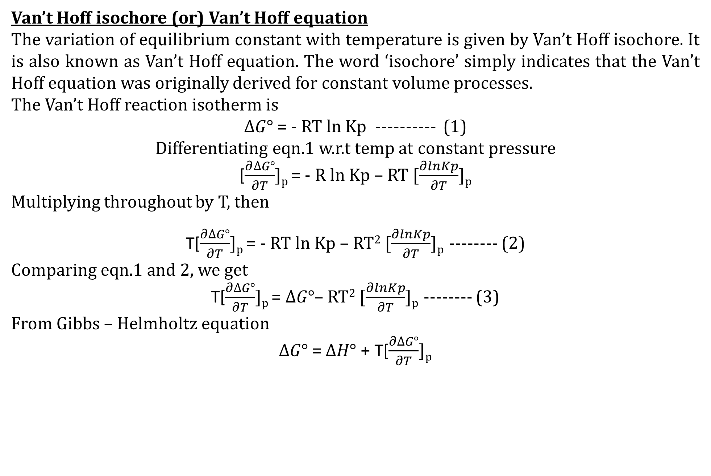
Van’t Hoff isochore (or) Van’t Hoff equation
The variation of equilibrium constant with temperature is given by Van’t Hoff isochore. It is also known as Van’t Hoff equation. The word ‘isochore’ simply indicates that the Van’t Hoff equation was originally derived for constant volume processes.
The Van’t Hoff reaction isotherm is
$∆G°$ = - RT ln Kp ---------- (1)
Differentiating eqn.1 w.r.t temp at constant pressure
[$\frac{∂∆G°}{∂T}$]_{p} = - R ln Kp – RT [$\frac{∂lnKp}{∂T}$]_{p}
Multiplying throughout by T, then
T[$\frac{∂∆G°}{∂T}$]_{p} = - RT ln Kp – RT² [$\frac{∂lnKp}{∂T}$]_{p} -------- (2)
Comparing eqn.1 and 2, we get
T[$\frac{∂∆G°}{∂T}$]_{p} = $∆G°$– RT² [$\frac{∂lnKp}{∂T}$]_{p} -------- (3)
From Gibbs – Helmholtz equation
$∆G°$ = $∆H°$+ T[$\frac{∂∆G°}{∂T}$]_{p}

Slide 5
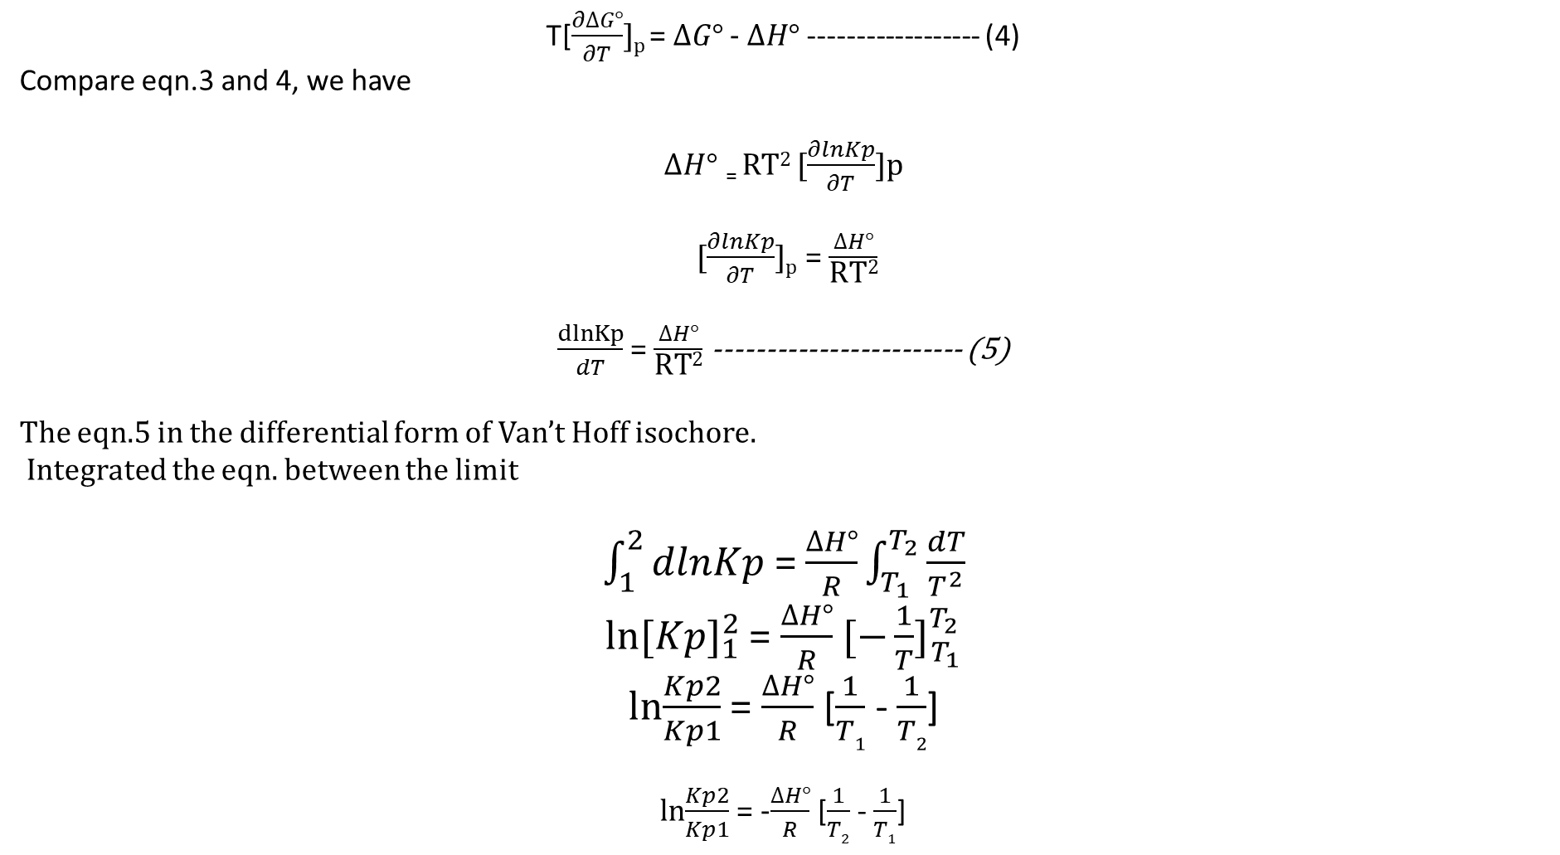
T[$\frac{∂∆G°}{∂T}$]_{p} = $∆G°$ - $∆H°$------------------ (4)
Compare eqn.3 and 4, we have
$∆H°$ ₌ RT² [$\frac{∂lnKp}{∂T}$]p
[$\frac{∂lnKp}{∂T}$]_{p} = $\frac{∆H°}{\text{RT}\text{2}}$
$\frac{dlnKp}{dT}$ = $\frac{∆H°}{\text{RT}\text{2}}$ ------------------------ (5)
The eqn.5 in the differential form of Van’t Hoff isochore.
Integrated the eqn. between the limit
$\int_{1}^{2}{dlnKp}$ = $\frac{∆H°}{R}\int_{T_{1}}^{T_{2}}{\frac{dT}{T^{2}}}$
ln${[Kp]}_{1}^{2}$ = $\frac{∆H°}{R}$ ${[−\frac{1}{T}]}_{T_{1}}^{T_{2}}$
ln$\frac{Kp2}{Kp1}$ = $\frac{∆H°}{R}$ [$\frac{1}{T1}$ - $\frac{1}{T2}$]
ln$\frac{Kp2}{Kp1}$ = -$\frac{∆H°}{R}$ [$\frac{1}{T2}$ - $\frac{1}{T1}$]

Slide 6
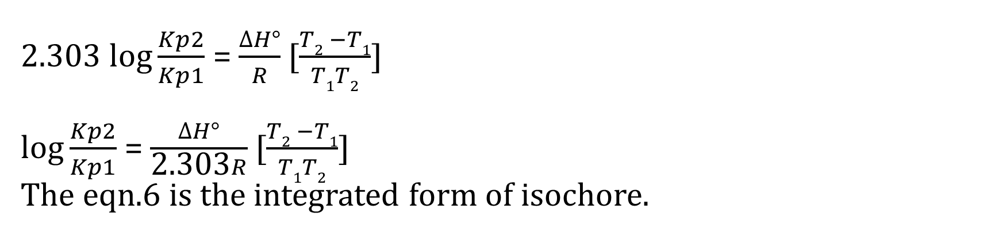
2.303 lo$g\frac{Kp2}{Kp1}$ = $\frac{∆H°}{R}$ [$\frac{T2 −T1}{T1T2}$] lo$g\frac{Kp2}{Kp1}$ = $\frac{∆H°}{\text{2.303}R}$ [$\frac{T2 −T1}{T1T2}$]
The eqn.6 is the integrated form of isochore.

Slide 7
Thank you

