Slide 1
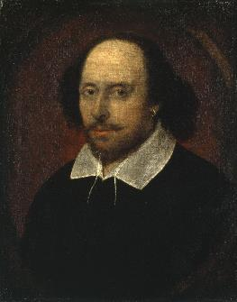

Twelfth Night
A Comedy by William Shakespeare
Date: Written around 1601-1602

Slide 2
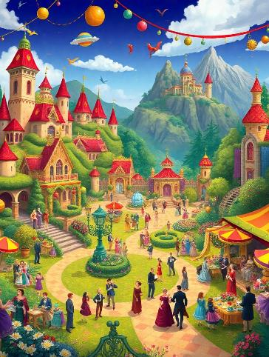
Introduction to Twelfth Night
Overview: Twelfth Night is a romantic comedy that explores themes of love, identity, and the complexities of human relationships. Setting: Fictional land of Illyria, characterized by its festive atmosphere and social chaos.

Slide 3


Main Characters
Olivia and Malvolio
Viola and Duke Orsino
Olivia: A wealthy countess mourning her brother. Malvolio: The pompous steward of Olivia who aspires to rise socially.
Viola: Shipwrecked and disguises herself as a man named Cesario. Duke Orsino: In love with Olivia but is oblivious to Viola's affections for him.

Slide 4
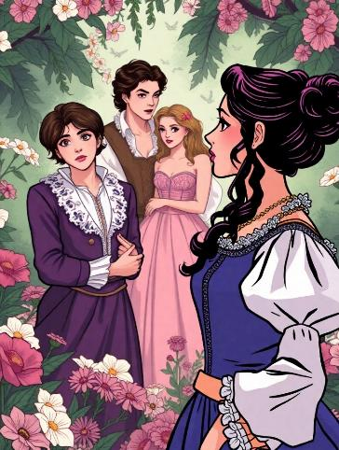
Plot Summary
Act I: Viola disguises herself as Cesario to serve Duke Orsino.
Act II: Love triangles develop; Olivia falls for Cesario (Viola).
Act III: Malvolio is tricked into believing Olivia loves him.
Act IV & V: Revelations occur.

Slide 5


Themes of Love
Romantic Confusion
Love's Complexity
Romantic Confusion: The love triangle between Orsino, Olivia, and Cesario highlights the chaos of desire.
Love's Complexity: The play illustrates love as both joyous and painful, showcasing its unpredictable nature.

Slide 6


Gender and Identity
Performance of Gender
Gender Fluidity
Performance of Gender: The play illustrates how gender can be performed and manipulated through disguise.
Gender Fluidity: Viola's disguise challenges traditional gender roles, raising questions about identity.

Slide 7
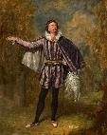

Deception and Disguise
Malvolio's Folly
Viola's Disguise
His ambition leads to his downfall when he is deceived by Maria's scheme.
Her role as Cesario allows her to navigate a male-dominated society while hiding her true identity.

Slide 8

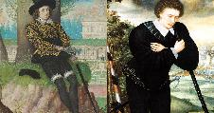

Madness and Melancholy
Cure Through Revelation
Melancholy as a Theme
Madness in Love
Characters find clarity and resolution when truths are revealed, transforming madness into joy.
The Renaissance view of melancholy reflects emotional turmoil stemming from unrequited love.
Characters like Orsino and Olivia exhibit behaviors resembling madness due to their obsessive desires.

Slide 9
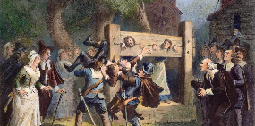
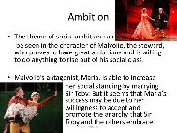
Social Commentary
Critique of Puritanism
Class and Ambition
Malvolio’s character serves as a foil to the revelry embraced by other characters, mocking strict moral codes.
Malvolio’s aspirations highlight class distinctions and social mobility within the play.

Slide 10
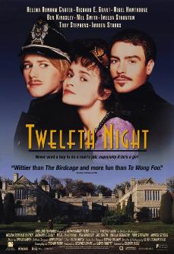
Conclusion
Twelfth Night remains a timeless exploration of love, identity, and societal norms.

