Slide 1
The Transition Metals

Slide 2
The Metals in the Middle
Groups 3-12 are called the transition elements.
All of them are metals.
Across any period from Group 3 through 12, the properties of the elements change less noticeably than they do across a period of representative elements.
Most transition elements are found combined with other elements in ores.

Slide 3
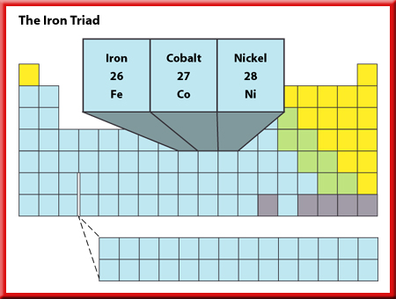
The Iron Triad
Three elements in period 4—iron, cobalt, and nickel—have such similar properties that they
are known as the iron triad.
These elements, among others, have magnetic properties.

Slide 4
The Iron Triad
Industrial magnets are made from an alloy of nickel, cobalt, and aluminum.
Nickel is used in batteries along with cadmium.
Iron is a necessary part of hemoglobin, the substance that transports oxygen in the blood.
Iron also is mixed with other metals and with carbon to create a variety of steels with different properties.

Slide 5
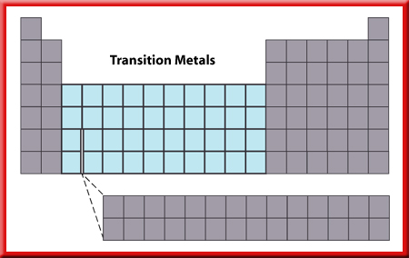
Uses of Transition Elements
Most transition metals have higher melting points than the representative elements.
The filaments of lightbulbs are made of
tungsten, element 74.

Slide 6
Uses of Transition Elements
Tungsten has the highest melting point of any metal (3,410°C) and will not melt when a current passes through it.

Slide 7

Uses of Transition Elements
Mercury, which has the lowest melting point of any metal (–39°C), is used in thermometers and in barometers.
Mercury is the only metal that is a liquid at room temperatures.
Like many of the heavy metals, mercury is poisonous to living beings.

Slide 8

Uses of Transition Elements
Chromium’s name comes from the Greek word for color, chrome.
Many other transition elements combine to form substances with brilliant colors.

Slide 9
Uses of Transition Elements
Ruthenium, rhodium, palladium, osmium, iridium, and platinum are sometimes called the platinum group because they have similar properties.
They do not combine as easily with other elements.
As a result, they can be used as catalysts.

Slide 10
Uses of Transition Elements
A catalyst is a substance that can make something happen faster but is not changed itself.
Other transition elements, such as nickel, zinc, and cobalt, can be used as catalysts.

