Slide 1
Thermal Physics and Acoustics
R.BHUVANESHKUMAR
Assistant Professor
C.P.A College Bodinayakanur

Slide 2
Introduction
Heat
Temperature
Thermometer

Slide 3
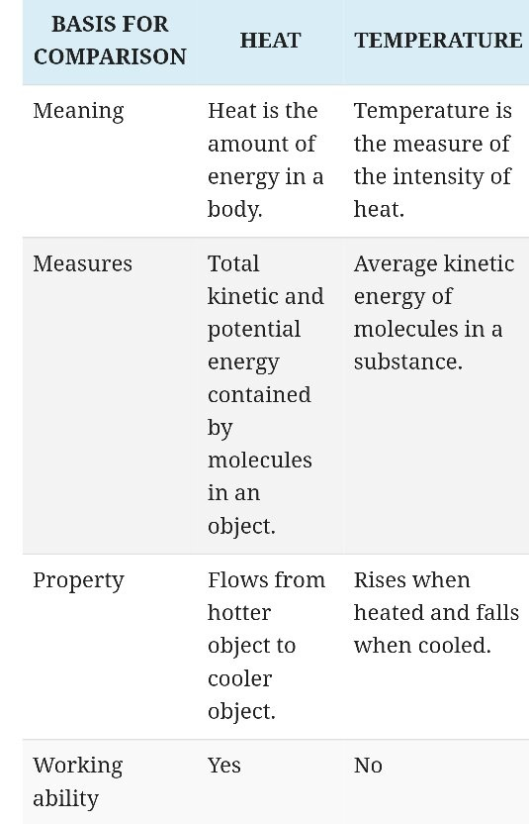
Heat & Temparature

Slide 4
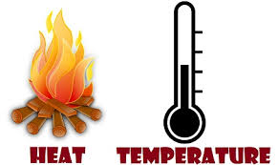
Diff. b/w Heat & Temp

Slide 5
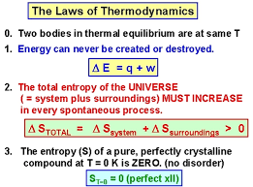
Laws of Thermodynamics

Slide 6
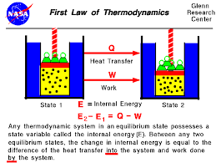
First Law of Thermodynamics

Slide 7
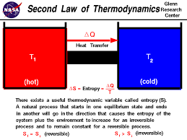
Second Law of Thermodynamics

Slide 8
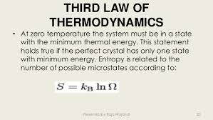
Third Law of Thermodynamics

Slide 9
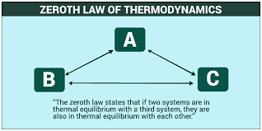
Zeroth Law of Thermodynamics

Slide 10
Entrophy
Entropy
Common symbols | S
SI unit | joules per kelvin (J⋅K⁻¹)
In SI base units | kg⋅m²⋅s⁻²⋅K⁻¹

Slide 11
THANK YOU

