Slide 1

Title: Swami and His Friends
Subtitle: A Journey Through Childhood in Malgudi
Author: R. K. Narayan
Notes:
Entered text
Slide 1: Title Slide
Title: Swami and His Friends
Subtitle: A Journey Through Childhood in Malgudi
Author: R. K. Narayan
Slide 2: Introduction to the Story
Setting: The fictional town of Malgudi in South India.
Main Character: Swaminathan, a ten-year-old schoolboy.
Themes: Friendship, childhood innocence, social class differences.
Slide 3: Main Characters
Swaminathan (Swami): Lazy and carefree schoolboy.
Rajam: Wealthy new boy, son of the police superintendent.
Samuel ("The Pea"): Swami's short friend known for his height.
Sankar: Intelligent classmate who eventually leaves Malgudi.
Mani: Strong and loyal friend who often gets into trouble.
Slide 4: Plot Overview
Swami's life revolves around school, friends, and family.
The arrival of Rajam creates rivalry but leads to friendship.
Their bond is tested through various adventures and challenges.
Slide 5: Key Events
Introduction of Rajam: Threatens Swami's popularity.
Formation of the Cricket Club: Swami and Rajam unite their friends.
Protests Against British Rule: Swami participates and faces consequences.
Slide 6: Conflict and Resolution
School Expulsions: Swami is expelled from two schools due to truancy.
Running Away: Overwhelmed by fear of punishment, he attempts to escape.
Return Home: Realizes the importance of home and friendship.
Slide 7: Themes Explored
Friendship: The dynamics between Swami, Rajam, and their friends.
Social Class Differences: The impact of wealth on relationships.
Childhood Innocence vs. Reality: Navigating the complexities of growing up.
Slide 8: Symbolism
Cricket Club (M.C.C.): Represents camaraderie and youthful aspirations.
School Environment: Reflects societal expectations and pressures on children.
Slide 9: Critical Reception
Recognized as a classic of Indian literature.
Praised for its humor, relatable characters, and vivid portrayal of childhood.
Slide 10: Conclusion
Swami and Friends captures the essence of childhood adventures and friendships.
R. K. Narayan’s storytelling offers insights into human relationships within a historical context.

Slide 2
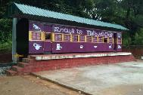



Introduction to the Story
Setting: The fictional town of Malgudi in South India
Main Character: Swaminathan, a ten-year-old schoolboy
Themes: Friendship, childhood innocence, social class differences
The story is set in the fictional town of Malgudi, a vibrant and lively place that embodies the essence of Indian culture and society. Through its streets, schools, and homes, Narayan paints a vivid picture of childhood experiences in a small town.
The protagonist, Swaminathan, affectionately known as Swami, is a ten-year-old schoolboy whose adventures and misadventures form the heart of the story. His character embodies the curiosity and innocence of childhood, leading readers through his emotional and social challenges.
The narrative explores significant themes such as friendship, which is central to Swami's life, the innocence of childhood juxtaposed against the harsh realities of growing up, and the social class differences that influence relationships among children in Malgudi.

Slide 3
Main Characters
Swaminathan (Swami): Swami is depicted as a lazy and carefree schoolboy, whose life revolves around his friends, school, and family. His personality reflects the typical traits of childhood, including a penchant for adventure and a reluctance towards responsibility.
Rajam: Rajam is the wealthy new boy in town, the son of the police superintendent. His arrival poses a threat to Swami's popularity, yet it also leads to a unique friendship that evolves throughout the story.
Samuel ("The Pea"): Samuel, nicknamed "The Pea," is Swami's short and spirited friend, known for his height and playful attitude. His character adds a humorous element to the group dynamics.
Sankar: Sankar is portrayed as an intelligent classmate who ultimately leaves Malgudi. His departure emphasizes the transient nature of childhood friendships and the impact of change.
Mani: Mani is characterized as a strong and loyal friend who often finds himself in trouble. His unwavering loyalty to Swami and the group showcases the essence of friendship.

Slide 4
Plot Overview
Swami's life revolving around school, friends, and family
The arrival of Rajam creating rivalry but leading to friendship
Their bond being tested through various adventures and challenges
Swami's daily life is a blend of school activities, friendships, and family interactions, depicting the essence of childhood in Malgudi. His experiences are relatable and reflect the joys and struggles of growing up.
Rajam's arrival introduces a sense of rivalry as he quickly becomes popular among their peers. However, this rivalry transforms into a strong friendship as they unite over shared interests and experiences.
Throughout the story, Swami and Rajam face numerous adventures and challenges that test their friendship, including school pressures and societal expectations. These experiences forge a deeper bond between them.

Slide 5
Key Events
Introduction of Rajam
Formation of the Cricket Club
Protests Against British Rule
The introduction of Rajam marks a pivotal moment in the story, as his presence threatens Swami's social standing. This event serves as a catalyst for the evolving dynamics among the friends.
The formation of the Cricket Club becomes a significant event that unites Swami and Rajam, allowing them to channel their competitive spirits into a common interest. This club symbolizes their camaraderie and shared aspirations.
The boys' participation in protests against British rule highlights their emerging awareness of societal issues. Swami's involvement in these protests showcases the intersection of childhood innocence and the realities of political engagement.

Slide 6
Conflict and Resolution
School Expulsions
Return Home
Running Away
Swami faces the consequences of his actions when he is expelled from two schools due to truancy. This conflict illustrates the pressures of academic expectations and the challenges of growing up.
Ultimately, Swami realizes the importance of home and friendship. His return symbolizes growth and understanding, emphasizing the value of familial bonds and the support of true friends.
Overwhelmed by the fear of punishment, Swami attempts to run away, showcasing his desperation and the weight of societal expectations on children. This moment reflects the internal struggles many children face.

Slide 7
Themes Explored
Friendship
The dynamics of friendship among Swami, Rajam, and their friends are central to the narrative. Their interactions reflect the complexities of childhood relationships and the loyalty that defines true friendship.
Childhood Innocence vs. Reality
The tension between childhood innocence and the harsh realities of life is a recurring theme. Swami's journey navigates the complexities of growing up, showcasing the loss of innocence as he confronts societal pressures.
Social Class Differences
The story explores how social class differences impact relationships, particularly through the character of Rajam. Narayan highlights the disparities in wealth and privilege and their effects on childhood friendships.

Slide 8

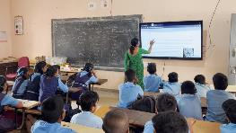
Symbolism
Cricket Club (M.C.C.)
School Environment
The Cricket Club symbolizes camaraderie and youthful aspirations. It represents the joys of childhood and the bonds formed through shared interests and activities.
The school environment reflects societal expectations and pressures on children. It serves as a backdrop for Swami's adventures and challenges, highlighting the influence of education on childhood development.

Slide 9
Critical Reception
Recognition as a classic of Indian literature
Praise for humor, relatable characters, and vivid portrayal of childhood
"Swami and His Friends" is recognized as a classic of Indian literature, celebrated for its authentic portrayal of childhood and the cultural nuances of Malgudi.
Critics have praised Narayan for his humor, relatable characters, and vivid portrayal of childhood, making the narrative resonate with readers across generations. His storytelling captures the essence of growing up in India.

Slide 10
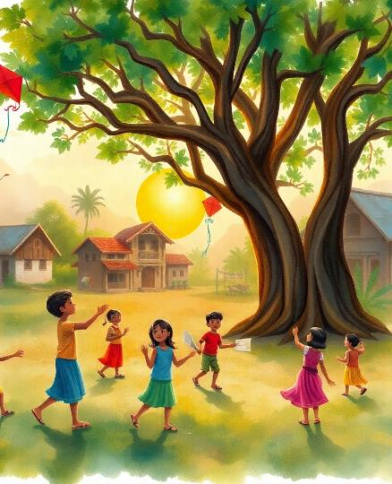
Conclusion
"Swami and Friends" captures the essence of childhood adventures and friendships, offering insights into the complexities of human relationships. R. K. Narayan’s storytelling not only entertains but also provides a lens through which we can understand the social and cultural context of childhood in India.

