Slide 1
State variables and Thermodynamic Processes
Dr. B. Kavitha
Assistant Professor
PG and Research Department of Chemistry
C.P.A. College, Bodinayakanur

Slide 2
State variables
A thermodynamic system is said to be in a certain state when all its properties are fixed.
The fundamental properties which determine the state of a system are pressure (P), temperature (T), volume (V), mass and composition.
Since a change in the magnitude of such properties alters the state of the system, these are referred to as State variables or state functions or Thermodynamic parameters.
It also stands to reason that a change of system from the initial state to the final state will be accompanied by change in the state variables.
It is not necessary to state all the properties (state variable) to define a system completely. For a pure gas, the composition is fixed automatically, as it is cent per cent. The remaining state variables P, V, T are interrelated in the form of an algebraic relationship called equation of State.
Thus for one mole of a pure gas, the equation of state is:
PV = RT
Where R is gas constant. If of the three state variables (P,V,T), P and T are specified, the value of third (V) is fixed automatically and can be calculated from the equation of state.

Slide 3
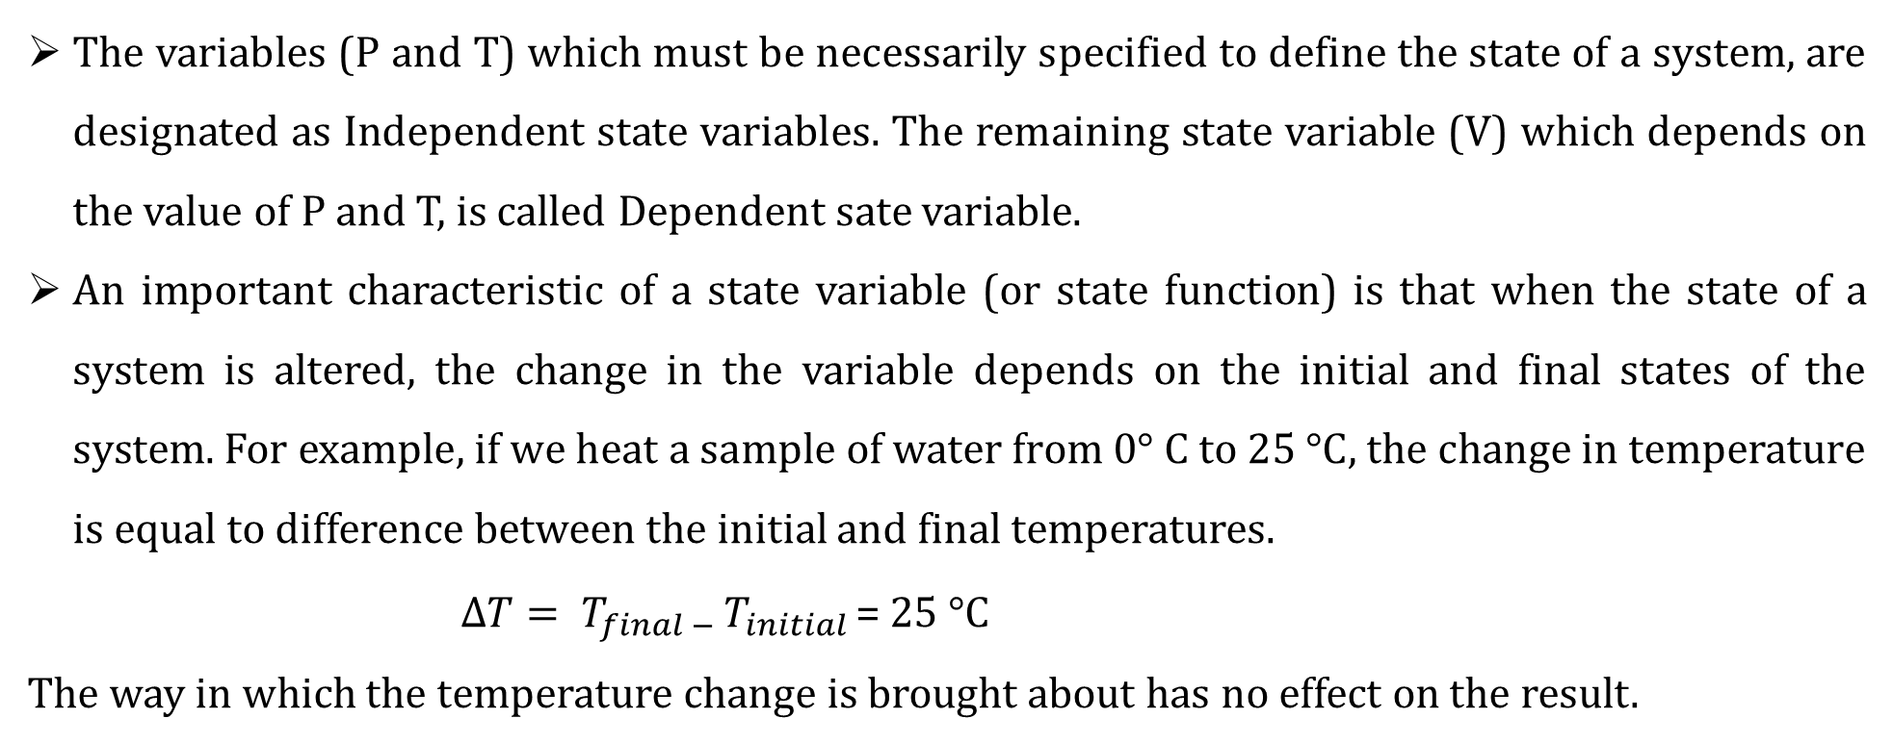
The variables (P and T) which must be necessarily specified to define the state of a system, are designated as Independent state variables. The remaining state variable (V) which depends on the value of P and T, is called Dependent sate variable.
An important characteristic of a state variable (or state function) is that when the state of a system is altered, the change in the variable depends on the initial and final states of the system. For example, if we heat a sample of water from 0° C to 25 °C, the change in temperature is equal to difference between the initial and final temperatures.
$∆T= T_{final − }T_{initial }$= 25 °C
The way in which the temperature change is brought about has no effect on the result.

Slide 4
Thermodynamic Processes
When a thermodynamic system changes from one state to another, the operation is called a process
These process involve the change of conditions (temperature, pressure and volume)
The various types of thermodynamic processes are:
Isothermal Processes
Those processes in which the temperature remains fixed, are termed isothermal processes. This is often achieved by placing the system in a thermostat (constant temperature path).
For an isothermal process dT = 0
2. Adiabatic Processes
Those processes in which no heat can flow into or out of the system are called adiabatic processes. Adiabatic conditions can be approached by carrying the process in an insulated container such as ‘thermos’ bottle. High vacuum and highly polished surfaces help to achieve thermal insulation
For an adiabatic process dq = 0
3. Isobaric Processes
Those processes which take place at constant pressure are called isobaric processes. For example, heating of water to its boiling point and its vaporization take place at the same atmospheric pressure. These changes are, therefore, designated as isobaric processes and are said to take place isobarically.
For an isobaric process dp = 0

Slide 5
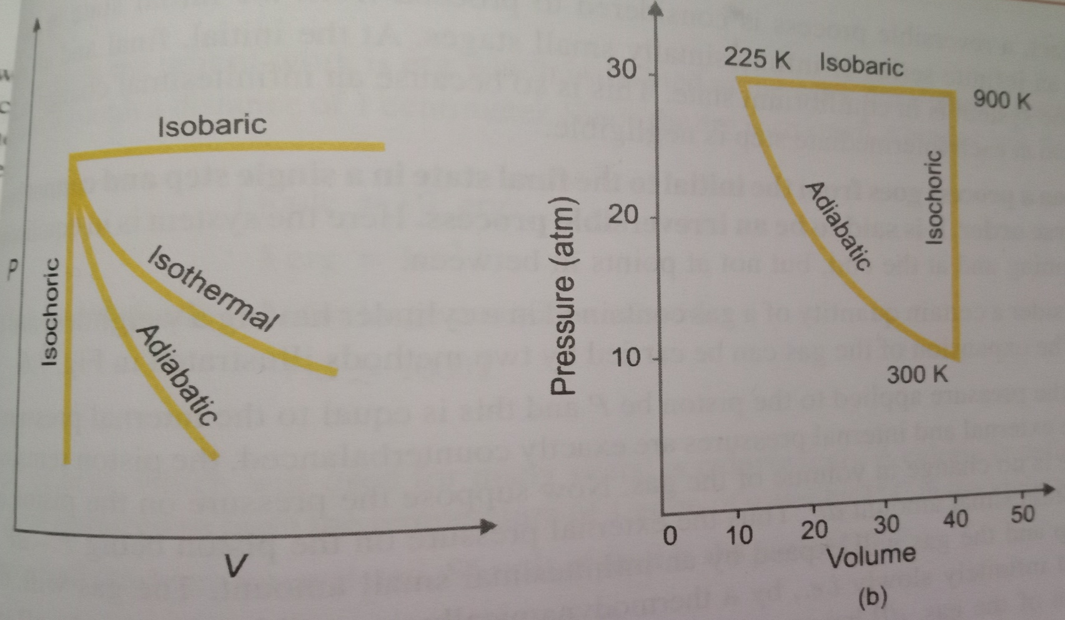
4. Isochoric Processes
Those processes in which the volume remains constant are known as isochoric processes. The heating of a substance in non-expanding chamber is an example of isochoric process.
For isochoric processes dV = 0
5. Cyclic Process
When a system in a given state goes through a number of different processes and finally returns to its initial state, the overall process is called a cycle or cyclic process.
For a cyclic process dE = 0, dH = 0

Slide 6
Thank you

