Slide 1
SECOND LAW OF THERMODYNAMICS AND ITS APPLICATIONS
Dr. B. Kavitha
Assistant Professor
PG and Research Department of Chemistry
C.P.A. College, Bodinayakanur

Slide 2
a) Limitation of first law and the need for second law
1)The Ist law establishes definite relationship between the heat absorbed and the work performed by a system in a given process, but it puts no restriction on the direction of flow of heat.
2)Accordingly to Ist law, the energy of an isolated system remains constant during a specified change of state, But it does not tell whether a specified change can occur spontaneously the whether it is feasible.
3) The first law states that energy of one form can be converted into an equivalent amount of energy of another from. But it does not that heat energy cannot be completely concerted into an equivalent and of work.

Slide 3
Various states of the second law of T.D
1) Kelvin statement
It is impossible to take heat from hotter reservoir and convert it completely into work by a cyclic process without transferring a part of heat to a cooler reservoir.
2) Clausius Statement
It is impossible for self acting machine unaided by any extend agency to transfer heat from colder to hotter body.
3) Entropy statement
The entropy of the universe remains constant in a reversible process but it tends to increase in a spontaneous process.

Slide 4
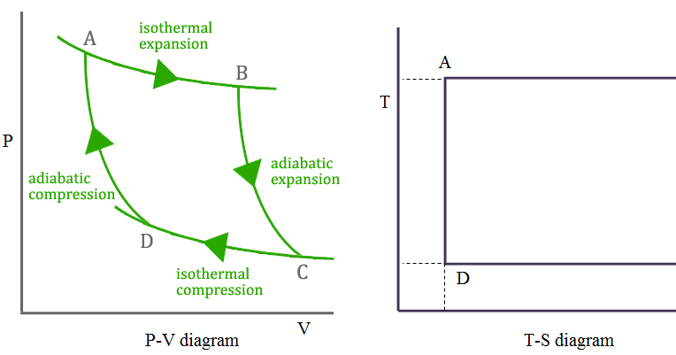
The Carnot Cycle - (Conversion of heat into work)
Any device that can convert heat into work is called a ‘heat engine’. In 1824, S.Carnot devised a heat engine using an ideal gas as the working substance. The gas is subjected to a cyclic change which involves 4 steps .
1) Isothermal reversible expansion
2) Adiabatic reversible expansion
3) Isothermal reversible compression
4) Adiabatic reversible compression
1) Isothermal reversible expansion
The cylinder containing into of the ideal gas, occupying a volume V₁ is placed inconstant with the heat reservoir (source) at temp T₂.
The gas absorbs heat q₂ from the source and expands isothermally and reversibly till its volume has increased to V₂. Since the gas is ideal ,the words done W₁ by 1 mole of the ideal gas will be
v₁
T₂
v₂
T₁

Slide 5
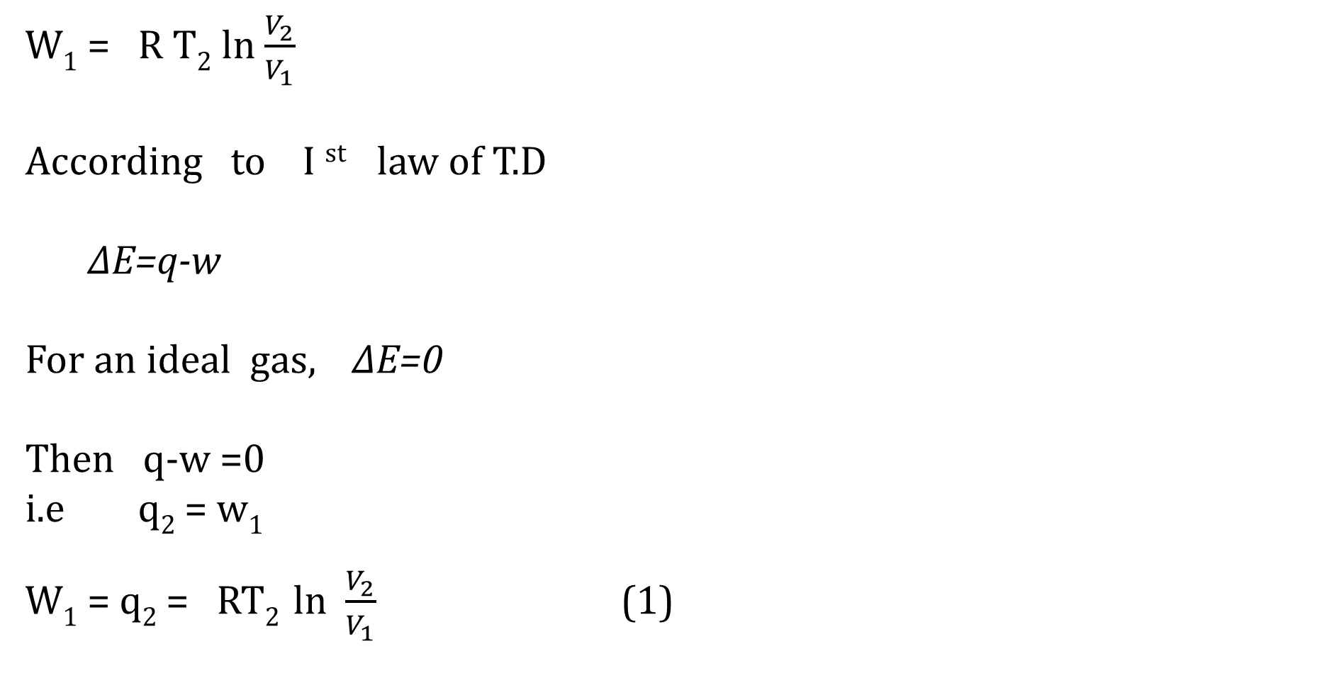
W₁ = R T₂ ln $\frac{V_{2}}{V_{1}}$
According to I ^{st} law of T.D
∆E=q-w
For an ideal gas, ∆E=0
Then q-w =0
i.e q₂ = w₁
W₁ = q₂ = RT₂ ln $\frac{V_{2}}{V_{1}}$ (1)

Slide 6
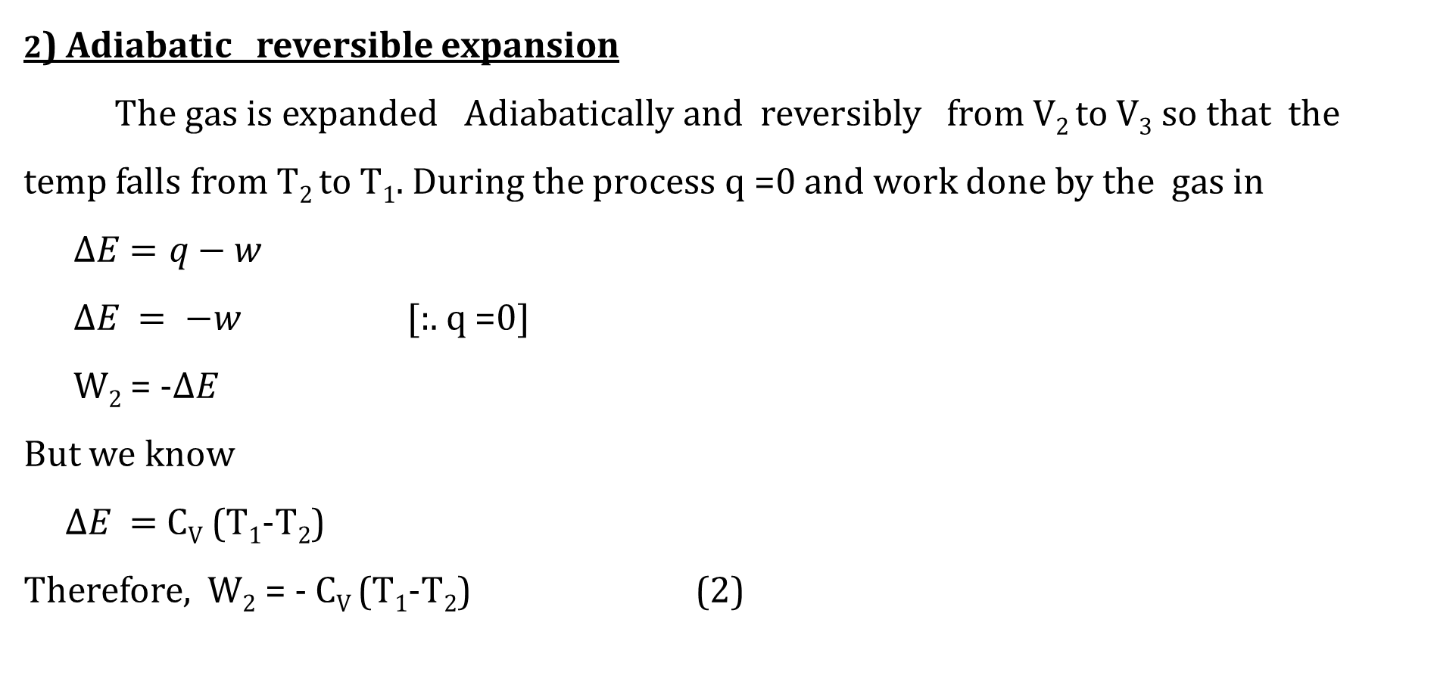
2) Adiabatic reversible expansion
The gas is expanded Adiabatically and reversibly from V₂ to V₃ so that the temp falls from T₂ to T₁. During the process q =0 and work done by the gas in
$∆E=q−w$
$∆E = −w$ [:. q =0]
W₂ = -$∆E$
But we know
$∆E =$ C_{V} (T₁-T₂)
Therefore, W₂ = - C_{V} (T₁-T₂) (2)

Slide 7
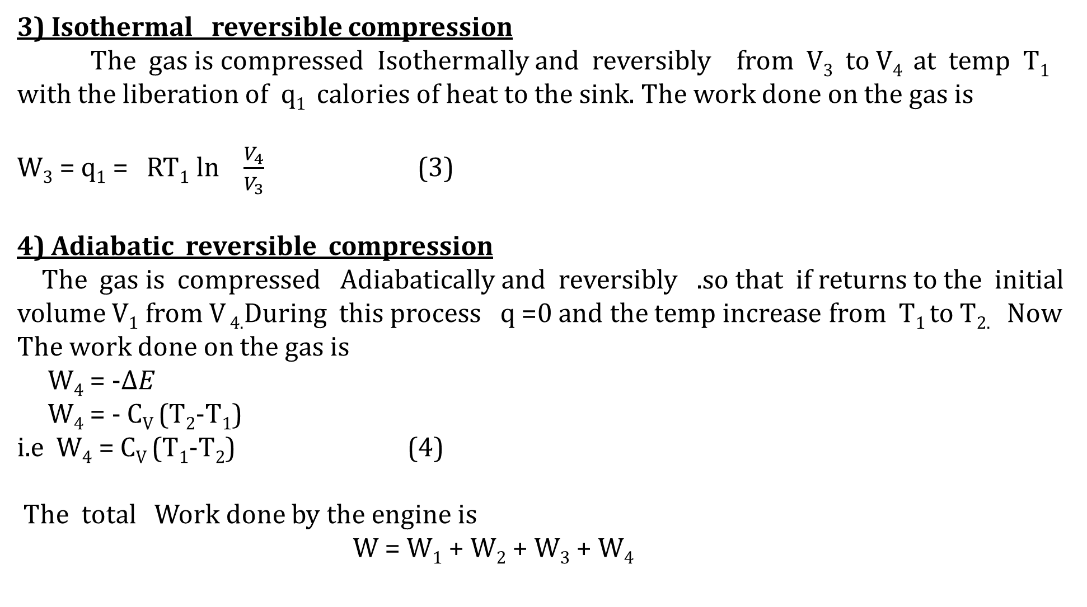
3) Isothermal reversible compression
The gas is compressed Isothermally and reversibly from V₃ to V₄ at temp T₁ with the liberation of q₁ calories of heat to the sink. The work done on the gas is
W₃ = q₁ = RT₁ ln $\frac{V_{4}}{V_{3}}$ (3)
4) Adiabatic reversible compression
The gas is compressed Adiabatically and reversibly .so that if returns to the initial volume V₁ from V _{4.}During this process q =0 and the temp increase from T₁ to T_{2.} Now The work done on the gas is
W₄ = -$∆E$
W₄ = - C_{V} (T₂-T₁)
i.e W₄ = C_{V} (T₁-T₂) (4)
The total Work done by the engine is
W = W₁ + W₂ + W₃ + W₄

Slide 8
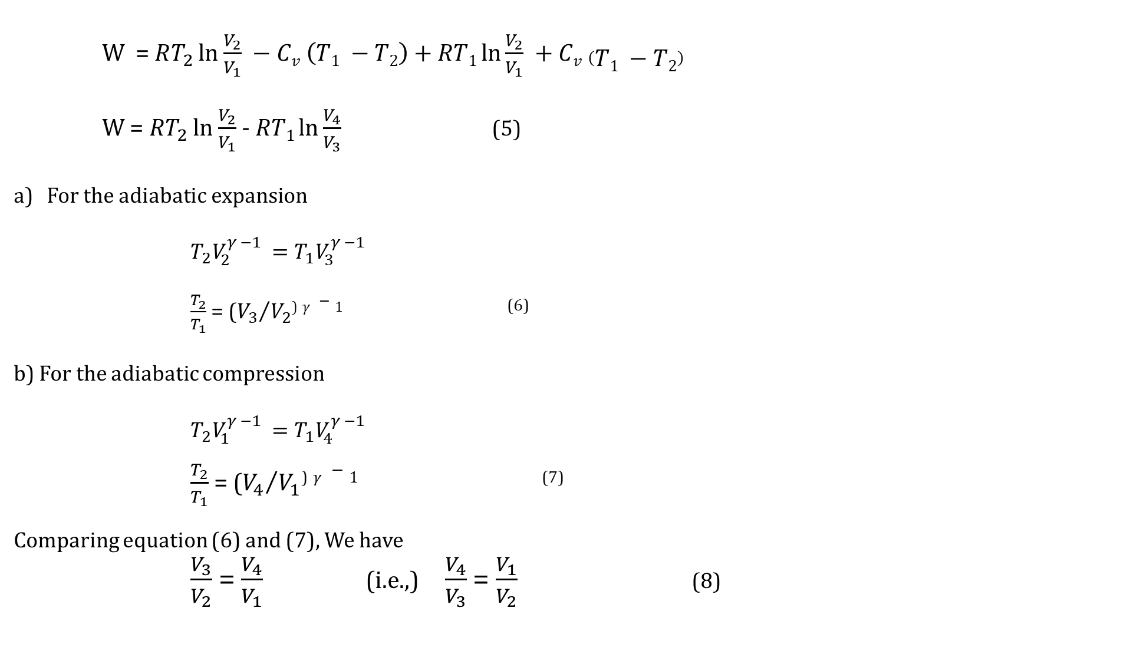
W = $RT_{2 }$ln $\frac{V_{2}}{V_{1}} −Cv \left(T1 −T2\right)+RT1\ln{\frac{V_{2}}{V_{1}} +Cv \left(T1 −T2\right)}$
W = $RT_{2 }$ln $\frac{V_{2}}{V_{1}}$ - $RT1\ln{\frac{V_{4}}{V_{3}}}$ (5)
For the adiabatic expansion
$T_{2}V_{2}^{γ −1 }=T_{1}V_{3}^{γ −1 }$
$\frac{T_{2}}{T_{1}}$ = (${V_{3}}/{V_{2}}$⁾ $γ −1$ ⁽⁶⁾
b) For the adiabatic compression
$T_{2}V_{1}^{γ −1 }=T_{1}V_{4}^{γ −1 }$
$\frac{T_{2}}{T_{1}}$ = (${V_{4}}/{V_{1}}$⁾ $γ −1$ ⁽⁷⁾
Comparing equation (6) and (7), We have
$\frac{V_{3}}{V_{2}}$ = $\frac{V_{4}}{V_{1}}$ (i.e.,) $\frac{V_{4}}{V_{3}}$ = $\frac{V_{1}}{V_{2}}$ (8)

Slide 9
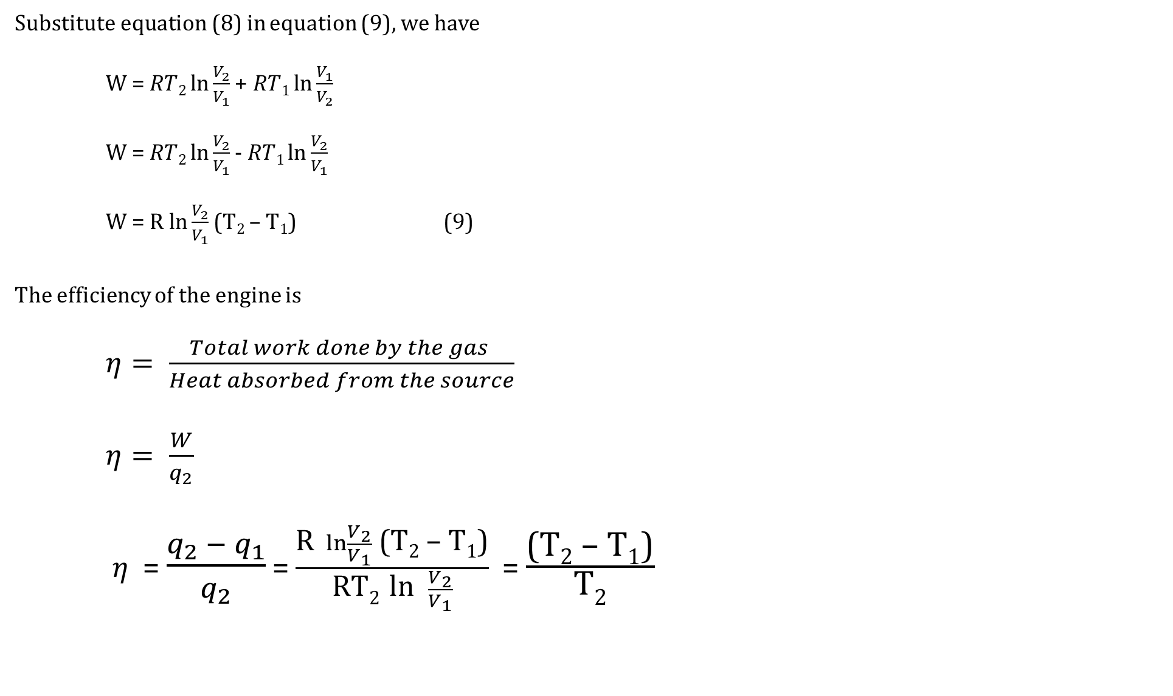
Substitute equation (8) in equation (9), we have
W = $RT2\ln{\frac{V_{2}}{V_{1}}}$ + $RT1\ln{\frac{V_{1}}{V_{2}}}$
W = $RT2\ln{\frac{V_{2}}{V_{1}}}$ - $RT1\ln{\frac{V_{2}}{V_{1}}}$
W = R $\ln{\frac{V_{2}}{V_{1}}}$ (T₂ – T₁) (9)
The efficiency of the engine is
$η= \frac{Total work done by the gas }{Heat absorbed from the source}$
$η= \frac{W}{q_{2}}$
$η$ = $\frac{q_{2 }− q_{1}}{q_{2}}$ = $\frac{\text{R} \ln{\frac{V_{2}}{V_{1}}}\text{ (}\text{T}\text{2}\text{ – }\text{T}\text{1}\text{)}}{\text{RT}\text{2 }\text{ln} \frac{V_{2}}{V_{1}}}$ = $\frac{\text{(}\text{T}\text{2}\text{ – }\text{T}\text{1}\text{)}}{\text{T}\text{2}}$

Slide 10
Thank you

