Slide 1
SURFACE CHEMISTRY
Dr. B. Kavitha
Assistant Professor
PG and Research Department of Chemistry
C.P.A. College, Bodinayakanur

Slide 2
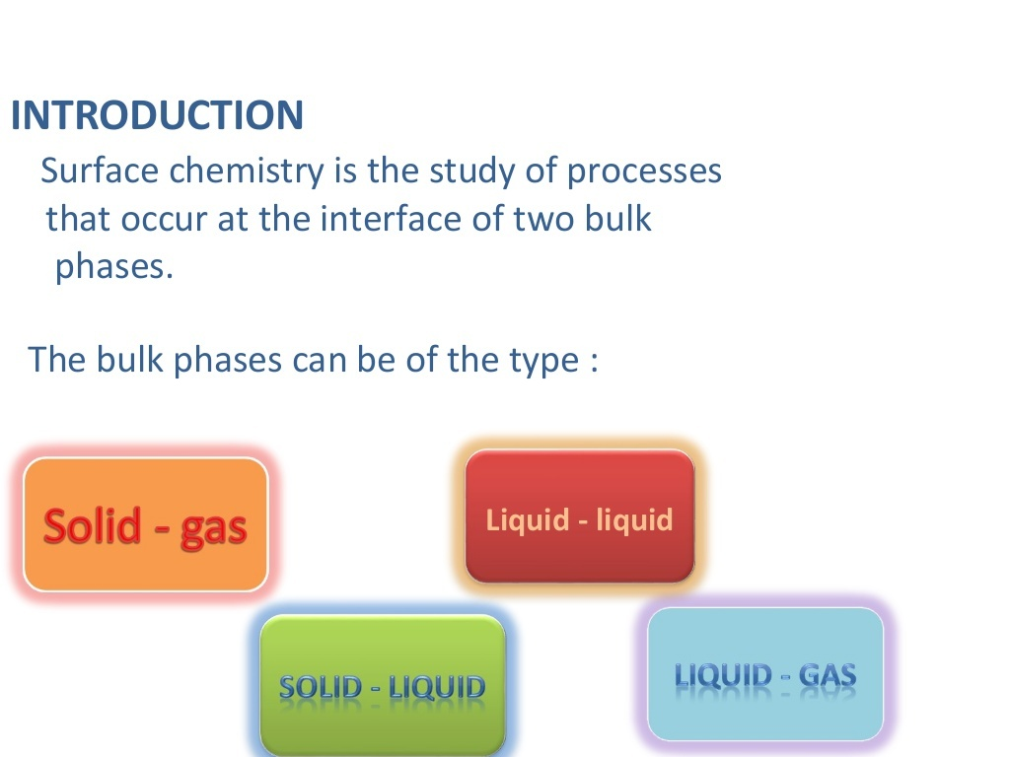
Surface Chemistry
Surface Chemistry is closely related to interface and colloidal science.

Slide 3

Definition of Adsorption
Adsorption is the phenomenon of concentration or assimilation of a gas or liquid on the surface of a solid or liquid with which it is in contact.
Adsorbent is the material which provides the surface on which adsorption occurs and the substance adsorbed or attached is called adsorbate. Examples of adsorbents are charcoal, silica gel, clay, fullers earth, alumina gel, etc. Adsorbent molecule (adsorbate)

Slide 4
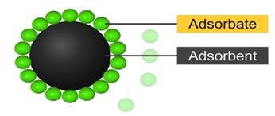
The substance on the surface of which adsorption takes place is called the ADSORBENT, while the substance thus adsorbed is called the ADSORBATE

Slide 5
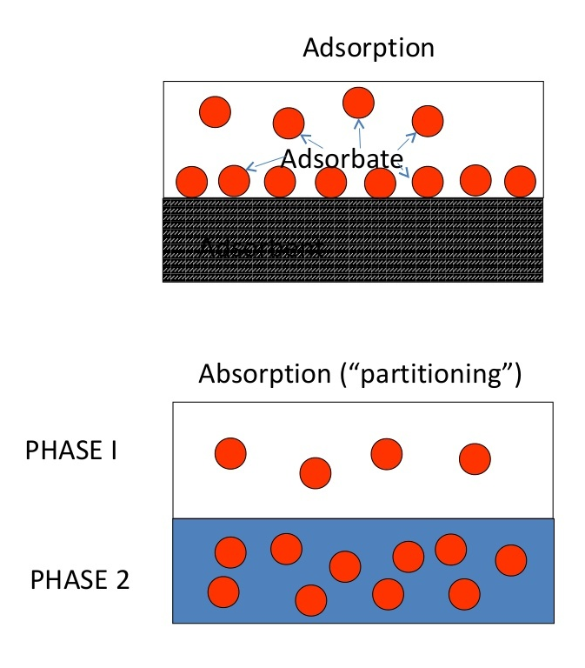
Differences between absorption and Adsorption
Adsorption is a surface phenomenon and it is a fast process. In absorption, diffusion into the interior of matter takes place, hence it is a slow process. For example, when a blotting paper is kept in contact with ink, ink is absorbed into the paper. on the other hand, if a dilute solution of litmus is shaken with animal charcoal the surface of charcoal takes away some of the litmus and all the litmus is concentrated on charcoal. In adsorption, equilibrium is easily attained but in absorption it takes some time to reach equilibrium. Absorption is a bulk phenomenon but adsorption is a surface phenomenon.
Adsorption depends on the surface area of adsorbent. Consequently, it is more rapid on finely divided and on a rough surface. Such effect is not observed in absorption.

Slide 6
Desorption:
The removal of the adsorbed substance from the surface, is called desorption.
It can be brought about by heating or by reducing the pressure.
Occlusion:
The adsorption of a gas on the surface of a metal is called occlusion.
EX: Hydrogen is adsorbed on the surface of nickel or palladium.

Slide 7
Types of Adsorption
Adsorption is not necessarily a physical phenomenon. It may be a chemical process involving chemical reaction between the surface atoms of adsorbent and the atoms of adsorbate. This type of adsorption is known as chemisorption. It results in surface complex. For example, O₂ is chemisorbed by carbon and H² by nickel under suitable conditions. Chemisorption differs from physical adsorption in the following respects:
1. Physical adsorption occurs appreciably at very low temperature, i.e, below boiling point of adsorbate. chemisorption occurs at all temperatures.
2. The magnitude of physical adsorption decreases with rise in temperature. The magnitude of chemisorption increases with temperature.
3. The heat evolved during physical adsorption is very low, i.e., 4–40 kJ mol^{–1}. It is very high (40–400 kJ mol^{–1}) in chemisorption.
Chemisorption is irreversible as the gas adsorbed cannot be recovered from adsorbent as such on lowering the pressure of the system at the same temperature. Physical adsorption is reversible as the gas adsorbed can be recovered by simply lowering the pressure of the system.
5. Physisorption may extend beyond a monolayer. Chemisorption operates within short distance only. It does not extend beyond the monolayer of gas molecules.
6. In physisorption, the adsorbate molecules are held together by weak van der Waals forces. Hence, activation energy for disorption in very low. In chemisorption, adsorbate molecules are held by strong valence forces and its activation energy for disorption is high.

Slide 8
Thank You

