Slide 1
Thermodynamic derivation of relationship between relative lowering of vapour pressure and elevation of boiling point
Dr. B. Kavitha
Assistant Professor
PG and Research Department of Chemistry
C.P.A. College, Bodinayakanur

Slide 2
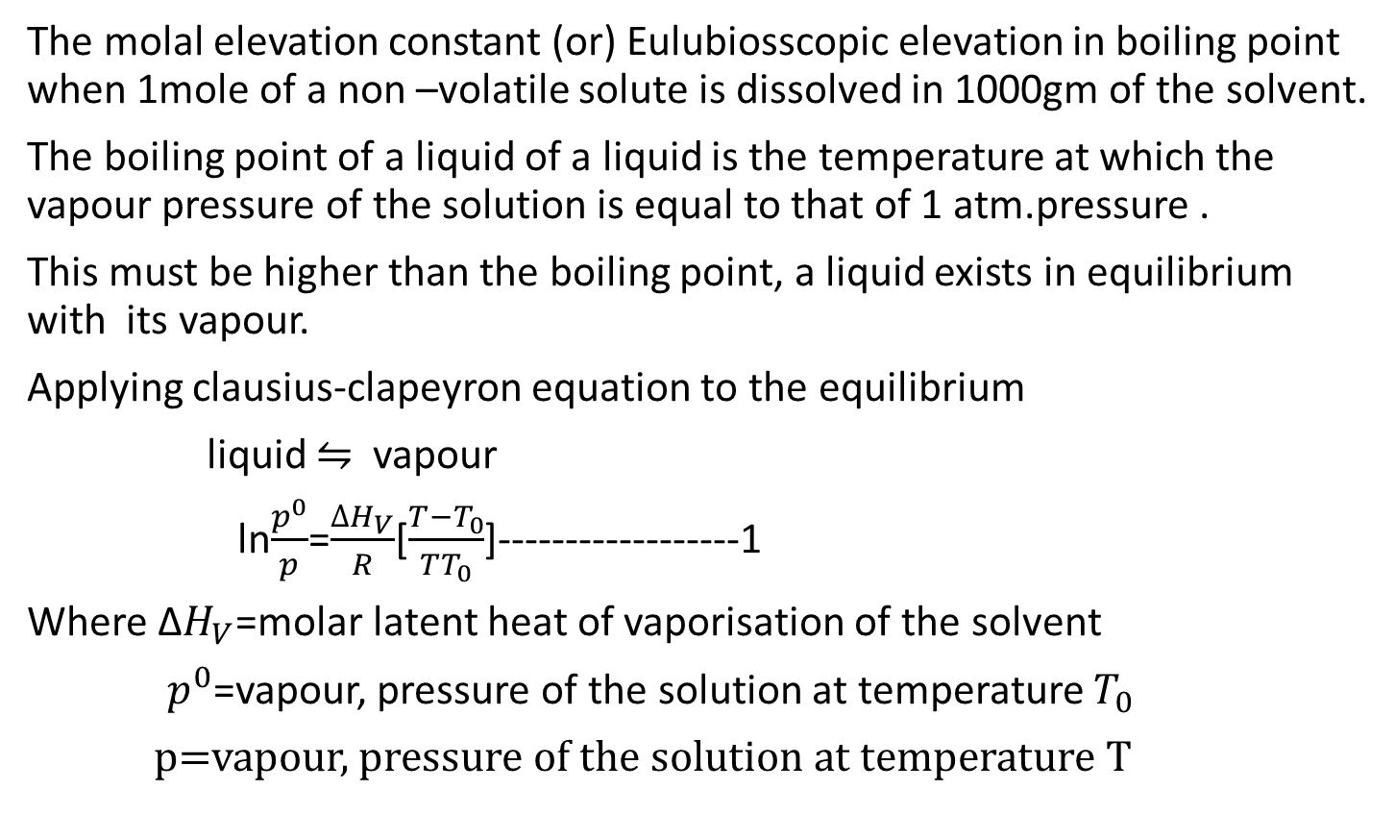
Thermodynamic derivation of relationship between relative lowering of vapour pressure and elevation of boiling point
The molal elevation constant (or) Eulubiosscopic elevation in boiling point when 1mole of a non –volatile solute is dissolved in 1000gm of the solvent.
The boiling point of a liquid of a liquid is the temperature at which the vapour pressure of the solution is equal to that of 1 atm.pressure .
This must be higher than the boiling point, a liquid exists in equilibrium with its vapour.
Applying clausius-clapeyron equation to the equilibrium
liquid $⇋$ vapour
ln$\frac{p^{0}}{p}$=$\frac{∆H_{V}}{R}$[$\frac{T−T_{0}}{TT_{0}}$]------------------1
Where Δ$H_{V}$=molar latent heat of vaporisation of the solvent
$p^{0}$=vapour, pressure of the solution at temperature $T_{0}$
p=vapour, pressure of the solution at temperature T

Slide 3
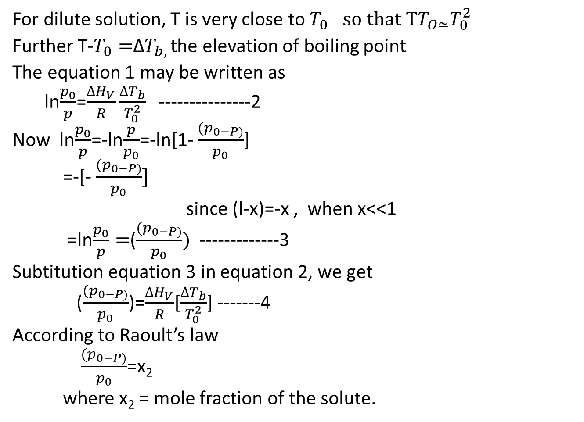
For dilute solution, T is very close to${ T}_{0 } so that TT_{O≃}T_{0}^{2}$
Further T-$T_{0}=$Δ$T_{b, }$the elevation of boiling point
The equation 1 may be written as
ln$\frac{p_{0}}{p}$=$\frac{∆H_{V}}{R}\frac{∆T_{b}}{T_{0}^{2}}$ ---------------2
Now ln$\frac{p_{0}}{p}$=-ln$\frac{p}{p_{0}}$=-ln[1- $\frac{{(p}_{0−P)}}{p_{0}}$]
=-[- $\frac{{(p}_{0−P)}}{p_{0}}]$
since (l-x)=-x , when x<<1
=ln$\frac{p_{0}}{p}=$($\frac{{(p}_{0−P)}}{p_{0}})$-------------3
Subtitution equation 3 in equation 2, we get
($\frac{{(p}_{0−P)}}{p_{0}}$)=$\frac{∆H_{V}}{R}$[$\frac{∆T_{b}}{T_{0}^{2}}$] -------4
According to Raoult’s law
$\frac{{(p}_{0−P)}}{p_{0}}$=x₂
where x₂ = mole fraction of the solute.

Slide 4
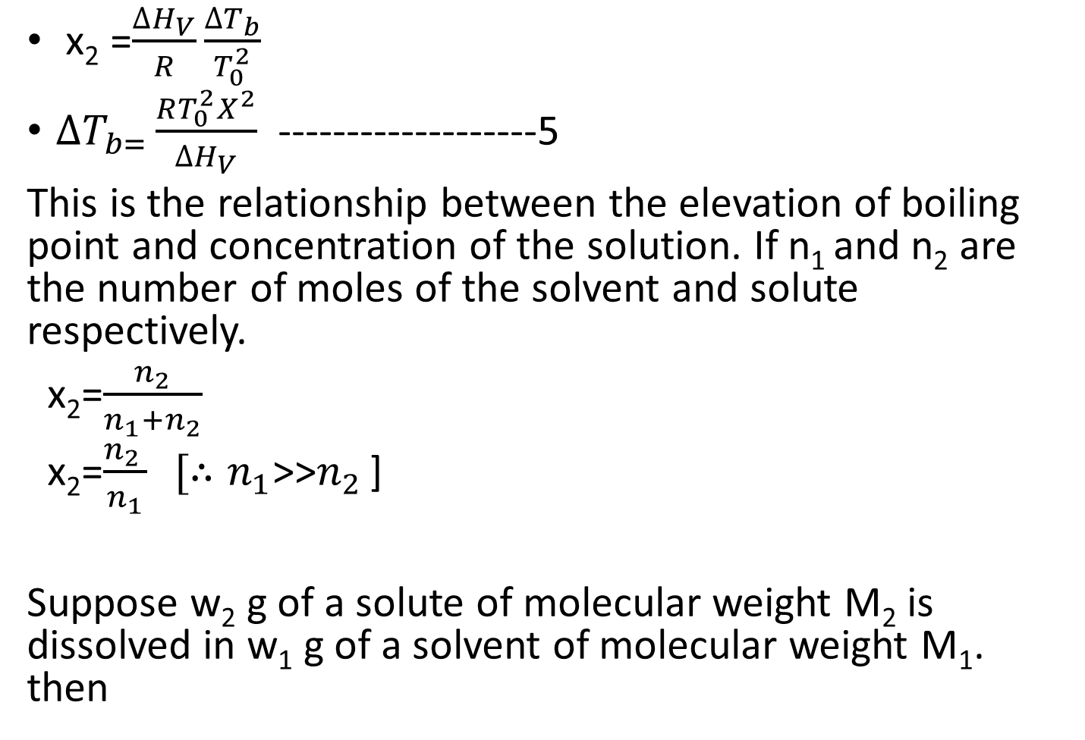
x₂ =$\frac{∆H_{V}}{R}\frac{∆T_{b}}{T_{0}^{2}}$
$∆T_{b=}\frac{RT_{0}^{2}X^{2}}{∆H_{V}}$ -------------------5
This is the relationship between the elevation of boiling point and concentration of the solution. If n₁ and n₂ are the number of moles of the solvent and solute respectively.
x₂=$\frac{n_{2}}{n_{1}+n_{2}}$
x₂=$\frac{n_{2 }}{n_{1}} [∴n_{1}$>>$n_{2 }$]
Suppose w₂ g of a solute of molecular weight M₂ is dissolved in w₁ g of a solvent of molecular weight M₁. then

Slide 5
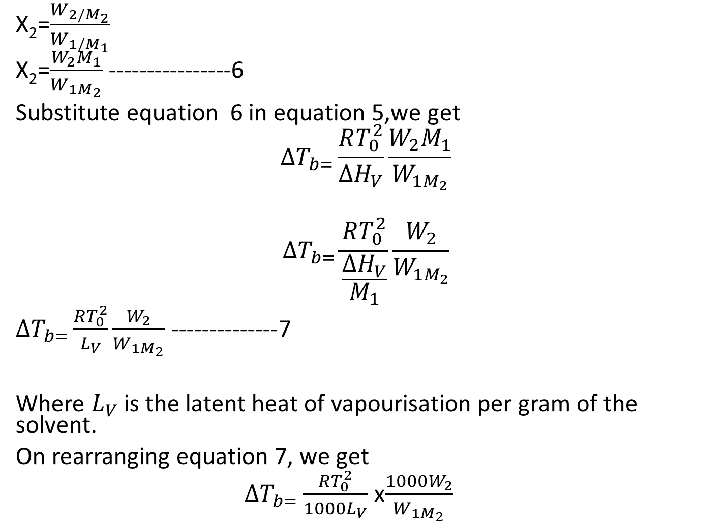
X₂=$\frac{W_{2/M_{2}}}{W_{1/M_{1}}}$
X₂=$\frac{W_{2}M_{1}}{W_{1M_{2}}}$ ----------------6
Substitute equation 6 in equation 5,we get
$$∆T_{b=}\frac{RT_{0}^{2}}{∆H_{V}}\frac{W_{2}M_{1}}{W_{1M_{2}}}$$
$$∆T_{b=}\frac{RT_{0}^{2}}{\frac{ΔH_{V}}{M_{1}}}\frac{W_{2}}{W_{1M_{2}}}$$
$∆T_{b=}\frac{RT_{0}^{2}}{L_{V}}\frac{W_{2}}{W_{1M_{2}}}$ --------------7
Where $L_{V}$ is the latent heat of vapourisation per gram of the solvent.
On rearranging equation 7, we get
$∆T_{b=}$ $\frac{RT_{0}^{2}}{1000L_{V}}$ x$\frac{1000W_{2}}{W_{1M_{2}}}$

Slide 6
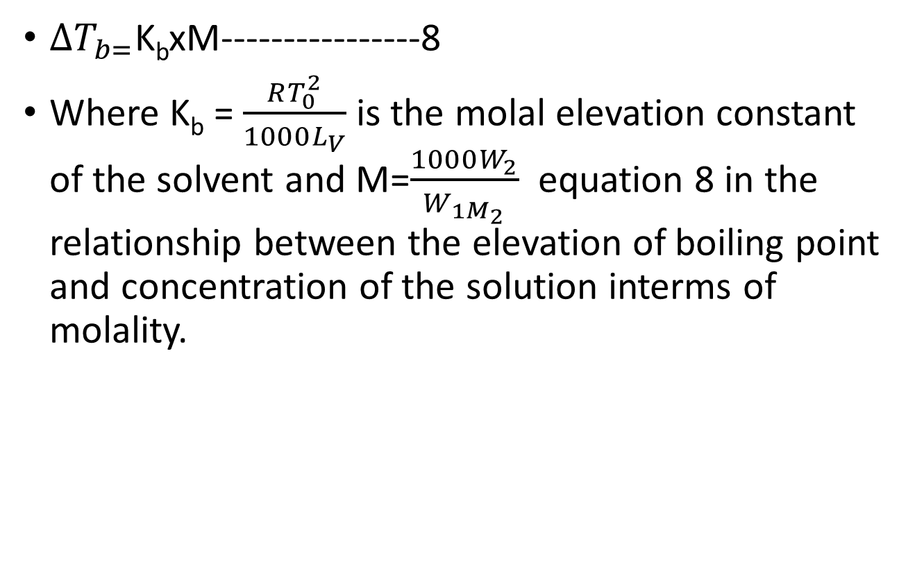
$∆T_{b=}$K_{b}xM----------------8
Where K_{b} = $\frac{RT_{0}^{2}}{1000L_{V}}$ is the molal elevation constant of the solvent and M=$\frac{1000W_{2}}{W_{1M_{2}}}$ equation 8 in the relationship between the elevation of boiling point and concentration of the solution interms of molality.

Slide 7
Thank You

