Slide 1

Queen Anne
18th Century England
Presentation by,
G.Sowdambika
Guest Lecturer
English Department(SF)
C.P.A.College,Bodinayakanur

Slide 2
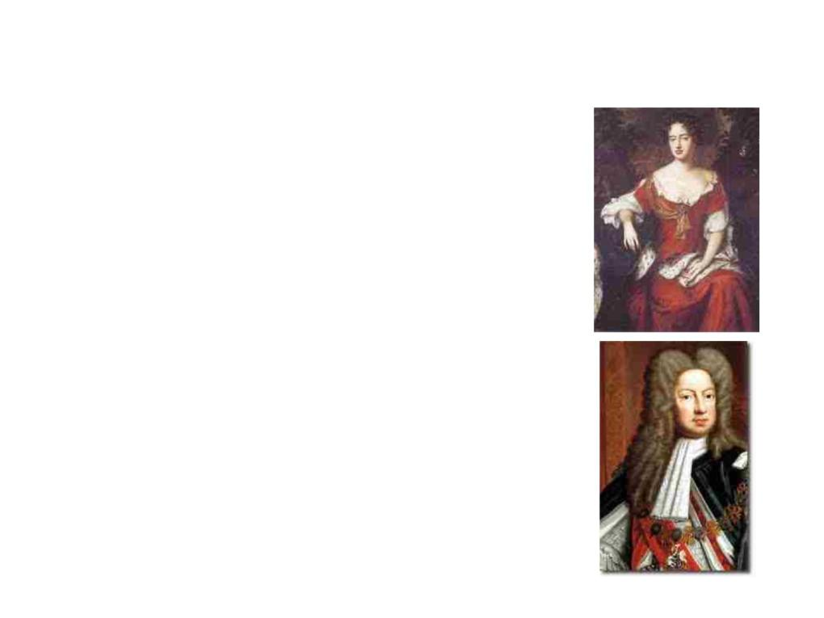
18th Century England
• In 1702 Queen Anne
began her reign.
• George I became king in
1714. He was also the
ruler of Hanover (part of
Germany) and he much
preferred to stay there.
George could not speak
English and was content
to leave the running of
Britain to his ministers.

Slide 3

• In 1711 the South Sea Company was formed. It was
given exclusive rights to trade with the Spanish
colonies in South America. (It transported many slaves
from Africa to South America). In 1720 shares in the
company became massively overpriced. Then the share
price collapsed. (The South Sea Bubble burst) and
many investors lost huge sums of money.
• From 1721 Robert Walpole (1676-1745) became the
king's chief minister. People began to call him Prime
Minister (Originally it was a term of abuse not an
official title). Walpole moved into Downing Street in
1735.
• 10 Downing Street became the Prime Minister's official
residence in 1732.

Slide 4
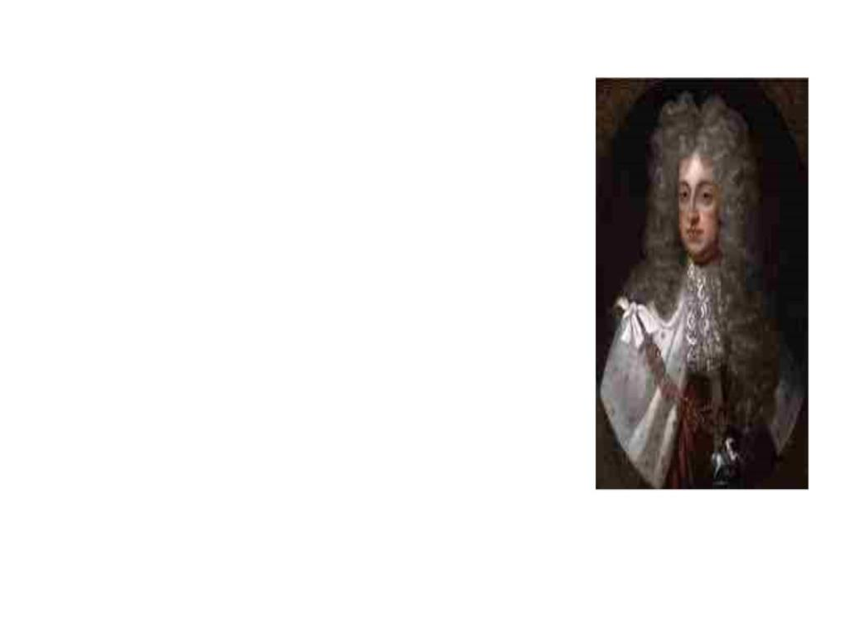
• George I died in 1727 and was
succeeded by his son George II.
Like his father George II was
content to leave government
largely in the hands of his
ministers. However he was the
last British king to lead an army
into battle. He led them to
victory against the French at
Dettingen in June 1743.

Slide 5
Religion in the 18th C.
• In the early 18th century England was notable for its lack of
religious zeal.
• Most people went to church on Sunday but very often they were
indifferent.
• Some of the clergy continued to do good work but generally there
was a lack of energy in the church.
• This began to change in the 1730s. First a man named George
Whitefield (1714-1770) became a great preacher. It was said that he
could preach to crowds of 20,000 people (without a microphone).
• Then in 1738 John Wesley (1703-1791) founded the Methodists.
Wesley did not want to break with the Church of England. He
wanted his followers to remain within it but in the end this proved
impossible and the Methodists were forced to become a separate
denomination.
• Meanwhile at the end of the 18th century religious enthusiasm
began to revive. Within the Church of England there were a number
of Evangelicals campaigning for an end to slavery.

Slide 6
• Finally in the 18th century there was a wave of
enclosures.
• When an act of enclosure was passed
commissioners divided up the land in the
village so each farmer had all his land in one
place.
• In 1756 Britain became embroiled in the
Seven Years War (1756-1763) with France.
• They won a great victory at Quebec. That
ensured that Canada became a British colony
rather than a French one.

Slide 7

• Meanwhile in 1760 George II died at the age
of 77.
• George III succeeded him. The first two
George's were content to leave government
in the hands of their ministers. However,
according to his enemies, George III tried to
gain more power for himself.
• During his reign Britain lost her colonies in
North America. Fighting began in 1775 and
the colonists declared themselves
independent in 1776.
• George was determined to suppress the
colonists, ignoring the wishes of those who
wanted reconciliation.
• However the Americans won a decisive
victory at Yorktown in 1781, which ensured
their independence..

Slide 8
• Meanwhile London was rocked by the anti-Catholic
Gordon riots in 1780.
• Riots were common in the 18th century. The workers
could not vote and there were no trade unions so if the
workers were disaffected they rioted.
• The Gordon riot was the worst. Lord George Gordon
(1751-1793) was an MP who led a huge crowd to
parliament to present a petition demanding the repeal
of a 1778 act, which removed certain restrictions on
Roman Catholics.
• The demonstration became a riot. With cries of 'No
Popery!' the rioters held London for several days until
the army restored order. About 300 people died in the
rioting.

Slide 9
The Industrial Revolution
• In the late 18th century everyday life in Britain was
transformed by the industrial revolution. Towns, industry and
trade had been growing for centuries but about 1780
economic growth took off.
• A number of technological advances made the revolution
possible.
• The first industry to become mechanized was the textile
industry.
• In 1771 Richard Arkwright opened a cotton-spinning mill with
a machine called a water frame, which was powered by a
water mill.
• Then, in 1779, Samuel Crompton invented a new cotton-
spinning machine called a spinning mule.
• Finally in 1785 Edmund Cartwright invented a loom that could
be powered by a steam engine.
• As a result of these new inventions cotton production
boomed.

Slide 10
• During the 19th century Britain was
transformed by the industrial revolution. In
1801, at the time of the first census, only
about 20% of the population lived in towns. By
1851 the figure had risen to over 50%. By
1881 about two thirds of the population lived
in towns.

Slide 11
Society in the 18th C. Britain
• Britain built up a great overseas empire.
• The North American colonies were lost after the War of
Independence 1776-1783.
• On the other hand after the Seven Years War 1756-
1763 Britain captured Canada and India. Britain also
took Dominica, Grenada, St Vincent and Tobago in the
West Indies.
• In 1707 the Act of Union was passed. Scotland was
united with England and Wales. England became part
of Great Britain.
• In the mid 18th century the population of Britain was
about 6 1/2 million. In the late 18th century it grew
rapidly and by 1801 it was over 9 million.

Slide 12
• Owning land was the main form of wealth in the
18th century.
• Political power and influence was in the hands of
rich landowners.
• At the top were the nobility. Below them were a
class of nearly rich landowners called the gentry.
• However other middle class people such as
merchants and professional men became richer
and more numerous, especially in the towns.
• Below them were the great mass of the
population, craftsmen and labourers.

Slide 13
Leisure in 18th Century Britain
• Traditional games remained popular in the
18th century. These included games such as
chess, draughts and backgammon. They also
tennis and a rough version of football.
• Horse racing was carried on for centuries
before the 18th century but at this time it
became a professional sport. The Jockey Club
was formed in 1727. The Derby began in 1780.
• For the rich card games and gambling were
popular. The theatre was also popular.
• In London pleasure gardens were created.

Slide 14
• Reading was also a popular pastime in the
18th century and the first novels were
published at this time. Books were still
expensive but in many towns you could pay to
join a circulating library. The first daily
newspaper in England was printed in 1702.
The Times began in 1785.
• Rich people liked fox hunting.
• Public executions were also popular and they
drew large crowds.

Slide 15
18th c. Education
• In the early 18th century charity schools were founded in
many towns in England.
• They were sometimes called Blue Coat Schools because of
the colour of the children's uniforms.
• Boys from well off families went to grammar schools. Girls
from well off families also went to school but it was felt
important for them to learn 'accomplishments' like
embroidery and music rather than academic subjects.
• However non-comformists or dissenters (Protestants who
did not belong to the Church of England) were not allowed
to attend most public schools. Instead they went to their
own dissenting academies.

Slide 16

• John Locke was one of the most influential
Enlightenment thinkers.
• He influenced other thinkers such as Rousseau,
Voltaire, among others.
• "He is one of the dozen or so thinkers who are
remembered for their influential contributions
across a broad spectrum of philosophical subfields
--in Locke's case, across epistemology, the
philosophy of language, the philosophy of mind,
metaphysics, rational theology, ethics, and
political philosophy.“
• He is still known today for his liberalism in political
theory.
• The main goal that most people remember about
him is his famous words of " Life, Liberty and
Property."
• With property he stated that it is a natural right
derived from labor.

