Slide 1
Pressure and Osmotic pressure
Dr. B. Kavitha
Assistant Professor
PG and Research Department of Chemistry
C.P.A. College, Bodinayakanur

Slide 2
Pressure and Osmotic pressure
It is possible to apply thermodynamics to derive a relation between osmatic pressure and vapour lowering of an ideal solution. During osmosis, transfer of solvent into a solution occurs because the chemical potential of the pure solvent (μ₀) is greater than that of the solution (μ) at constant T and atmospheric pressure.
μ⁰ > μ
We know
μ = μ⁰ + RTlnx₁
In order to bring about equilibrium between the solvent and solution ie., in order to prevent the flow of the solvent into the solution it is necessary to apply some additional pressure applied is equal to the osmotic pressure (Π) of the solution. Thus the total external pressure on the solution of the semipermeable membrane has been increased from 1 atm to (1+ Π) atm.

Slide 3
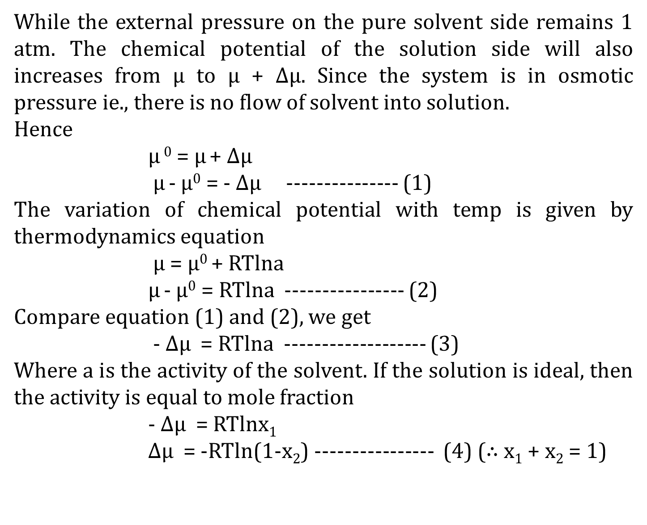
While the external pressure on the pure solvent side remains 1 atm. The chemical potential of the solution side will also increases from μ to μ + Δμ. Since the system is in osmotic pressure ie., there is no flow of solvent into solution.
Hence
μ ⁰ = μ + Δμ
μ - μ⁰ = - Δμ --------------- (1)
The variation of chemical potential with temp is given by thermodynamics equation
μ = μ⁰ + RTlna
μ - μ⁰ = RTlna ---------------- (2)
Compare equation (1) and (2), we get
- Δμ = RTlna ------------------- (3)
Where a is the activity of the solvent. If the solution is ideal, then the activity is equal to mole fraction
- Δμ = RTlnx₁
Δμ = -RTln(1-x₂) ---------------- (4) ($∴$ x₁ + x₂ = 1)

Slide 4
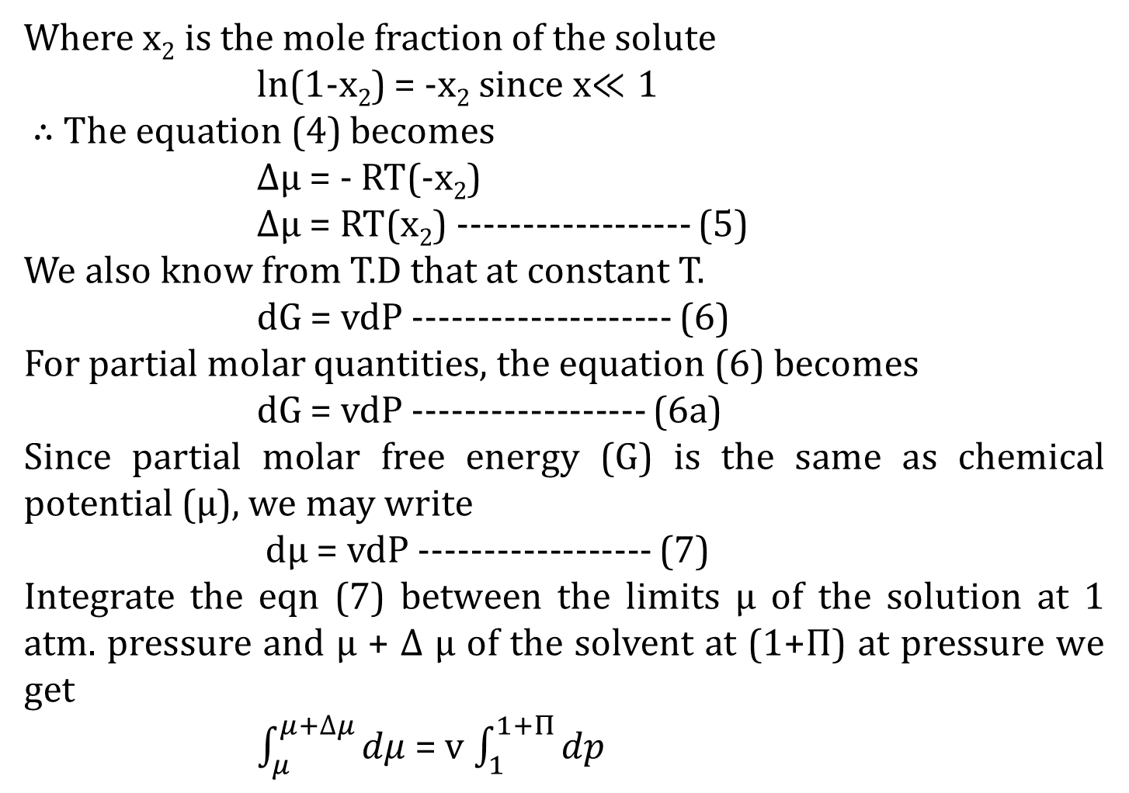
Where x₂ is the mole fraction of the solute
ln(1-x₂) = -x₂ since x$≪1$
$∴$ The equation (4) becomes
Δμ = - RT(-x₂)
Δμ = RT(x₂) ------------------ (5)
We also know from T.D that at constant T.
dG = vdP -------------------- (6)
For partial molar quantities, the equation (6) becomes
dG = vdP ------------------ (6a)
Since partial molar free energy (G) is the same as chemical potential (μ), we may write
dμ = vdP ------------------ (7)
Integrate the eqn (7) between the limits μ of the solution at 1 atm. pressure and μ + Δ μ of the solvent at (1+Π) at pressure we get
$\int_{μ}^{μ+∆μ}{dμ}$ = v $\int_{1}^{1+Π}{dp}$

Slide 5
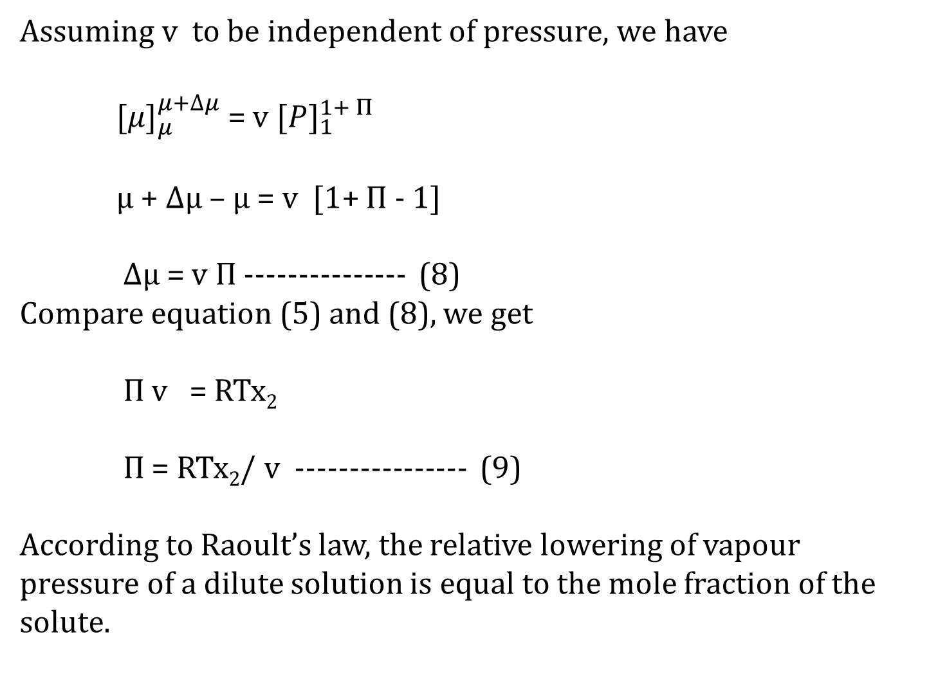
Assuming v to be independent of pressure, we have
${[μ]}_{μ}^{μ+∆μ}$ = v ${{[P]}_{1}^{1+ Π}}^{}$
μ + Δμ – μ = v [1+ Π - 1]
Δμ = v Π --------------- (8)
Compare equation (5) and (8), we get
Π v = RTx₂
Π = RTx₂/ v ---------------- (9)
According to Raoult’s law, the relative lowering of vapour pressure of a dilute solution is equal to the mole fraction of the solute.

Slide 6
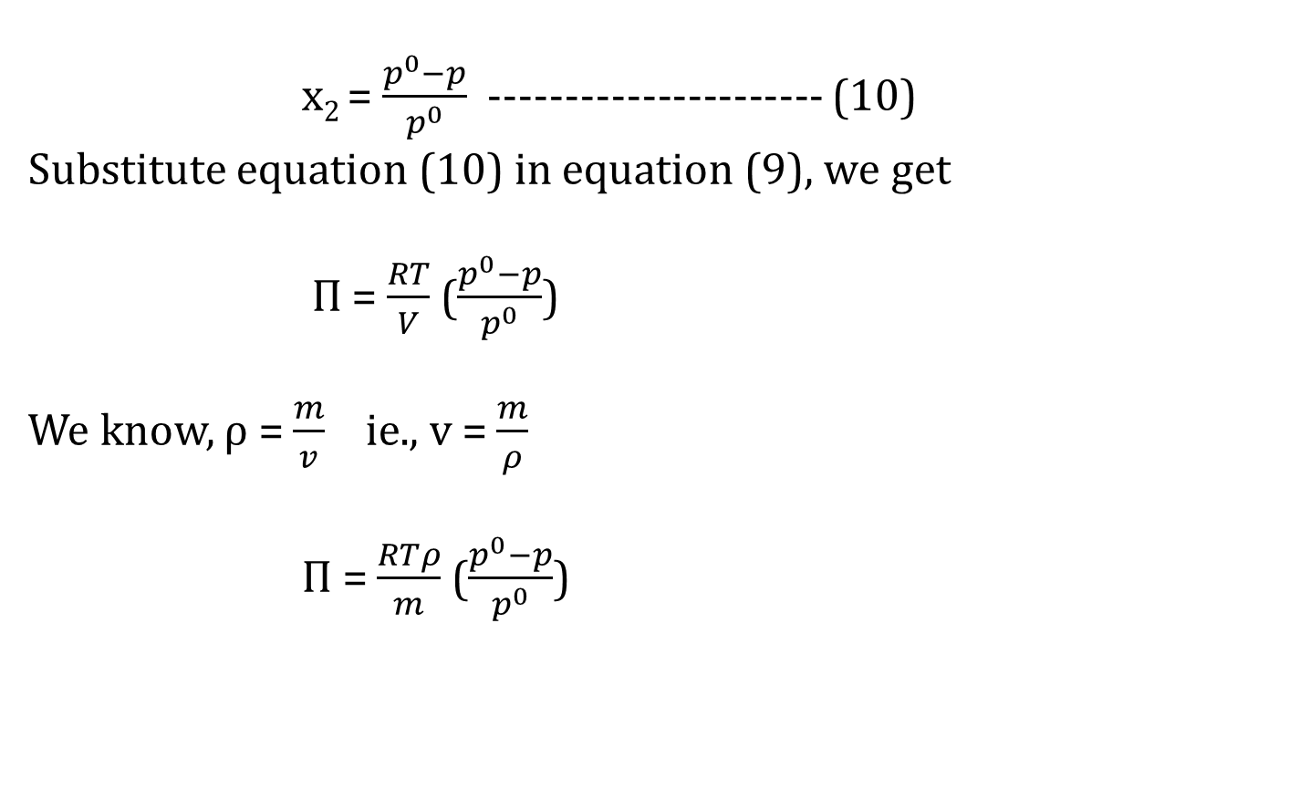
x₂ = $\frac{p^{0}−p}{p^{0}}$ ---------------------- (10)
Substitute equation (10) in equation (9), we get
Π = $\frac{RT}{V}$ ($\frac{p^{0}−p}{p^{0}}$)
We know, ρ = $\frac{m}{v}$ ie., v = $\frac{m}{ρ}$
Π = $\frac{RTρ}{m}$ ($\frac{p^{0}−p}{p^{0}}$)

Slide 7
Thank You

