Slide 1
NUCLEAR PHYSICS
BY
MARIASTEFFI.S
ASSISTANT PROFESSOR OF PHYSICS
CPA COLLEGE, BODINAYAKANUR

Slide 2
CONTENT
Introduction
Classification of Nuclei
Fission Vs Fusion
Nuclear chain reaction
Cosmic ray Shower
Applications

Slide 3
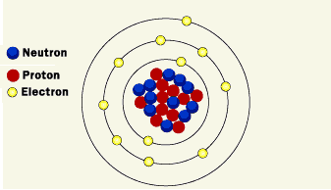
INTRODUCTION
Atomic nucleus is composed of protons and neutrons Protons and neutrons have approximately the same mass, but protons carry one unit of positive charge (+e) and neutrons carry no charge.

Slide 4
CLASSIFICATION OF NUCLEI
Isotopes
They are atoms of the same element having the same atomic number Z but different mass number A. The nuclei ₁H ¹, ₁H² and ₁H³ are the isotopes of hydrogen.
Isobars
They are atoms of different elements having the same mass number A, but different atomic number Z. The nuclei ₈O¹⁶ and ₇N¹⁶ represent two isobars.
Isotones
They are atoms of different elements having the same number of neutrons. ₆C¹⁴ and ₈O¹⁶ are some examples of isotones.

Slide 5
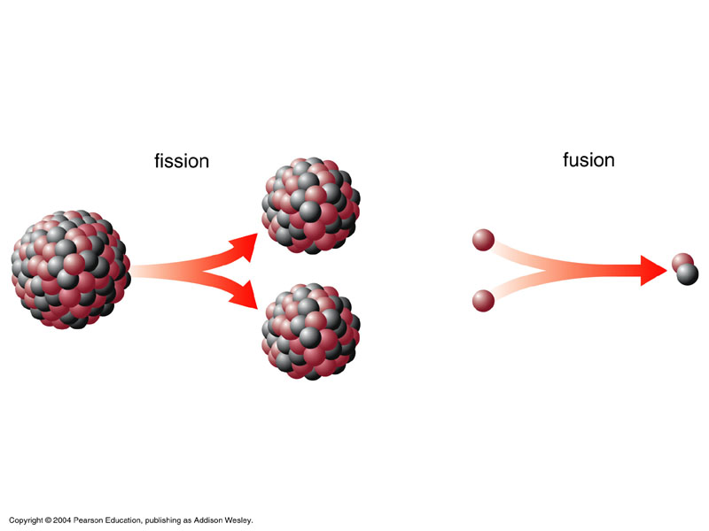
FISSION VS FUSION

Slide 6
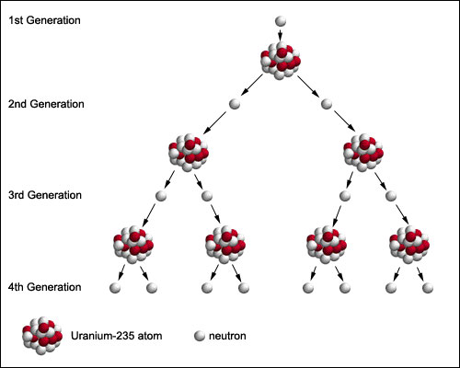
Nuclear Chain Reactions
A chain reaction refers to a process in which neutrons released in fission produce an additional fission in at least one further nucleus. This nucleus in turn produces neutrons, and the process repeats.
The process may be controlled (nuclear power) or uncontrolled (nuclear weapons).

Slide 7
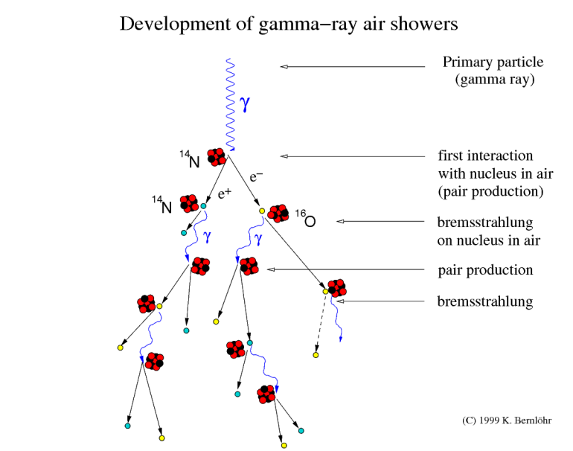
COSMIC-RAY SHOWER
A shower of ionizing particles originating in bombardment by a single cosmic ray that reveals itself by leaving tracks in a cloud chamber or by actuating a counting tube

Slide 8
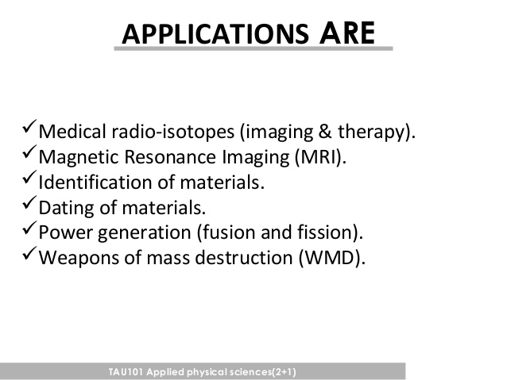

Slide 9
THANK YOU

