Slide 1
Nernst Heat Theorem and Raoult’s Law
Dr. B. Kavitha
Assistant Professor
PG and Research Department of Chemistry
C.P.A. College, Bodinayakanur

Slide 2
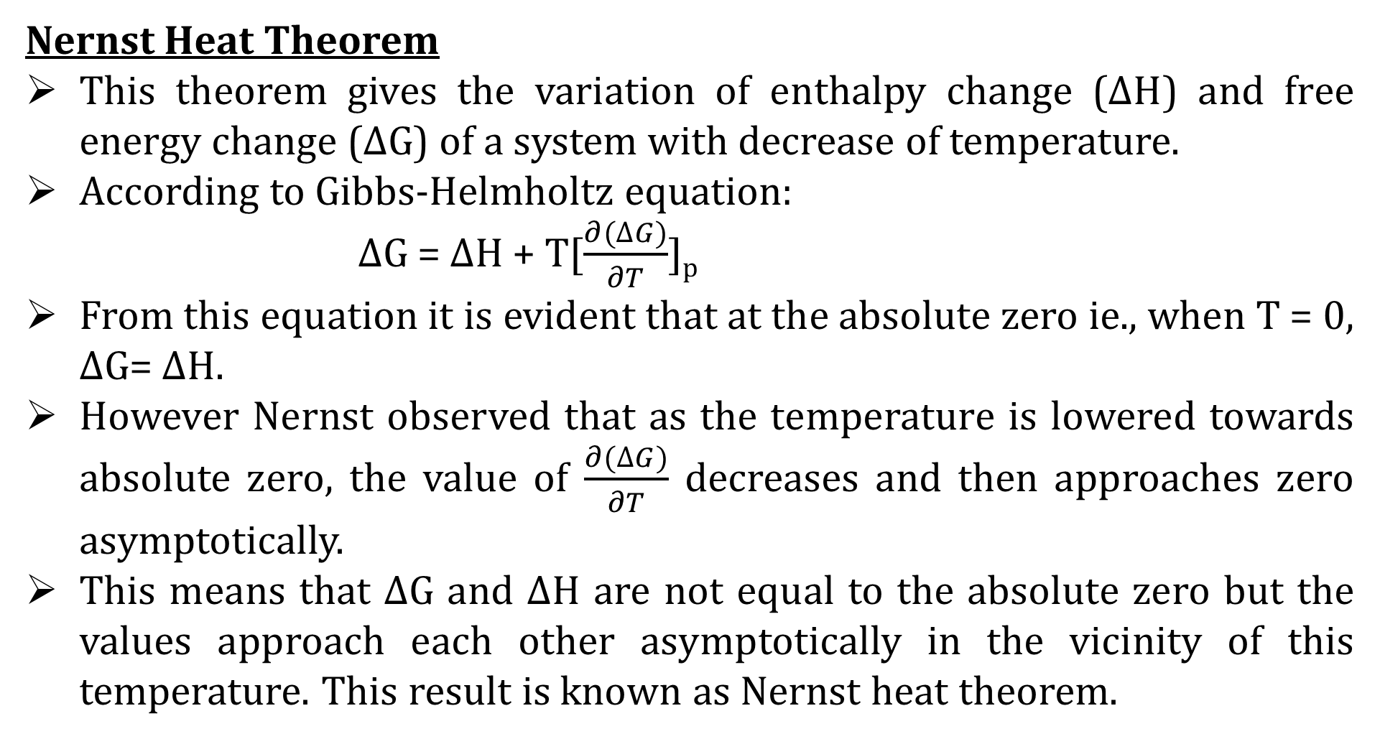
Nernst Heat Theorem
This theorem gives the variation of enthalpy change (ΔH) and free energy change (ΔG) of a system with decrease of temperature.
According to Gibbs-Helmholtz equation:
ΔG = ΔH + T[$\frac{∂(∆G)}{∂T}$]_{p}
From this equation it is evident that at the absolute zero ie., when T = 0, ΔG= ΔH.
However Nernst observed that as the temperature is lowered towards absolute zero, the value of $\frac{∂(∆G)}{∂T}$ decreases and then approaches zero asymptotically.
This means that ΔG and ΔH are not equal to the absolute zero but the values approach each other asymptotically in the vicinity of this temperature. This result is known as Nernst heat theorem.

Slide 3
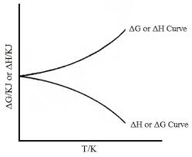
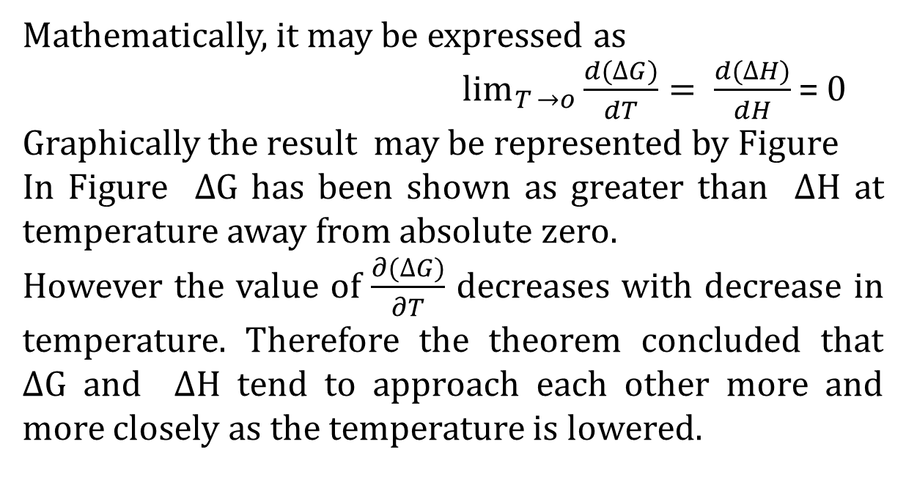
Mathematically, it may be expressed as
$\lim_{T →o}{\frac{d(∆G)}{dT}= \frac{d(∆H)}{dH}}$ = 0
Graphically the result may be represented by Figure
In Figure ΔG has been shown as greater than ΔH at temperature away from absolute zero.
However the value of $\frac{∂(∆G)}{∂T}$ decreases with decrease in temperature. Therefore the theorem concluded that ΔG and ΔH tend to approach each other more and more closely as the temperature is lowered.
Colligative properties
A colligative property depend on the number of solute particles in solution and it is independent of their nature

Slide 4
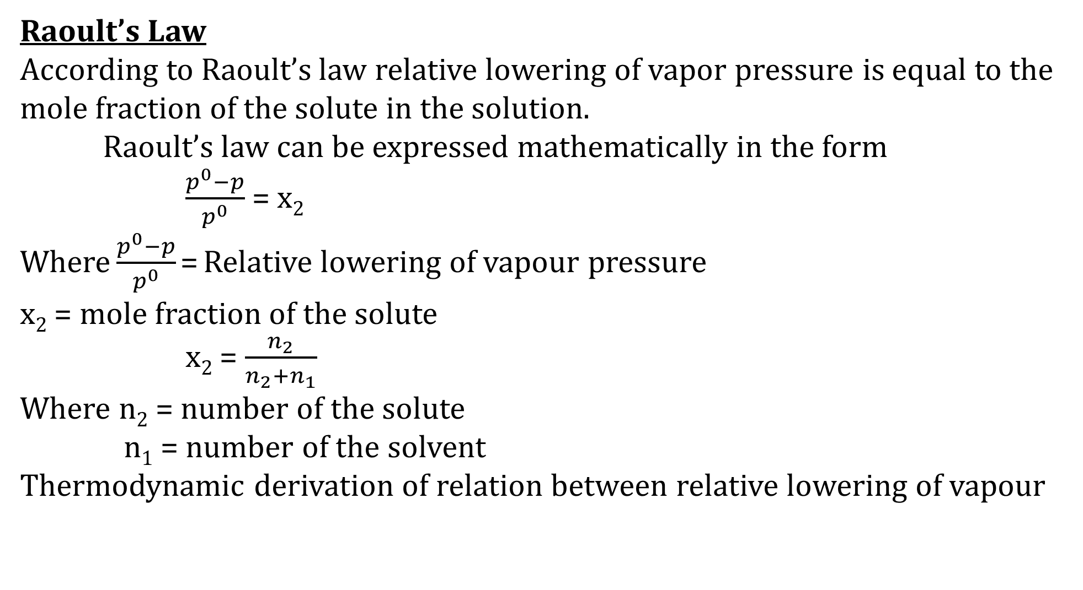
Raoult’s Law
According to Raoult’s law relative lowering of vapor pressure is equal to the mole fraction of the solute in the solution.
Raoult’s law can be expressed mathematically in the form
$\frac{p^{0}−p}{p^{0}}$ = x₂
Where $\frac{p^{0}−p}{p^{0}}$ = Relative lowering of vapour pressure
x₂ = mole fraction of the solute
x₂ = $\frac{n_{2}}{n_{2}+n_{1}}$
Where n₂ = number of the solute
n₁ = number of the solvent
Thermodynamic derivation of relation between relative lowering of vapour

Slide 5
Thank You

