Slide 1
MATERIAL SCIENCE
DEPARTMENT OF PHYSICS (SF)
PREPARED BY
PROF.R.YOGA
GUEST LECTURER
CPA COLLEGE
BODI.

Slide 2
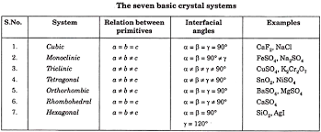
CRYSTAL STRUCTURE

Slide 3
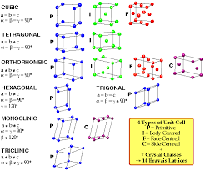

Slide 4
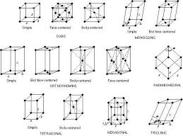

Slide 5
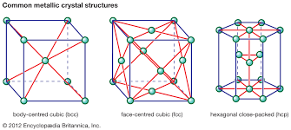

Slide 6
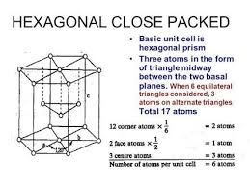

Slide 7
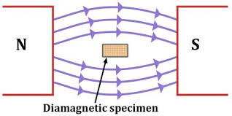
MAGNETIZATION MATERIALS
Diamagnetism is a quantum mechanical effect that occurs in all materials; when it is the only contribution to the magnetism, the material is called diamagnetic.

Slide 8
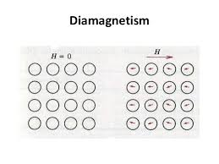

Slide 9
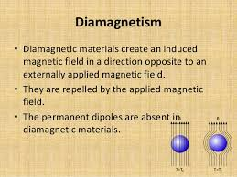

Slide 10
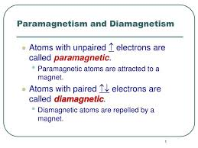

Slide 11
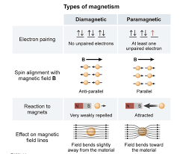

Slide 12
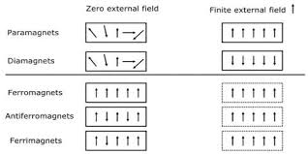

Slide 13
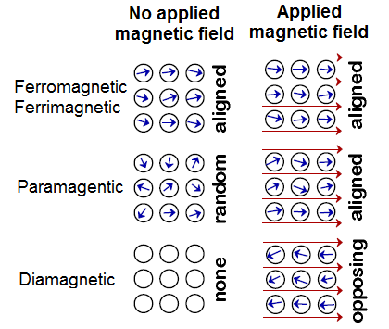

Slide 14
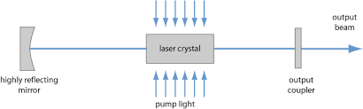
LASER PRINCIPLE

Slide 15
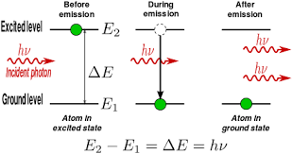

Slide 16
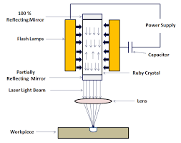

Slide 17
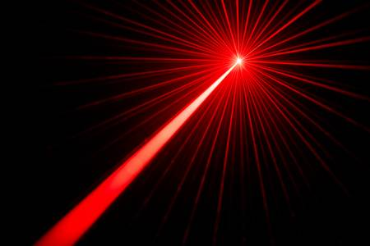

Slide 18
