Slide 1
Macbeth by William Shakespeare
Presentation by,
G.Sowdambika
Guest Lecturer
English Department(SF)
C.P.A.College,Bodinayakanur

Slide 2
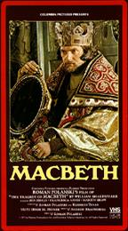
Shakespeare’s
Macbeth
AP Literature, Elaine Kaye, GCHS

Slide 3
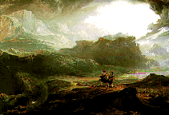
Introduction to Macbeth
Macbeth is another one of Shakespeare’s great tragedies, based on Holinshed’s Chronicles of England, Scotland, and Ireland. It was written around 1605 but was not published in the first Folio until 1623. It tells about the fall of the ambitious couple, Macbeth and Lady Macbeth. Macbeth is the tragic hero, a character who has a fatal (tragic)flaw within himself that he cannot change. He is not a bad person; he is just too ambitious. Macbeth is a story about the murder of a king by his brother, the revenge of a son (Macbeth), three witches who plot against Macbeth, and Macbeth’s rise and fall.

Slide 4
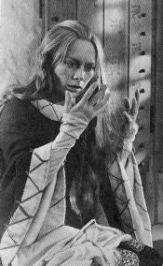
Macbeth is an interesting character to follow. As you read, you can see how he has changed. We first meet Macbeth as a brave soldier and later find him as a murderer who kills everyone who is in his way of the throne. Lady Macbeth is also a well-developed character. She is conniving and ruthless, though she does seem to have some humane qualities.

Slide 5
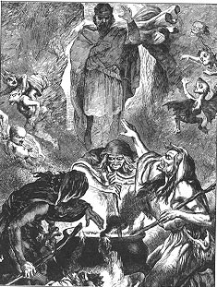
The play opens in Scotland. Macbeth and Banquo have defeated their enemies in battle, leading King Duncan to give the title of thane of Cawdor to Macbeth (who doesn’t know this yet). While Macbeth and Banquo are walking, they encounter three chanting witches. The witches speak to Macbeth as thane of Glamis, thane of Cawdor, and king hereafter. They also tell Banquo that though we will not be king, he will beget kings (i.e., his sons will be kings). Macbeth wonders about this prediction as the king’s messenger arrives. He tells him that he has been appointed thane of Cawdor. Macbeth is momentarily tempted to kill the king in order to fulfill the prophesy, but decides not to.

Slide 6
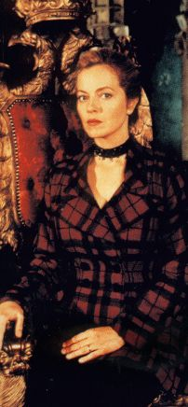
Lady Macbeth, however, urges her husband to kill the king. Since the king is staying at their castle overnight, that must be when they kill him. She plans the whole thing, making the king’s guards drunk. By using their daggers to kill the king and putting the king’s blood on them, Lady Macbeth will frame the guards. It is now time for Macbeth to stab the king. Though he has bad visions and feelings, Macbeth kills the king. Afterwards, he is troubled. "I am afraid to think what I have done; Look on ‘t again I dare not," he says.

Slide 7
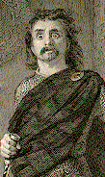
The next morning, the murder is blamed on the guards. Macbeth kills them before they can protest, explaining that he killed them out of rage. The king’s sons, however, are still fearful for their lives and runaway. Macbeth is crowned king. Macbeth knows that Banquo is suspicious of him. When Macbeth learns that Banquo and his son are riding, he sends men out to kill them. They are only half successful in their job, and Banquo’s son escapes. Meanwhile, at Macbeth’s ball, the seat for Banquo is empty (because he’s dead). In the empty seat, the ghost of Banquo appears, frightening Macbeth to death.

Slide 8
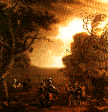
Macbeth also learns that King Duncan’s son Malcolm and Lord Macduff are attempting to kill him. Unsure of what to do, Macbeth visits the three witches again. The witches, along with the moon goddess Hecate, have planned what they will tell Macbeth in order to destroy him. They prepare a brew, singing "Double, double, toil and trouble; Fire burn and cauldron bubble." When Macbeth arrives, they give him a false hope, telling him three things. First, beware of Macduff. Second, "none of woman born shall harm Macbeth." Third, Macbeth will not be conquered until Birnam wood comes to the hill of Dunsinane. They also tell Macbeth that Banquo’s descendents will become kings.

Slide 9
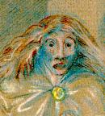
Macduff has left for England, so Macbeth sends people to kill his wife and children. In England, Macduff befriends the dead king’s son, after they are sure of the other’s loyalty.
Lady Macbeth has begun sleepwalking because her conscience weighs too heavily on herself. She tells about her crimes and the murder of the king, unaware that her doctor and waiting woman are watching her. She later dies, possibly from suicide.

Slide 10
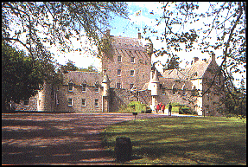
The invaders from England have come to defeat Macbeth. The soldiers carry boughs from Birnam Wood in order to camouflage themselves. So, the witch’s prophesy of defeat when "Birnam forest come to Dunsinane" starts to become true. Macbeth then faces Macduff, but isn’t really scared. He has been told that he will not die from anyone woman born. But then Macduff tells him that he was not woman born; he was "from his mother’s womb untimely ripp’d" (C-section). When Macbeth realizes that he has been tricked, he gives up and is killed. Macduff decapitates him and King Duncan’s son becomes the new king of Scotland.

Slide 11
Macbeth: brave general under Duncan who becomes too ambitious after three witches prophesy that he will be King of Scotland. He turns to evil, killing the King, the guards, Banquo, and others. Macbeth dies at the hands of Macduff.
Lady Macbeth: vicious wife of Macbeth, even more ambitious than Macbeth. She convinces Macbeth to murder the King. Later, she becomes insane from her wrongdoings and sleepwalks. She dies.
Macduff: general, believes that Macbeth killed the King. His family is murdered by Macbeth; he later kills Macbeth.

Slide 12
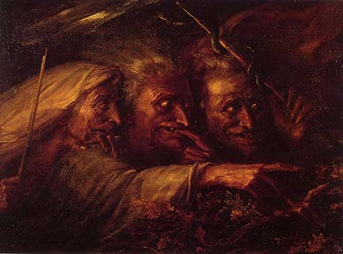
Banquo: Macbeth’s friend and general, suspected Macbeth of killing the King. He is killed by murderers sent by Macbeth, though his son escapes.
King Duncan: King of Scotland, murdered by Macbeth who was one of his generals whom he had just promoted.
Malcolm: Duncan’s eldest son, runs away to England after he learns of his father’s murder in order to escape the same fate. Becomes King of Scotland at the end of the play.
The three witches: They tell Macbeth that he is to become King, leading him to evil. They also tell him that he will be defeated, but they disguise it in a way as to give him false confidence.

Slide 13
Hecate: moon goddess and goddess of the witches, directs supernatural occurrences. Makes plan to give Macbeth false security.
Donalbain: Duncan’s youngest son, runs away to Ireland after he learns of his father’s murder in order to escape the same fate
Ross: Macduff’s cousin, messenger who carries news to people like Macbeth and Macduff throughout the play.
Lennox: nobleman, suspicious of the murder of the king
Seyton: Macbeth’s lieutenant.
Porter: watches Macbeth’s castle; when drunk, thought that he was the keeper of Hell’s Gates and that sinners were knocking at the door to be admitted.
Old Siward: Earl of Northumberland, ally of Malcolm and Macduff against Macbeth.
Young Siward: Old Siward’s son, killed by Macbeth in an encounter at the end of the play.

Slide 14
Seyton: Macbeth’s lieutenant.
Porter: watches Macbeth’s castle; when drunk, thought that he was the keeper of Hell’s Gates and that sinners were knocking at the door to be admitted.
Old Siward: Earl of Northumberland, ally of Malcolm and Macduff against Macbeth.
Young Siward: Old Siward’s son, killed by Macbeth in an encounter at the end of the play.
Begin excerpt of Macbeth, produced by Notley HS

Slide 15
This powerpoint was kindly donated to www.worldofteaching.com
http://www.worldofteaching.com is home to over a thousand powerpoints submitted by teachers. This is a completely free site and requires no registration. Please visit and I hope it will help in your teaching.

