Slide 1
Acid –Base concepts-5
Dr.G.Indramahalakshmi,M.Sc.,M.Phil.,M.Ed.,P.hd.,
Associate Professor,
Cardamom Planters Association College,
Bodinayakanur, Theni.

Slide 2
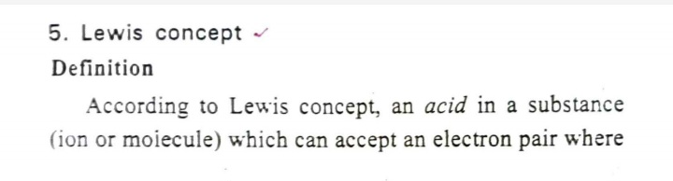

Slide 3
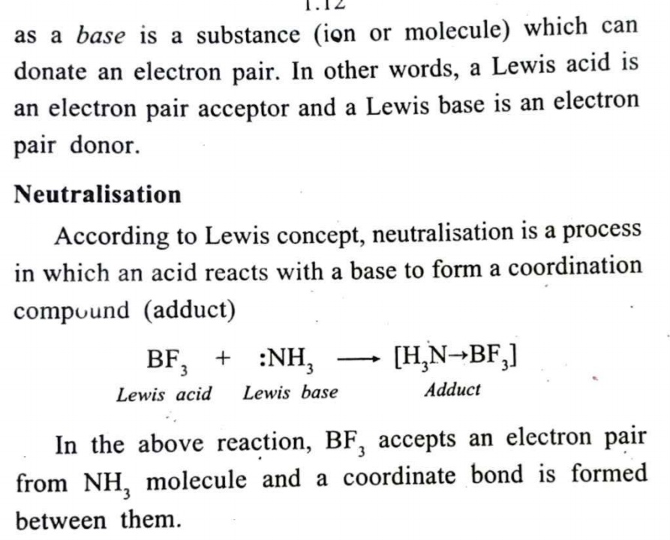

Slide 4
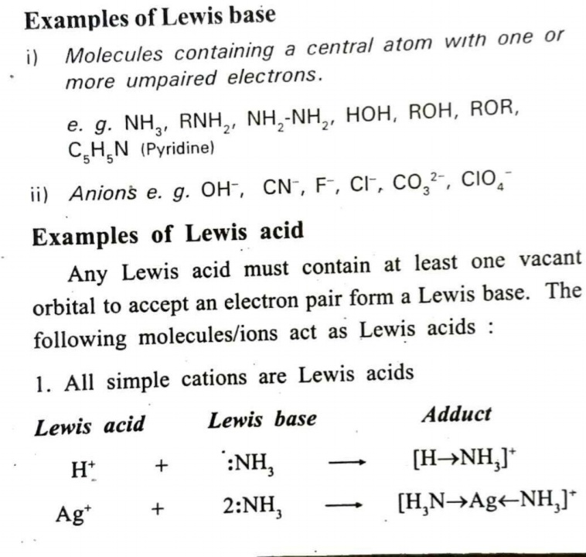

Slide 5
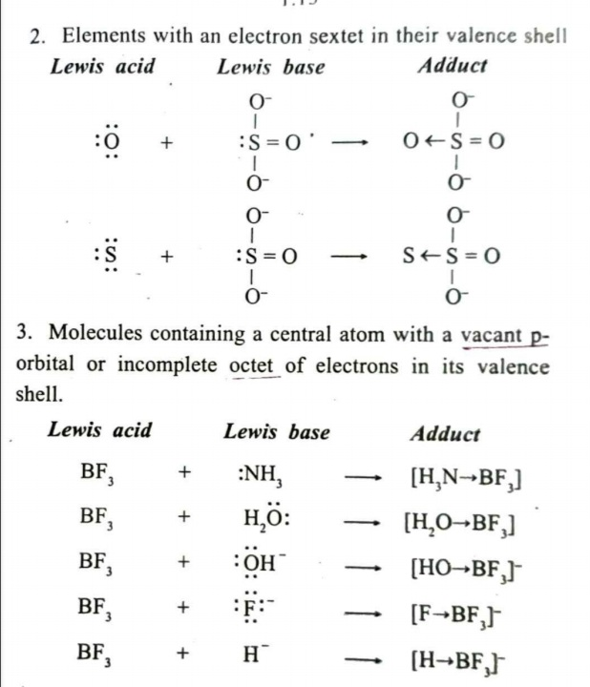

Slide 6
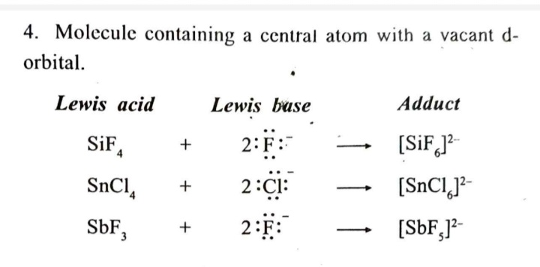

Slide 7
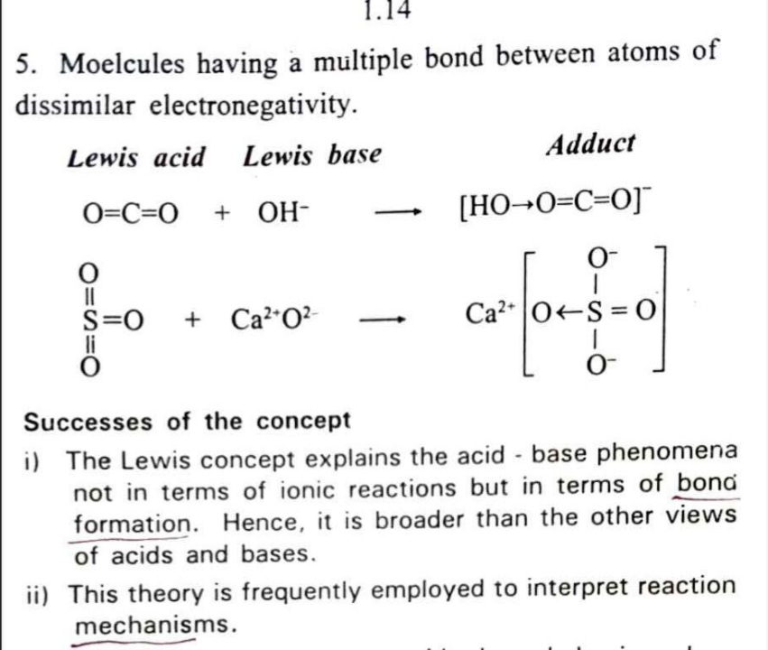

Slide 8
