Slide 1
Le-Chatlier- Braun Principle
Dr. B. Kavitha
Assistant Professor
PG and Research Department of Chemistry
C.P.A. College, Bodinayakanur

Slide 2
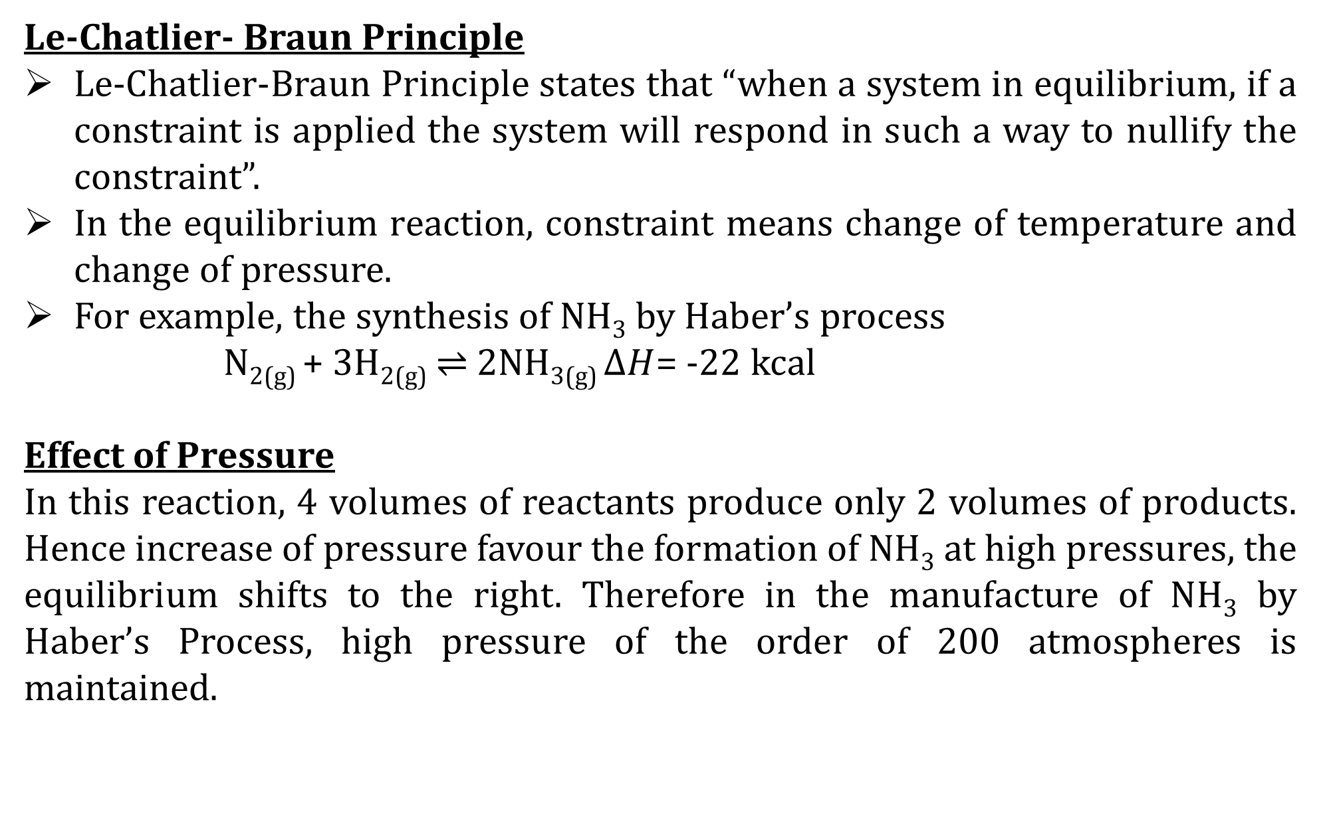
Le-Chatlier- Braun Principle
Le-Chatlier-Braun Principle states that “when a system in equilibrium, if a constraint is applied the system will respond in such a way to nullify the constraint”.
In the equilibrium reaction, constraint means change of temperature and change of pressure.
For example, the synthesis of NH₃ by Haber’s process
N_{2(g)} + 3H_{2(g)} $⇌$ 2NH_{3(g)} $∆H$= -22 kcal
Effect of Pressure
In this reaction, 4 volumes of reactants produce only 2 volumes of products. Hence increase of pressure favour the formation of NH₃ at high pressures, the equilibrium shifts to the right. Therefore in the manufacture of NH₃ by Haber’s Process, high pressure of the order of 200 atmospheres is maintained.

Slide 3
Effect of temperature
The formation of NH₃ from N₂ and H₂ is an exothermic reaction. The reverse reaction is endothermic.
Hence, increase of temperature favours the reverse reaction. Therefore low temperature will shift the equilibrium to the right.
At low temperatures, the rate of reaction low and long-time is required for establishment of equilibrium . Therefore optimum temperature 450⁰ has to he used.
At this temperature the reaction is sufficiently fast and the fraction of NH₃ that is decomposed is also small. To increase the rate of reaction, Finely divided Fe Containing Mo catalyst is used

Slide 4
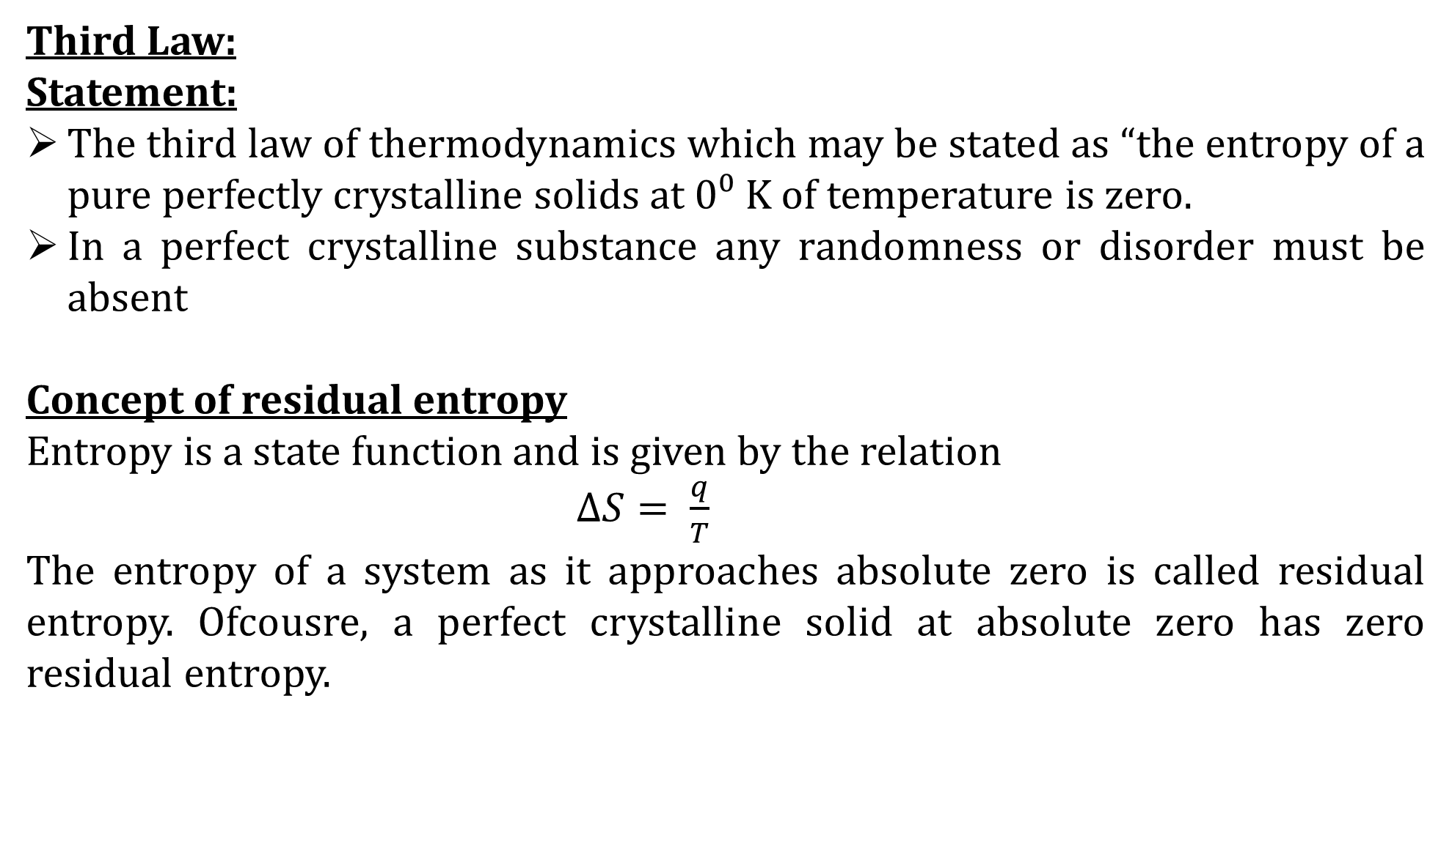
Third Law:
Statement:
The third law of thermodynamics which may be stated as “the entropy of a pure perfectly crystalline solids at 0⁰ K of temperature is zero.
In a perfect crystalline substance any randomness or disorder must be absent
Concept of residual entropy
Entropy is a state function and is given by the relation
$∆S= \frac{q}{T}$
The entropy of a system as it approaches absolute zero is called residual entropy. Ofcousre, a perfect crystalline solid at absolute zero has zero residual entropy.

Slide 5
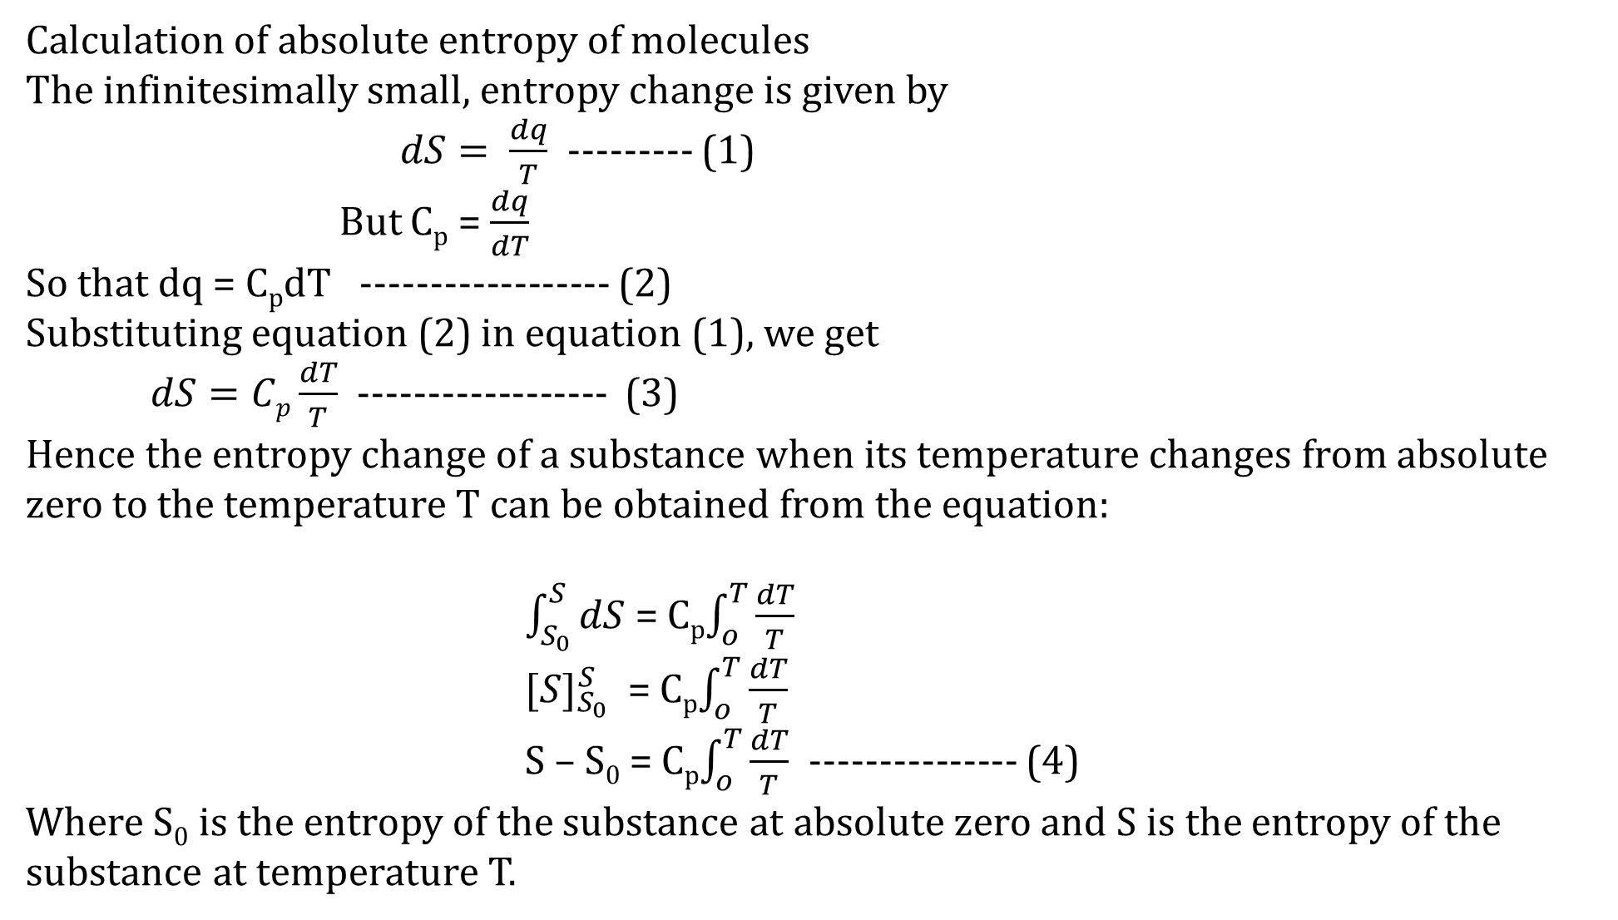
Calculation of absolute entropy of molecules
The infinitesimally small, entropy change is given by
$dS= \frac{dq}{T}$ --------- (1)
But C_{p} = $\frac{dq}{dT}$
So that dq = C_{p}dT ------------------ (2)
Substituting equation (2) in equation (1), we get
$dS=Cp\frac{dT}{T}$ ------------------ (3)
Hence the entropy change of a substance when its temperature changes from absolute zero to the temperature T can be obtained from the equation:
$\int_{S_{0}}^{S}{dS}$ = C_{p}$\int_{o}^{T}{\frac{dT}{T}}$
${[S]}_{S_{0}}^{S}$ = C_{p}$\int_{o}^{T}{\frac{dT}{T}}$
S – S₀ = C_{p}$\int_{o}^{T}{\frac{dT}{T}}$ --------------- (4)
Where S₀ is the entropy of the substance at absolute zero and S is the entropy of the substance at temperature T.

Slide 6
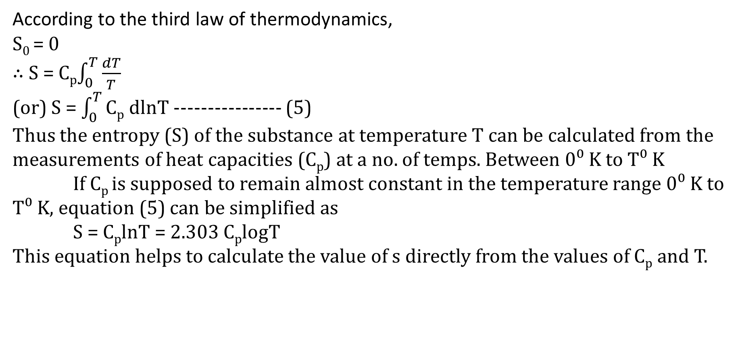
According to the third law of thermodynamics,
S₀ = 0
$∴$S = C_{p}$\int_{0}^{T}{\frac{dT}{T}}$
(or) S = $\int_{0}^{T}{\text{C}\text{p}}$ dlnT ---------------- (5)
Thus the entropy (S) of the substance at temperature T can be calculated from the measurements of heat capacities (C_{p}) at a no. of temps. Between 0⁰ K to T⁰ K
If C_{p} is supposed to remain almost constant in the temperature range 0⁰ K to T⁰ K, equation (5) can be simplified as
S = C_{p}lnT = 2.303 C_{p}logT
This equation helps to calculate the value of s directly from the values of C_{p} and T.

Slide 7
Thank You

