Slide 1
Law of mass action
Dr. B. Kavitha
Assistant Professor
PG and Research Department of Chemistry
C.P.A. College, Bodinayakanur

Slide 2
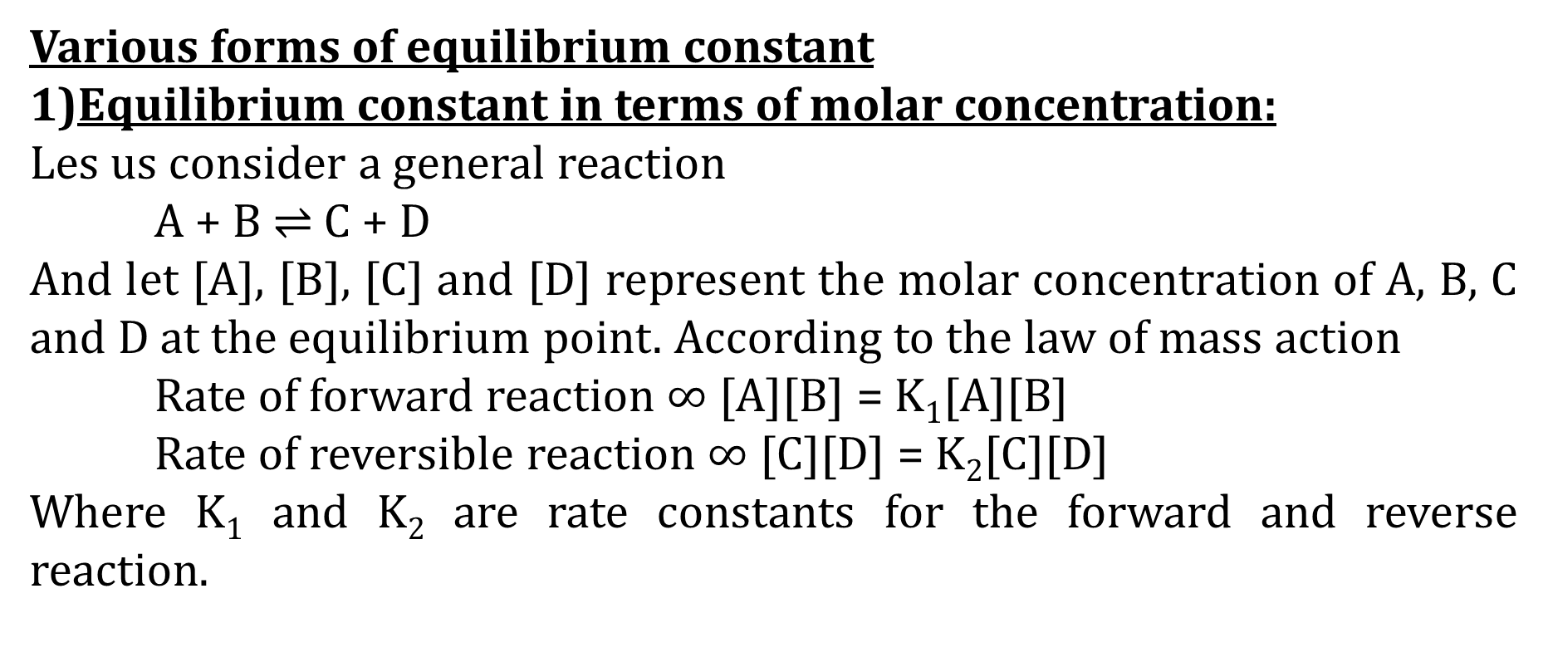
a) Law of mass action
Law of mass action states that the rate of a chemical reaction is proportional to the active masses of the reactants. By the term ‘active mass’ is meant the molar concentration ie., number of moles per litre
Various forms of equilibrium constant
Equilibrium constant in terms of molar concentration:
Les us consider a general reaction
A + B $⇌$ C + D
And let [A], [B], [C] and [D] represent the molar concentration of A, B, C and D at the equilibrium point. According to the law of mass action
Rate of forward reaction $∞$ [A][B] = K₁[A][B]
Rate of reversible reaction $∞$ [C][D] = K₂[C][D]
Where K₁ and K₂ are rate constants for the forward and reverse reaction.

Slide 3
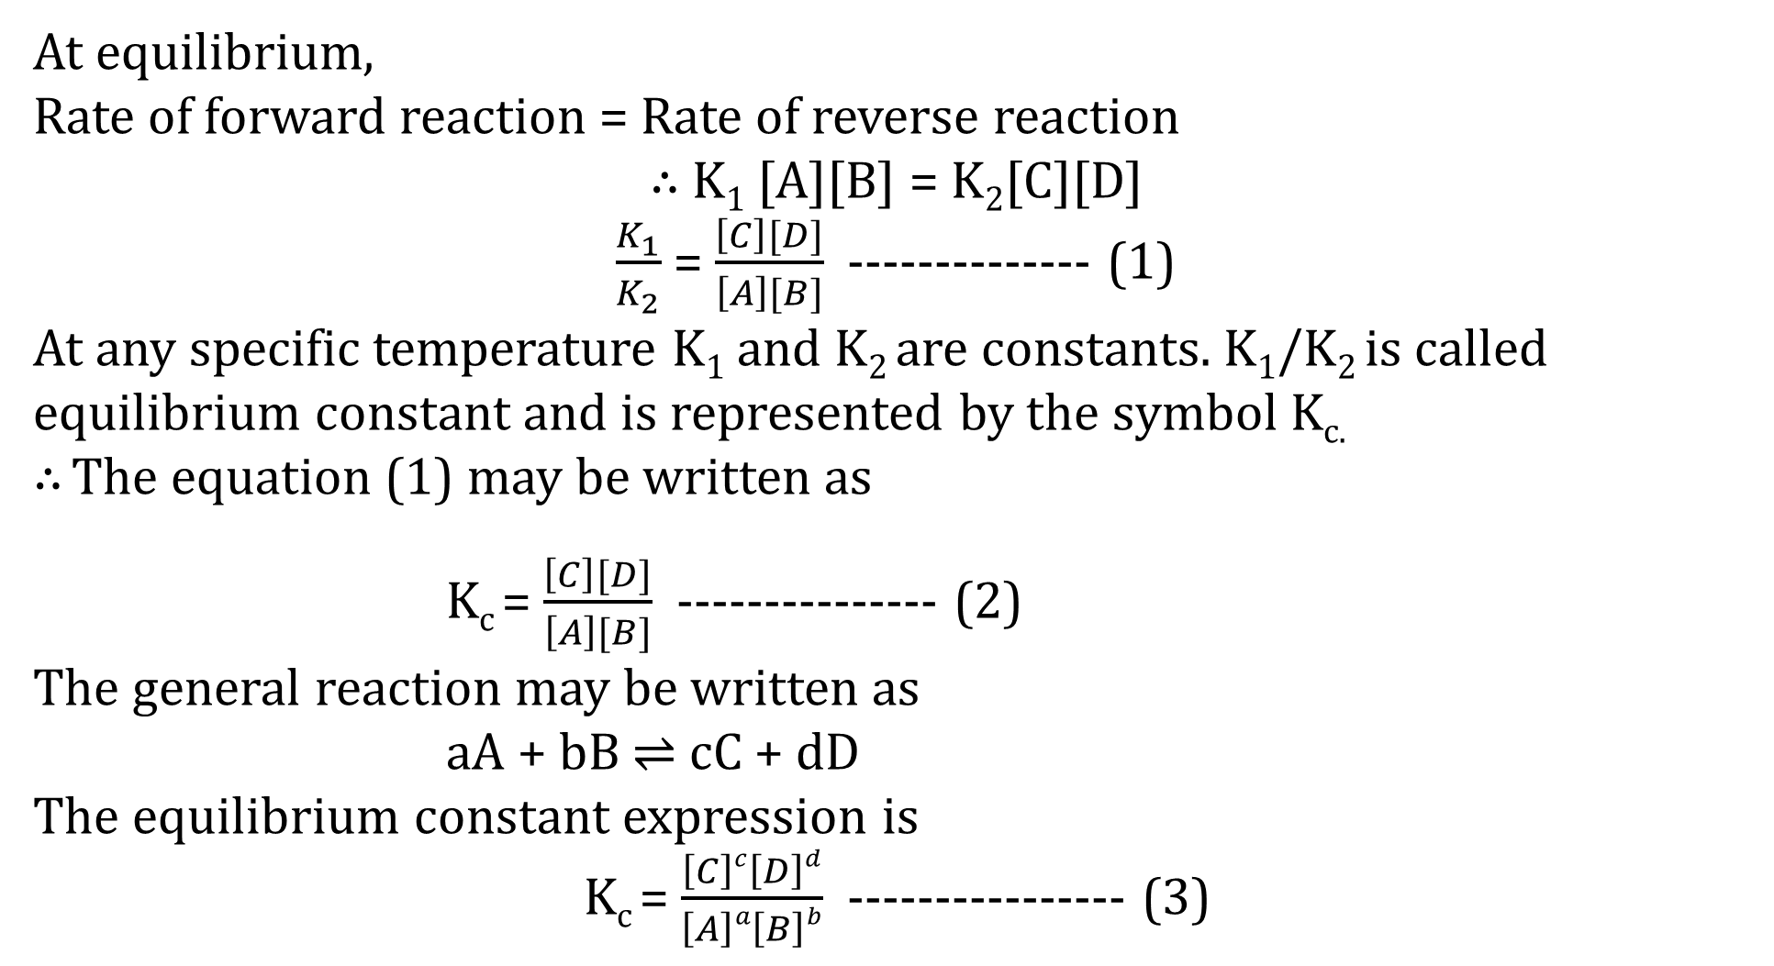
At equilibrium,
Rate of forward reaction = Rate of reverse reaction
$∴$ K₁ [A][B] = K₂[C][D]
$\frac{K_{1}}{K_{2}}$ = $\frac{\left[C\right][D]}{\left[A\right][B]}$ -------------- (1)
At any specific temperature K₁ and K₂ are constants. K₁/K₂ is called equilibrium constant and is represented by the symbol K_{c.}
$∴$ The equation (1) may be written as
K_{c} = $\frac{\left[C\right][D]}{\left[A\right][B]}$ --------------- (2)
The general reaction may be written as
aA + bB $⇌$ cC + dD
The equilibrium constant expression is
K_{c} = $\frac{\left[C\right]c\left[D\right]d}{\left[A\right]a\left[B\right]b}$ ---------------- (3)

Slide 4
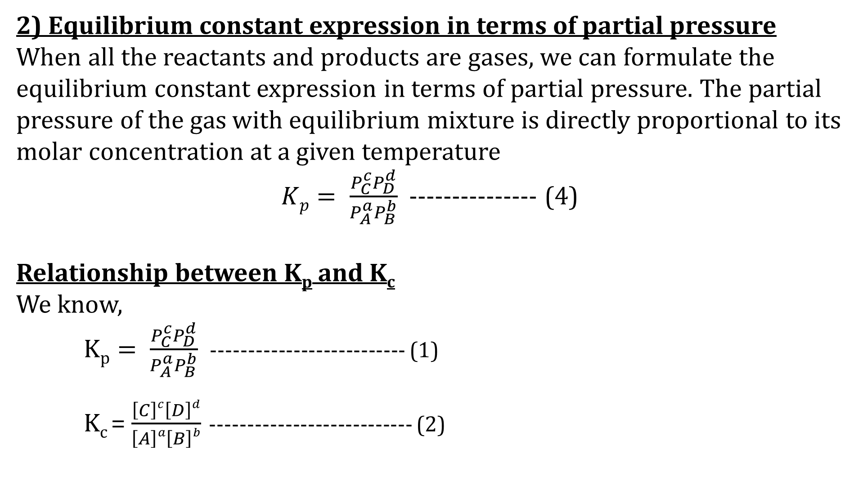
2) Equilibrium constant expression in terms of partial pressure
When all the reactants and products are gases, we can formulate the equilibrium constant expression in terms of partial pressure. The partial pressure of the gas with equilibrium mixture is directly proportional to its molar concentration at a given temperature
$Kp= \frac{P_{C}^{c}P_{D}^{d}}{P_{A}^{a}P_{B}^{b}}$ --------------- (4)
Relationship between K_{p} and K_{c}
We know,
$Kp= \frac{P_{C}^{c}P_{D}^{d}}{P_{A}^{a}P_{B}^{b}}$ -------------------------- (1)
K_{c} = $\frac{\left[C\right]c\left[D\right]d}{\left[A\right]a\left[B\right]b}$ --------------------------- (2)

Slide 5
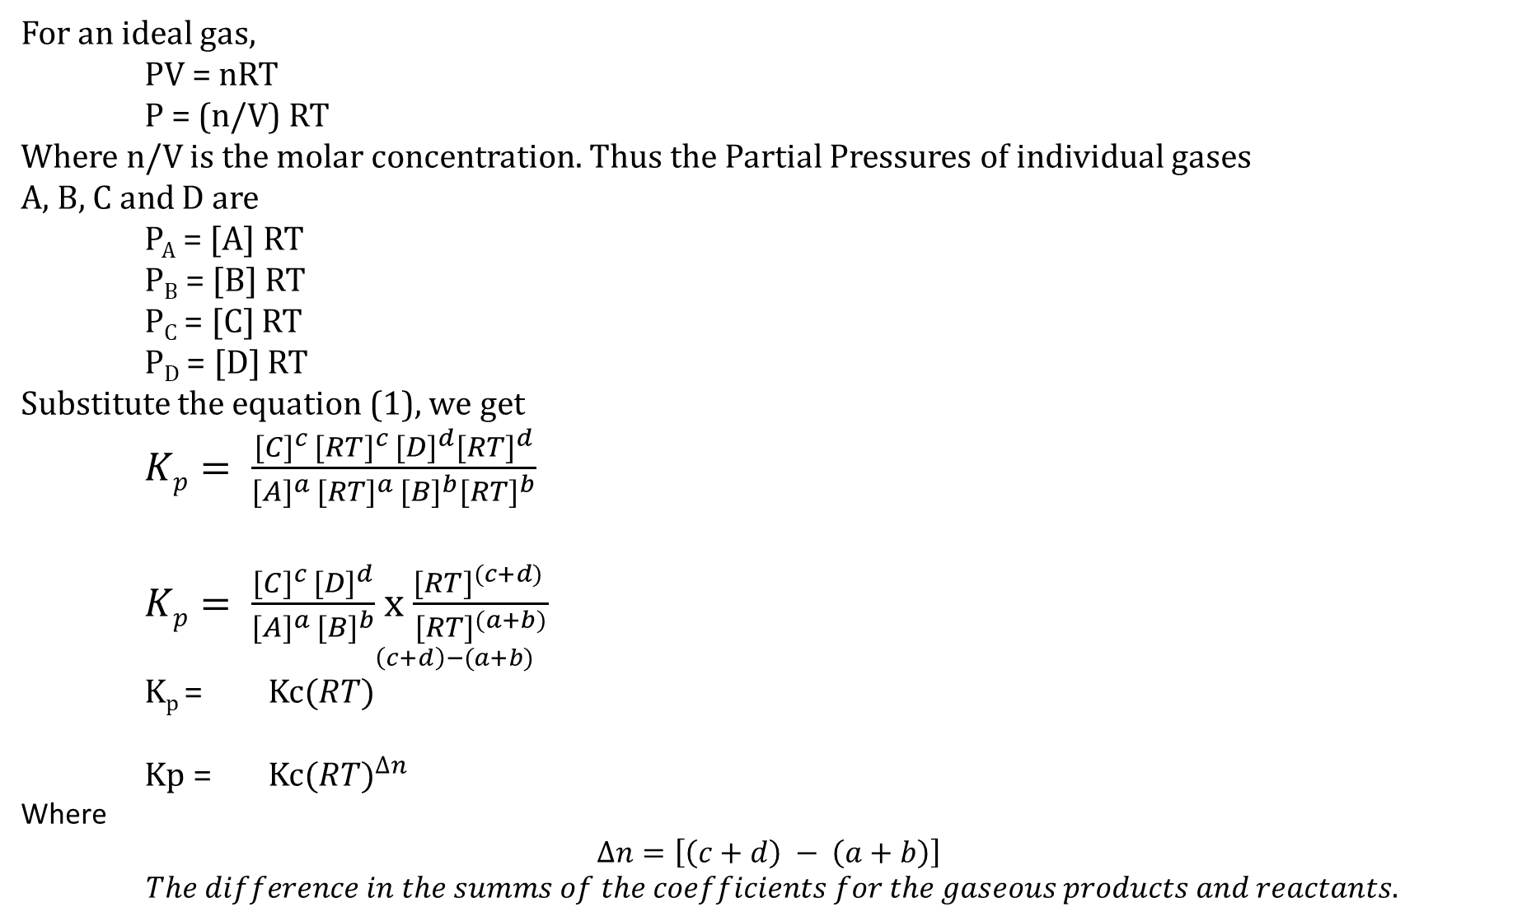
For an ideal gas,
PV = nRT
P = (n/V) RT
Where n/V is the molar concentration. Thus the Partial Pressures of individual gases
A, B, C and D are
P_{A} = [A] RT
P_{B} = [B] RT
P_{C} = [C] RT
P_{D} = [D] RT
Substitute the equation (1), we get
$Kp= \frac{{[C]}^{c }{[RT]}^{c }{[D]}^{d}{[RT]}^{d}}{{[A]}^{a }{[RT]}^{a }{[B]}^{b}{[RT]}^{b}}$
$Kp= \frac{{[C]}^{c }{[D]}^{d}}{{[A]}^{a }{[B]}^{b}}$ x $\frac{{[RT]}^{(c+d) }}{{[RT]}^{(a+b)}}$
K_{p} = Kc${(RT)}^{\begin{aligned}\left(c+d\right)−(a+b) \\ \end{aligned}}$
Kp = Kc${(RT)}^{∆n}$
Where
$$∆n=\left[\left(c+d\right) − \left(a+b\right)\right]$$
$$The difference in the summs of the coefficients for the gaseous products and reactants.$$

Slide 6
Thank you

