Slide 1
CARDAMOM PLANTERS’ ASSOCIATION COLLLEGE
BODINAYAKANUR
DEPARTMENT OF PHYSICS (SF)
LOGIC GATES
PREPARED BY
DR.S.KARTHIKA RANI
ASSISTANT PROFESSOR
DEPARTMENT OF COLLEGE
CPA COLLEGE, BODI.

Slide 2

LOGIC GATES:
Logic Gate: Is an electronic circuit and are the basic building blocks of digital electronics.
It has one or more inputs and only one output.
Out put ( 0 or 1) depends on certain combinations of input
BASIC LOGIC GATES:
The basic logic gates are NOT, AND and OR DERIVED LOGIC GATES:
Derived logic gates are NAND,NOR,X-OR X-NOR
Universal gates: NAND, NOR

Slide 3

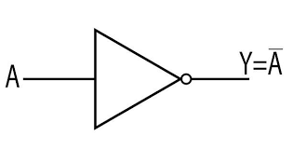
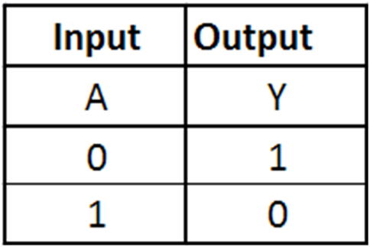
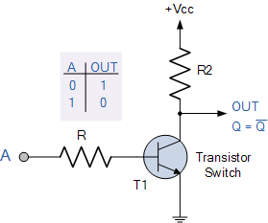
BASIC GATES:
NOT GATE (INVERTER):
NOT also called Inverter
Used to complement or invert digital signal To change one logic level to opposite
SYMBOL:
TRUTH TABLE:

Slide 4
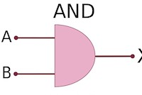
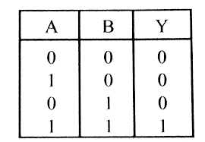
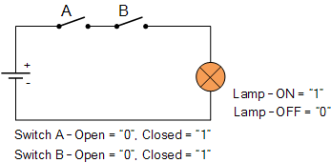
BASIC GATES:
AND GATE :
Logical multiplication
Two or more input and only one output Boolean expression: Y=A.B
SYMBOL:
TRUTH TABLE:
Y

Slide 5
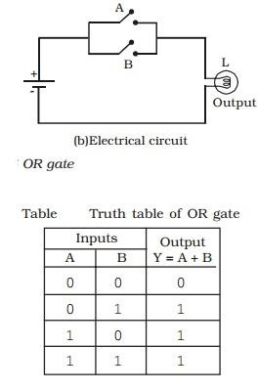
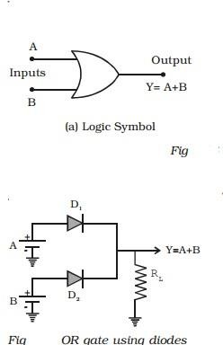
BASIC GATES:
OR GATE :
Logical addition
Two or more input and only one output Boolean expression: Y=A+B

Slide 6

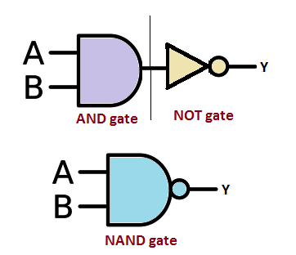
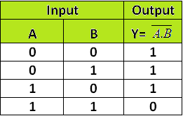
UNIVERSAL GATES: NAND GATE :
Universal gate due to versatile in nature Two or more input and only one output
Boolean expression: Y=AB

Slide 7
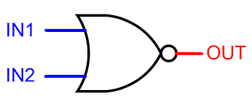
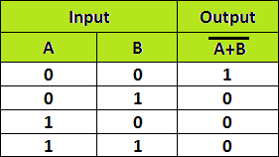
NOR GATE :
Universal gate due to versatile in nature Two or more input and only one output
Boolean expression: Y=A+B

Slide 8



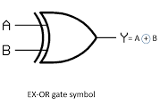
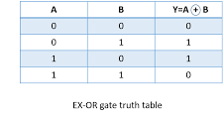
X-OR GATE: EXCLUSIVE-OR GATE :
Exclusive OR operation widely used in digital circuit Two or more input and only one output
Can not be performed using basic gates Boolean expression: Y=A B+A B

Slide 9


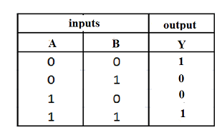
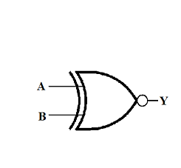
EX-NOR GATE: EXCLUSIVE-NOR GATE :
Exclusive NOR is complement of Ex-OR Two or more input and only one output
Can not be performed using basic gates Boolean expression: Y=A B+A B

Slide 10


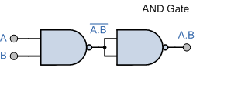
UNIVERSAL PROPERTIES OF NAND:
All digital logic can be performed by using NAND gate
NOT from NAND:
BY connecting both or all inputs of NAND together For two input NAND Boolean expression is Y=A.A.=A
AND using NAND
Inverting the output of NAND gate AND operation will be formed
Y=A.B =A.B

Slide 11
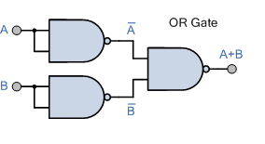
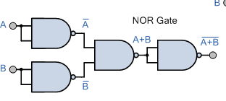
UNIVERSAL PROPERTIES OF NAND:
OR Gate from NAND Gate:
Inputs are inverted before applied to another NAND gate For two input NAND Boolean expression is
Y=A.B.=A+B =A+B
NOR using NAND
Out put of OR is inverted to get NOR
Y=A.B = A+B =A+B

Slide 12

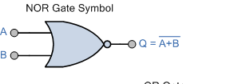
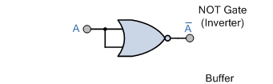
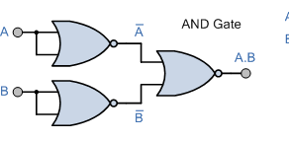
UNIVERSAL PROPERTIES OF NOR:
1) NOT Gate from NOR Gate:
Connecting all inputs of NOR gate
For two input NOR Boolean expression is
Y=A+A =A
2) AND using NOR
AND gate can be formed using NOR gate with inverted inputs
Y=A+B = A.B =A.B

Slide 13
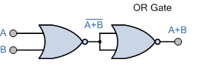
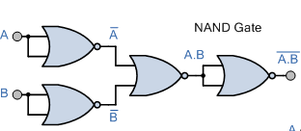
UNIVERSAL PROPERTIES OF NOR:
3) OR Gate from NOR Gate:
Out put of NOR is inverted
For two input NOR Boolean expression is
Y=A+B =A+B
4) NAND using NOR
NAND gate can be formed using NOR gate with expressions
Y=A+B = A.B =A.B

Slide 14

LOGIC OPERATORS :
AND OPERATOR:
In Boolean algebra AND operator is denoted by( .) or no operator symbol at all Similar to multiplication in ordinary algebra
For example A.B = Y
OR OPERATOR: Indicated by + sign
Similar to addition in ordinary algebra For example A+B =Y
A | B | Y=A.B
0 | 0 | 0
0 | 1 | 0
1 | 0 | 0
1 | 1 | 1
A | B | Y=A+B
0 | 0 | 0
0 | 1 | 1
1 | 0 | 1
1 | 1 | 1

Slide 15
LOGIC OPERATORS :
3) NOT OPERATOR:
Used for complement or inversion Symbol is bar on over variable For example A=A
A =A
A | A
0 | 1
1 | 0

Slide 16

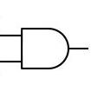
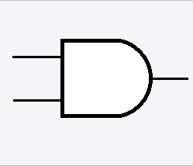

BOOLEAN ALGEBRA LAWS AND RULES :
1) AND LAWS:
Law 1 : A.0 =0
Law 2: A.1=A
Law 3: A.A=A
A 0
A
0
A 1
A
A
A
Law 4:
A.A=0
A
0
A

Slide 17
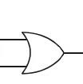
BOOLEAN ALGEBRA LAWS AND RULES :
1) OR LAWS: Law 5 :
A 0
A
A+0 =A
Law 6:
A+1=1
A 1
1
Law 7:
A+A=A _{A}
A
Law 8:
A+A=1
A
1
A

Slide 18

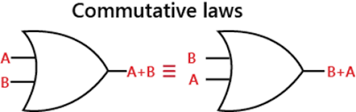
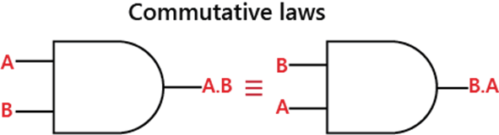
BOOLEAN ALGEBRA LAWS AND RULES :
Commutative Law: order of variables in OR and AND operation is insignificant( allows change of position of variable)
Law 9 ( Commutative law of addition) : A + B = B + A
Law 10 (Commutative law of multiplication)
: A . B = B . A

Slide 19
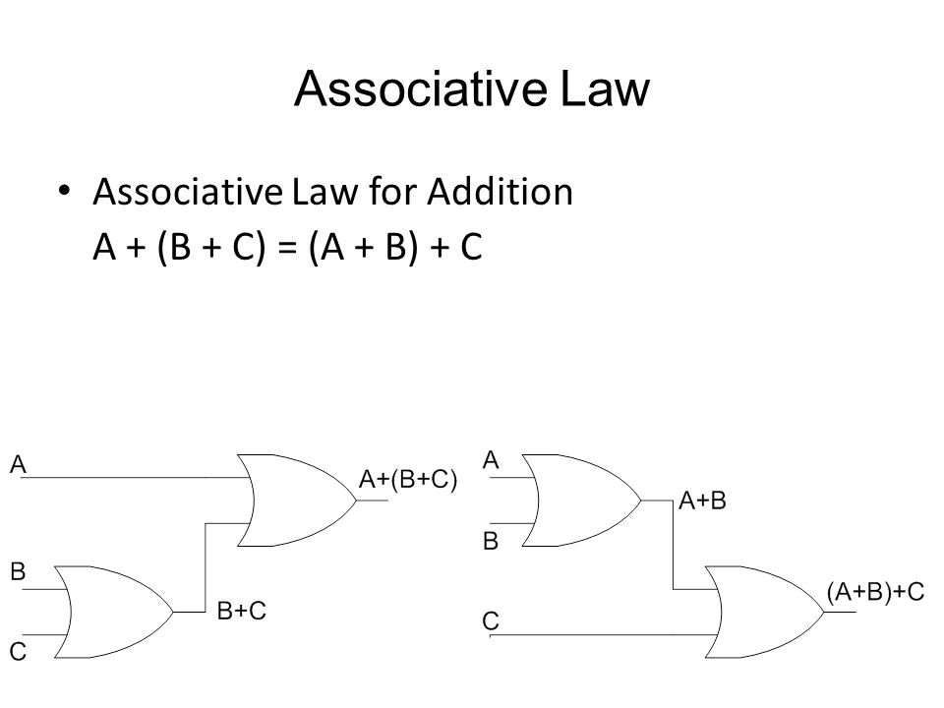
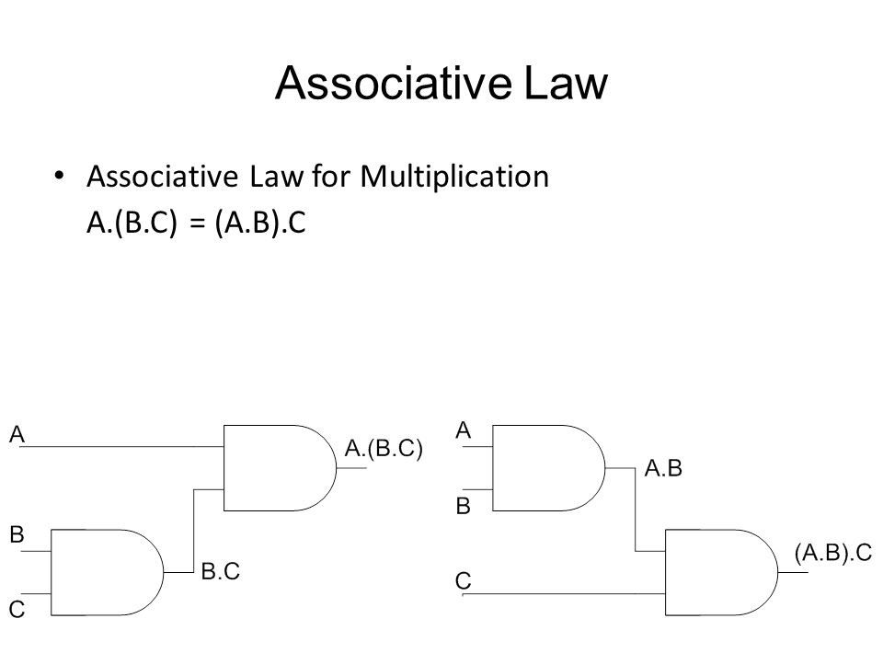
BOOLEAN ALGEBRA LAWS AND RULES :
Associative Law: order of grouping in OR and AND operation is insignificant( allows change of grouping)

Slide 20
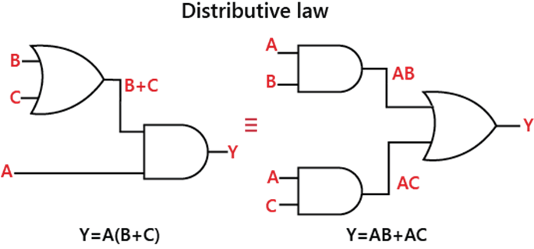
BOOLEAN ALGEBRA LAWS AND RULES :
Distributive Law: factoring or multiplying of different terms in an expression is allowed.
Law 13
Law 14
: A . (B + C) = AB + AC
: A + (B . C) = ( A + B). ( A + C)

Slide 21



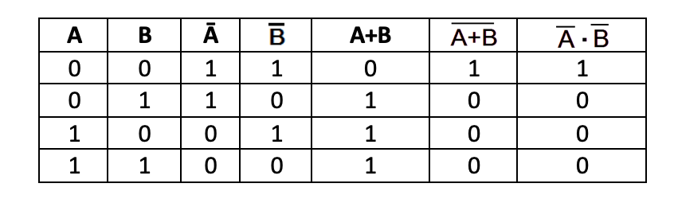
DE-MORGAN’S THEOREMS :
Demorgan’s first Theorem:
Statement: Complement of sum is equal to the product of
complement
A + B = A . B
Proof:

Slide 22
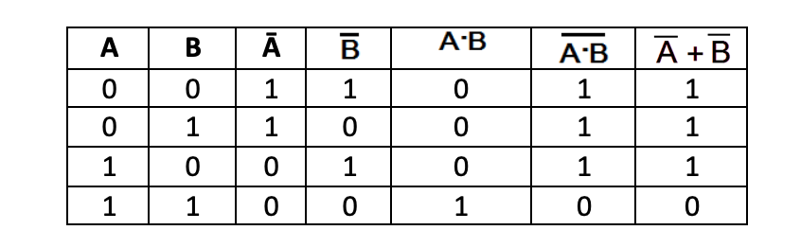
DE-MORGAN’S THEOREMS :
Demorgan’s Second Theorem:
Statement: Complement of product is equal to the sum of
complement
A . B = A + B
Proof:

