Slide 1
Inorganic Semi micro Qualitative analysis
Dr. B. Kavitha
Assistant Professor
PG and Research Department of Chemistry
C.P.A. College, Bodinayakanur

Slide 2
Semi micro qualitative analysis of inorganic salt mixture containing two anions (interfering) and two cations
Simple Anions: Carbonate, nitrate, sulphate, sulphide, sulphite, chloride and bromide
Interfering anions: borate, fluoride, oxalate, phosphate, arsenite and chromate
Cations :
  Group I cations : lead
  Group II cations : lead, copper, cadmium, bismuth, antimony and tin
  Group III cations : aluminium, ferrous, ferric and chromium
  Group IV cations : Cobalt, nickel, Manganese and zinc
  Group V cations : Calcium, Strontium and barium
  Group VI cations : Magnesium and ammonium

Slide 3
Qualitative analysis
Systematic Analysis for Inorganic substance
S.No | Experiment | Observation | Inference
Preliminary Dry Reactions
1 | Colour of the salt | Blue colour | Presence of Copper
 |  | Green colour | Presence of Nickel, Ferrous, copper
 |  | Pink colour | Presence of Manganese, cobalt salt
 |  | Colourless/White | Absence of copper, Nickel, Iron. Manganese salts
2 | Action of Heat: The salt is heated in a dry test tube | Colourless gas turning lime water milky | Presence of Carbonate
 |  | Colourless gas giving white fumes with Conc. HCl taken at the end of glass rod | Presence of ammonium
 |  | Reddish Brown gas | Presence of Bromide, Nitrate

Slide 4
2 | Action of Heat: The salt is heated in a dry test tube | Residue changes yellow when hot and white when cold Residue changes brown when hot and yellow when cold White sublimation | Presence of Zinc Presence of Lead Presence of ammonium salts
 |  | Charring takes place colorless gas burning with blue flame | Presence of oxalate
 |  | No Characteristic reaction | Absence of Zinc, Ammonium, Lead, Carbonate, Nitrate and Bromide
3 | Flame Test: Salt is made to a paste with 2 drops of con. HCl in a watch glass. The paste is introduced in a non-luminous flame at the end of the charred splinter. | Bluish green flame | Presence of Copper
 |  | Pale green flame | Presence of Barium
 |  | Brick red flame | Presence of Calcium
 |  | Lilac (crimson red) Flame | Presence of Strontium
 |  | No Characteristic coloured flame | Absence of copper, Barium, Calcium salts

Slide 5
4 | Charcoal Cavity test: Salt + Na₂CO₃ are mixed in 1 : 2 ratio and placed in a charcoal cavity, moistened and heated with a blow pipe. | Residue yellow when hot and white when cold | Presence of Zinc
 |  | Residue Brown when hot and Yellow when cold | Presence of Lead
 |  | Red scales | Presence of copper
 |  | No Characteristic coloured mass | Absence of Zinc, Lead and Copper
5 | Cobalt Nitrate Test: To the above mass a drop of Co(NO)₂ is added and heated again. | Green mass | Presence of Zinc
 |  | Blue mass | Presence of Aluminium
 |  | Pink mass | Presence of Magnesium
 |  | No characteristic mass | Absence of Zinc, Aluminium, Magnesium

Slide 6
Systematic Analysis for Cations (Basic Radicals)
Solubility test:
Salt + Water Soluble/Insoluble
Salt + Con. HCl Soluble/ Insoluble
Original Solution: The original solution is prepared by dissolving the salt in dil.HCl
Elimination of Borate, Fluoride, Chromate
Salt and 2 ml of con. HCl are taken in a china dish and evaporated. Conc. HCl is again added and evaporated and the process is repeated for 3 times. The final paste is dissolved in. This is the original solution of the substance. dil. HCl
Elimination of Oxalate
The substance is roasted in a china dish for 3 minutes and cooled. It is then boiled with dil.HCl and centrifuged. The centrifugate is the original solution.
Elimination of Phosphate
(Phosphate is eliminated before going to the third group). To the original solution con. HNO₃ is added and boiled and zirconium chloride (nitrate) is added and boiled. The white precipitate formed is removed by filtration. The precipitate is analysed for III group and the filtrate for IV, V, VI groups.

Slide 7
Elimination of Arsenite
(Arsenite is eliminated prior to second group). The centrifugate from the first group is boiled with con. HCl. H₂S gas is passed through the hot solution. The yellow precipitate (As₂S₃) is centrifuged and centrifugate is again boiled and H₂S gas is passed again. This Process is repeated till no more yellow precipitate appears. The precipitate is analysed for II group and the centrifugate for III, IV, V and VI group.

Slide 8
Separation of Basic Radicals into groups
To the original solution dil. HCl is added
Precipitate Presence of I group. No Precipitate Absence of I group. | Filtrate+ H₂O + H₂S is passed
 | Residue presence of II group No residue Absence of II group | Filtrate + con.HNO₃ (boiled) + Solid NH₄Cl + NH₄OH (Excess)
 |  | Residue Presence of III group No residue Absence of III group | Filtrate + NH₄OH + H₂S is passed
 |  |  | Residue Presence of IV group No Residue Absence of IV group | Filtrate: Boiled, NH₄Cl + NH₄OH and ammonium carbonate are added
 |  |  |  | Residue Presence of V group No Residue Absence of V Group | Filtrate: Analysed for VI group radicals

Slide 9
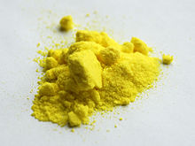
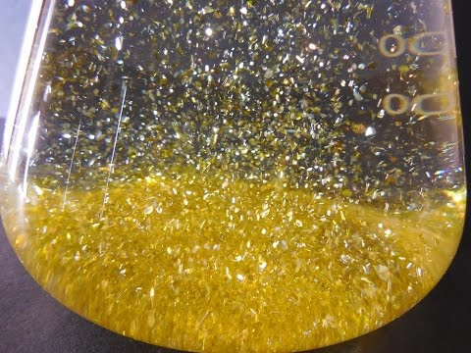
Analysis of I group (Lead, Silver, Mercury)
The precipitate is boiled with water
No residue Absence of Silver, Mercury | Filtrate Filtrate + acetic acid + K₂CrO₄ – Yellow Precipitate- Presence of Lead Filtrate + KI – Yellow precipitate, boiled with water and cooled. Precipitate dissolves and appears as golden yellow spangles. Presence of Lead
PbCl₂ + K₂CrO₄ + 2CH₃COOH → PbCrO₄ + 2KCOOH + 2CH₃Cl
PbCl₂ + 2KI → PbI₂ + 2KCl

Slide 10
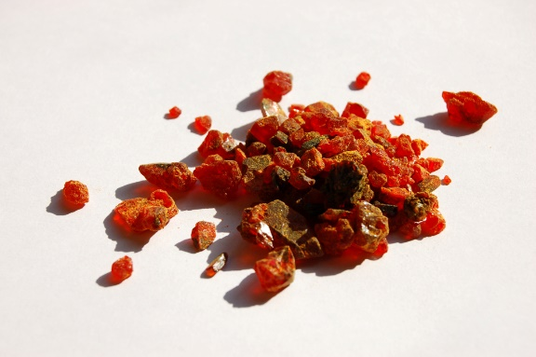
Separation of II group as II A and II B sub groups
The II group precipitate is boiled with NaOH
Residue Presence of II A sub group No Residue: Absence of II A sub group | Filtrate: It is analysed for II B group
Analysis of II A sub group
(Mercury, Lead, Bismuth, Copper, Cadmium
II A group precipitate + dil HNO₃ (boiled + dil H₂SO₄
Residue Original solution + K₂CrO₄ – Yellow precipitate Presence of Lead No residue – Absence of Lead | Filtrate + NH₄OH
 | Residue + Con. HCl poured in excess of water – White precipitate Presence of Bismuth No Residue Absence of Bismuth | Filtrate Blue in colour + acetic acid + potassium Ferro cyanide, Brown Precipitate Presence of copper 2. Filtrate + acetic acid + H₂S + Water Yellow precipitate – Presence of cadmium No Characteristic precipitate. Absence of Copper, Cadmium

Slide 11
Analysis of II – B sub group
Filtrate from II A group + con. HCl (No residue absence of II – B sub group)
Residue + (NH₄)₂CO₃ + dil. HCl – Yellow precipitate Presence of Arsenic No Residue – Absence of arsenic | Filtrate (i) Filtrate + Iron dust (heated and filtered) + HgCl₂ – A silky white precipitate – presence of Tin (ii) Filtrate + Solid ammonium oxalate + H₂S Orange precipitate. Presence of Antimony No Characteristic precipitate Absence of Tin, Antimony

Slide 12
Analysis of III Group
Iron, Chromium, Aluminium, Manganese
Precipitate of III group + Sodium peroxide
Residue + dil. HCl (dissolves) Solution + Ammonium thiocyanate – Blood Red Colour – Presence of Ferric (iron) Solution + Potassium ferricyanide – Prussian (deep) blue precipitate- Presence of Ferrous (iron) Solution + Lead dioxide + Con. HNO₃ – (heated) + water – pink colour – presence of Manganese No residue – Absence of iron, Manganese | Filtrate + dil. HCl + NH₄OH (drops) – Gelatinous white precipitate. Presence of Aluminium Filtrate + lead acetate + acetic acid – yellow precipitate – presence of Chromium No Characteristic reaction – Absence of Chromium and Aluminium

Slide 13
Analysis of IV Group
Nickel, Cobalt, Manganese, Zinc
Precipitate + dil. HCl
Residue Residue + Con.HCl + Con.HNO₃ – evaporated to dryness dissolved in water and taken for analysis Solution + dimethyl glyoxime + NH₄OH – Scarlet red precipitate – Presence of Nickel Solution + amyl alcohol + ammonium thiocyanate – shaked – alcohol layer is blue coloured. Presence of cobalt Solution + K₄Fe(CN)₆ – Reddish Brown precipitate – presence of Cobalt No Characteristic reaction- Absence of Nickel, Cobalt | Filtrate + NaOH (Boiled)
 | Residue + Con. HNO₃ + sodium bismuthate + water – Pink colour. Presence of Manganese No residue Absence of Manganese | Filtrate + K₄Fe(CN)₆ Blue/white Precipitate Presence of Zinc No characteristic reaction Absence of Zinc

Slide 14
Analysis of V Group
Barium, Strontium, Calcium
Precipitate + dil. Acetic acid (warmed) - Dissolves
Solution + K₂CrO₄ yellow precipitate – presence of Barium No precipitate – Absence of Barium | 2. Solution + CaSO₄ – white precipitate – presence of Strontium No Precipitate Absence of Strontium | 3. Solution + NH₄OH + Ammonium oxalate – White precipitate Presence of Calcium No precipitate-Absence of Calcium
Analysis of VI Group
Magnesium, Ammonium
Original solution (centrifugate from V group) + NH₄OH + Sodium hydrogen phosphate | White precipitate on scratching the sides of the test tube | Presence of Magnesium
Original solution + NaOH | White Precipitate insoluble in excess of NaOH | Presence of Magnesium
Original solution (only) + NaOH + Nesseler’s reagent substance + NaOH (boiled) | Brown Precipitate Colourless gas giving white fumes with con.HCl taken at the end of the glass rod | Presence of Ammonium

Slide 15
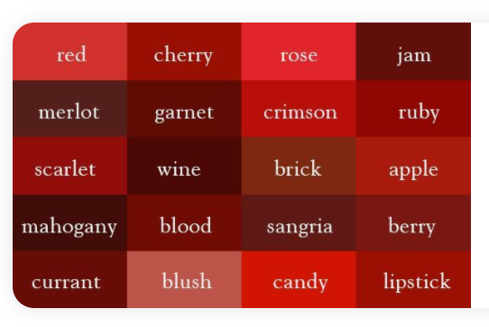

Slide 16
Thank You

