Slide 1
Harry Potter and the Philosopher's Stone
Author: J.K. Rowling
Published: June 26, 1997 (UK), September 1998 (US as Harry Potter and the Sorcerer's Stone)

Slide 2
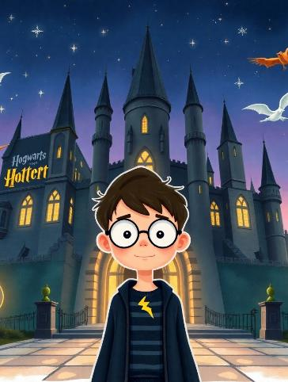

Overview of the Story
Introduces Harry Potter, an orphan who discovers he is a wizard on his eleventh birthday.
Enrolls at Hogwarts School of Witchcraft and Wizardry.
Learns about his past and the dark wizard Voldemort who killed his parents.

Slide 3
Meet the Main Characters
Hermione Granger
Harry Potter
A brilliant Muggle-born witch and Harry's close friend.
The protagonist, known for his lightning-shaped scar.

Slide 4
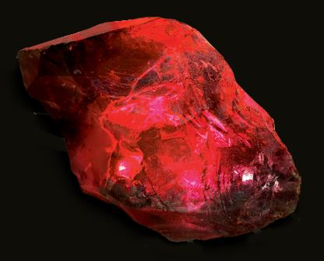
The Magical Setting
Godric's Hollow
The Burrow
The Forbidden Forest
Hogsmeade
Diagon Alley

Slide 5
Plot Summary: The Quest for the Stone
Harry learns about the Philosopher's Stone, which grants immortality.
He, Ron, and Hermione navigate challenges to protect the Stone from Voldemort.
Key events include encountering Fluffy (the three-headed dog) and facing Professor Quirrell.

Slide 6
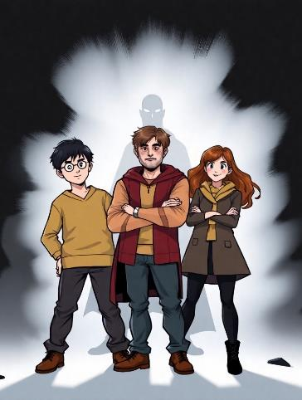
Themes of Friendship and Courage
Friendship: The bond between Harry, Ron, and Hermione is central to their success.
Good vs. Evil: The struggle against Voldemort represents the classic battle between light and darkness.
Courage: Harry's bravery in facing dangers highlights the importance of courage.

Slide 7
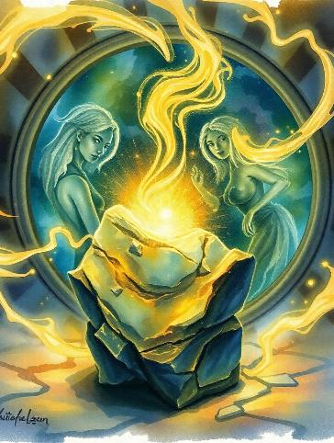
Important Magical Elements
The Philosopher's Stone: A legendary object that can turn metal into gold and grant immortality.
The Mirror of Erised: Shows one’s deepest desires; plays a crucial role in the story’s climax.

Slide 8
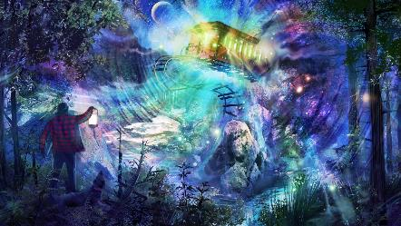
Critical Reception and Awards
Widely acclaimed for its imaginative storytelling and character development.
Received numerous awards and has been translated into multiple languages.

Slide 9
Film Adaptation and Success
November 10, 2001
November 16, 2001
$974 million
-
Release date in the UK
Release date in the US
Gross revenue worldwide
Director: Chris Columbus

Slide 10
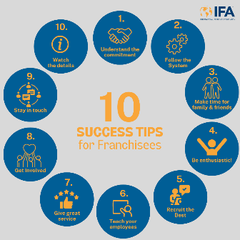
Legacy and Impact on Literature
Launched a successful franchise including seven sequels, spin-off films, and a vast merchandise line.
Influenced a generation of readers and sparked interest in fantasy literature globally.

