Slide 1
Fluorescence Spectroscopy
Dr. B. Kavitha
Assistant Professor
PG and Research Department of Chemistry
C.P.A. College, Bodinayakanur

Slide 2
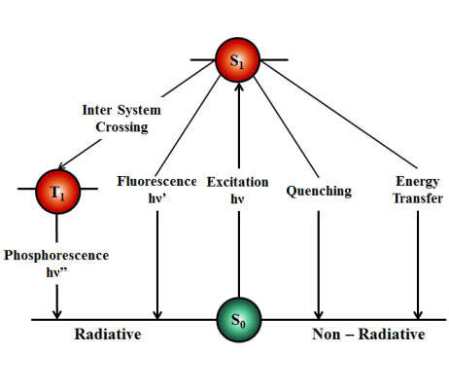
Fluorescence Spectroscopy
When a molecule absorbs light, an electron is promoted to a higher excited state (generally a singlet state, but may also be a triplet state). The excited state can get depopulated in several ways.
The molecule can lose its energy non – radiatively by giving its energy to another absorbing species in its immediate vicinity (energy transfer) or by collisions with other species in the medium.
If an excited state triplet overlaps with the exited state singlet, the molecule can cross over into this triplet state. This is known as inter system crossing. If the molecule then returns to the ground state singlet (T₁ S₀ ) by emitting light, the process is known as phosphorescence.
The molecule can partially dissipate its energy by undergoing conformational changes and relaxed to the lowest vibrational level of the excited state in a process called vibrational relaxation. If the molecule is rigid and cannot vibrationally relax to the ground state, it then returns to the ground state (S₁ S₀ ) by emitting light, the process is known as fluorescence.

Slide 3
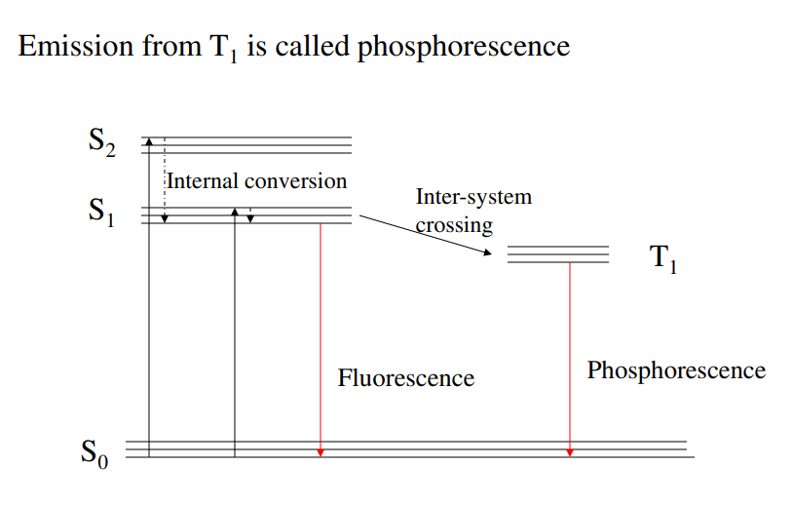
Jablonski diagram

Slide 4
The Stokes Shift
The energy of emission is typically less than that of absorption. Fluorescence typically occurs at lower energies or longer wavelength.
Characteristic of a fluorescence spectra
Kasha’s Rule: The same fluorescence emission spectrum is generally observed irrespective of excitation wavelength. This happens since the internal conversion is rapid.
Some important facts
Upon return to the ground state the fluorophore can return to any of the ground state vibrational level.
The spacing of vibrational energy levels of the excited states is similar to that of the ground state.
The consequence of above two is that the emission spectrum is typically a mirror image of the absorption spectrum of the S₀ to S₁ transition.

Slide 5
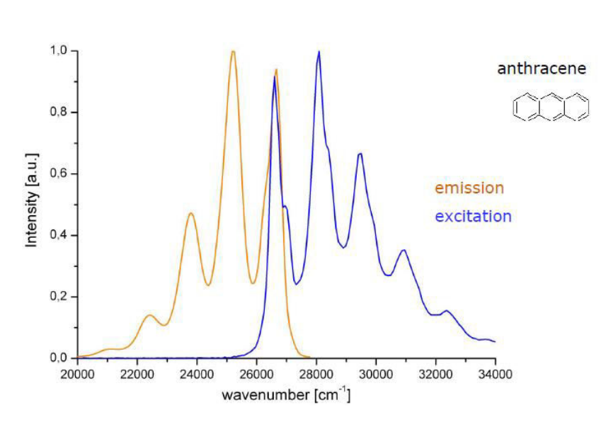

Slide 6
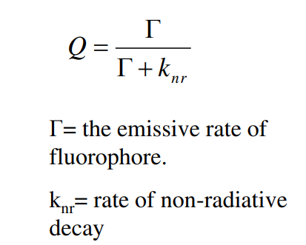
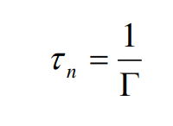
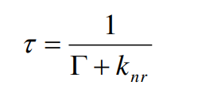
Fluorescence life times and quantum yield
Quantum yield is the ratio of the number of photons emitted to the number absorbed.
The lifetime of the fluorophore in the absence of radiative process is called the intrinsic or natural life time.
Fluorescence lifetimes are near 10 ns.
• Scintillators have large Γ value. Hence they have large Q and lifetime.
• The fluorescence emission of aromatic substances containing nitro group are generally weak due to large knr value.
The lifetime of the excited state is defined by the average time the molecule spends in the excited state prior to the return to the ground state.

Slide 7
Absorption versus Emission spectra
Absorption is an instantaneous event. It occurs so fast that there is no time for molecular motion during the absorption process.
Thus absorption spectra are not sensitive to molecular dynamics and can provide information on average solvent shell adjacent to the chromophore
In contrast to absorption, emission occurs over a longer period of time.
The length of time fluorescent molecules remain in excited state provides an opportunity for interactions with other molecule in solution like oxygen.
Other example of dynamic processes in solution involve fluorophore-solvent interactions and rotational diffusion.

Slide 8
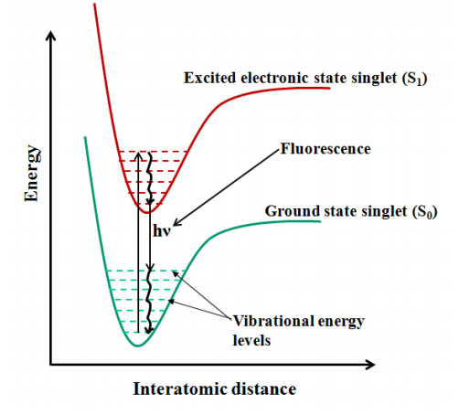
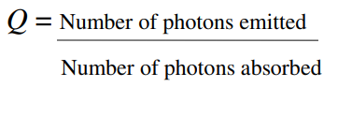
In terms of energy level
The emitted light is always of lower energy (longer wavelength). This is known as the Stoke’s shift.
The quantum yield (Q) of a fluorescence phenomena is given by:
In a given solvent, the quantum yield of a particular fluorophore will be fixed. Because of this, every fluorophore will have a characteristic fluorescence spectrum

Slide 9
Scope of quenching and energy loss during fluorescence
Energy may be lost in vibrational transition, collision with the solvent, heat transfer etc. .Only a part of the light absorbed is emitted. It’s because of this that the quantum yield in most practical cases is not equal to one.
Quenching of fluorescence may also occur due to the presence of some foreign molecule in the solution which is acting as a quencher, or due to some structural rearrangement in the molecule (say protein), which drives the fluorophore to a conformation where it is in vicinity of a quencher (any amino acid residue or disulphide bond).
Fluoresence intensity may also decrease due to the transfer of the emitted energy to some other chromophore, which absorbs at that energy. This phenomena is called FRET. However, FRET and quenching should not be treated synonymously

Slide 10
Instrumentation
All fluorescence instruments contain three basic items: a source of light, a sample holder and a detector. In addition, to be of analytical use, the wavelength of incident radiation needs to be selectable and the detector signal capable of precise manipulation and presentation.
In simple filter fluorimeters, the wavelengths of excited and emitted light are selected by filters which allow measurements to be made at any pair of fixed wavelengths. Simple fluorescence spectrometers have a means of analysing the spectral distribution of the light emitted from the sample, the fluorescence emission spectrum, which may be by means of either a continuously variable interference filter or a monochromator.
In more sophisticated instruments, monochromators are provided for both the selection of exciting light and the analysis of sample emission. Such instruments are also capable of measuring the variation of emission intensity with exciting wavelength, the fluorescence excitation spectrum.
In principle, the greatest sensitivity can be achieved by the use of filters, which allow the total range of wavelengths emitted by the sample to be collected, together with the highest intensity source possible.
In practice, to realize the full potential of the technique, only a small band of emitted wavelengths is examined and the incident light intensity is not made excessive, to minimize the possible photodecomposition of the sample.

Slide 11
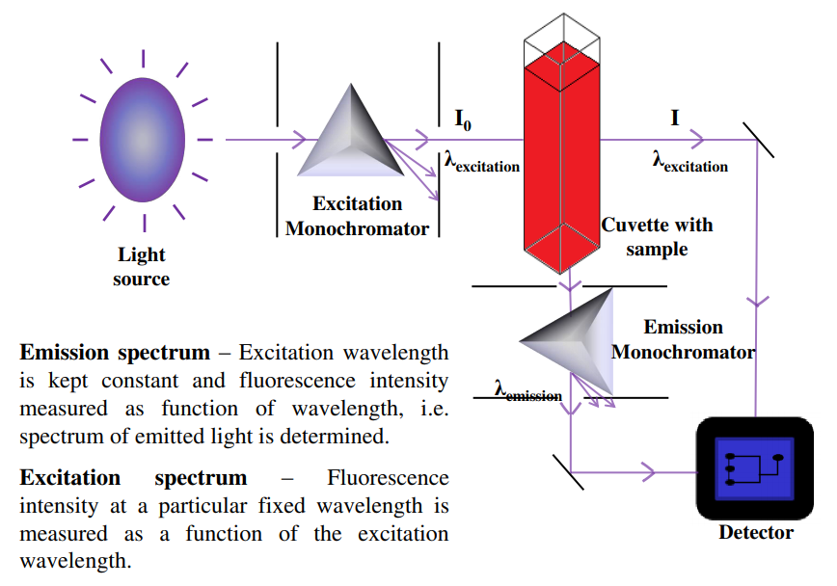
Experimental Set Up

Slide 12
Light sources:
Commonly employed sources in fluorescence spectrometry have spectral outputs either as a continuum of energy over a wide range or as a series of discrete lines. An example of the first type is the tungsten-halogen lamp and of the latter, a mercury lamp.
Mercury lamps are the most commonly employed light sources and have the property that their spectral output depends upon the pressure of the filler gas. The output from a low-pressure mercury lamp is concentrated in the UV range, whereas the most commonly employed lamps, of medium and high pressure, have an output covering the whole UV-visible spectrum.
Although in many cases the output from a line source will be adequate, it is rare that an available line will exactly coincide with the optimum excitation wavelength of the sample. It is therefore advantageous to employ a source whose output is a continuum and the most commonly employed type is the xenon arc. Xenon arc sources can be operated either on a continuous DC basis or stroboscopically; the latter method offers advantages in the size and cost of lamps. The output is essentially a continuum on which are superimposed a number of sharp lines, allowing any wavelength throughout the UV-visible region of the spectrum to be selected.

Slide 13
Arc lamps are inherently more unstable than discharge sources and for long term stability a method of compensating for drift is advisable. The most satisfactory method of doing this is to split the excitation energy so that a small portion is led to a reference detector. The signal from this reference detector is ratioed with the signal from the detector observing the sample. Such a ratio-recording system is therefore independent of changes in the source intensity.
All sources of UV radiation will produce ozone from atmospheric oxygen, which should be dispersed, since it is not only toxic, but also absorbs strongly in the region below 300 nm. For this reason, most lamps will be operated in a current of air and, if the supply fan fails, the lamp should be extinguished immediately. Lamps must be handled with great care since fingermarks will seriously decrease the UV output.

Slide 14
Detectors
All commercial fluorescence instruments use photomultiplier tubes as detectors and a wide variety of types are available. The material from which the photocathode is made determines the spectral range of the photomultiplier and generally two tubes are required to cover the complete UV-visible range.
The S5 type can be used to detect fluorescence out to approximately 650 nm, but if it is necessary to measure emission at longer wavelengths, a special red sensitive, S20, photomultiplier should be employed.
The limit of sensitivity of a photomultiplier is normally governed by the level of dark current (which is the signal derived from the tube with no light falling on it).
The dark current is caused by thermal activation and can usually be reduced by cooling the photomultiplier. Another method of minimizing dark current is to use a stroboscopic source since the ratio of dark current to fluorescence will be very small during each high intensity flash.

Slide 15
During the periods between flashes when the dark current is relatively high, the photomultiplier output can be disconnected.
The overall result is that the dark current no longer becomes the limitation to sensitivity.
The spectral response of all photomultipliers varies with wavelength, but it is sometimes necessary to determine the actual quantum intensity of the incident radiation and a detector insensitive to changes in wavelength is required.
A suitable quantum counter can be made from a concentrated solution of Rhodamine 101 in ethylene glycol which has the property of emitting the same number of quanta of light as it absorbs, but over a very wide wavelength range.
Thus, by measuring the output of the quantum counter at one wavelength, the number of incident quanta over a wide wavelength range can be measured.

Slide 16
Read-out devices
The output from the detector is amplified and displayed on a readout device which may be a meter or digital display. It should be possible to change the sensitivity of the amplifier in a series of discrete steps so that samples of widely differing concentration can be compared.
A continuous sensitivity adjustment is also useful so that the display can be made to read directly in concentration units.
Digital displays are most legible and free from misinterpretation. Improvement in precision is obtained by the use of integration techniques where the average value over a period of a few seconds is displayed as an unchanging signal.
Microprocessor electronics provide outputs directly compatible with printer systems and computers, eliminating any possibility of operator error in transferring data.

Slide 17
Sample holders
The majority of fluorescence assays are carried out in solution, the final measurement being made upon the sample contained in a cuvette or in a flowcell.
Cuvettes may be circular, square or rectangular (the latter being uncommon), and must be constructed of a material that will transmit both the incident and emitted light. Square cuvettes, or cells will be found to be most precise since the parameters of pathlength and parallelism are easier to maintain during manufacture.
However, round cuvettes are suitable for many more routine applications and have the advantage of being less expensive.
The cuvette is placed normal to the incident beam. The resulting fluorescence is given off equally in all directions, and may be collected from either the front surface of the cell, at right angles to the incident beam, or in-line with the incident beam.

Slide 18
Some instruments will provide the option of choosing which collecting method should be employed, a choice based upon the characteristics of the sample. A very dilute solution will produce fluorescence equally from any point along the path taken by the incident beam through the sample.
Under these conditions, the right-angled collection method should be used since it has the benefit of minimizing the effect of light scattering by the solution and cell. This is the usual measuring condition in analytical procedures.
Although fluorescence takes place from every point along the light path, only a small fraction of this emission is actually collected by the instrument and transmitted to the detector.
The result is that much of the solution does not contribute to the fluorescence emission and the same intensity will be observed from a much smaller volume of solution contained in a microcell whose dimensions more closely match the optical considerations of the instrument

Slide 19
As the absorbance of the solution increases, the fluorescence emission becomes progressively distorted until a point is reached where little actually penetrates the main bulk of the solution and the fluorescence will be confined to the front surface of the cuvette.
Front surface collection will still allow measurements to be made, although the contribution due to light scattered from the cuvette wall will be large. Front surface collection will at least always show emission (possibly distorted) from a fluorescent sample, whereas the fluorescence obtained from 90° collection falls rapidly as the absorbance of the solution increases.
It is possible to dismiss a potential sample as non-fluorescent simply because the concentration is too high.
Wherever possible, the absorbance of a completely unknown solution should be measured before attempting a fluorescence check and the concentration adjusted to provide a solution of absorbance

Slide 20
Applications of fluorescence spectroscopy
The applications of fluorescence spectroscopy are almost as wide as one’s imagination. It is hard to imagine the chemical and biological sciences without this technique nowadays. Only selected examples of application per sector, for some of the most common sectors it is used in, will be mentioned in the quick overview that follows.
Bioscience
In the biosciences, one of the most frequent applications of fluorescence spectroscopy is the high precision quantification of DNA and RNA. An extrinsic fluorophore (often ethidium bromide) is added to a DNA sample and the sample is loaded into a fluorescence spectrometer to obtain a reading of the sample’s concentration. Another modern application is SMRT (single molecule real-time) DNA sequencing. In its ability to produce long read single molecules with high accuracy, it is predicted to be central to the next genetic diagnostic revolution.
Industrial
Fluorescence spectroscopy is used in several industrial settings as a fast, noninvasive technique in the assessment of contamination. For example, it has been used to detect contaminating organic compounds in groundwater, after hydraulic fracturing for gas exploration

Slide 21
Chemical
An important chemical application of fluorescence spectroscopy can be found in the field of nanoparticle synthesis for potential medical uses, such as drug delivery. When nanoparticles are exposed to biological fluids, they become coated with proteins and other biomolecules (called the protein corona). The interactions between the nanoparticle and the protein corona has implications for its safe use in vivo. Time-resolved fluorescence quenching and fluorescence correlation spectroscopy are used to study these interactions and understand nanotechnology better
Environmental
In environmental monitoring, the technique also has wide application. One example is in the treatment of water surrounding landfill areas. As rainwater percolates through waste and liquid forms during the biodegradation of waste in a landfill, landfill leachates form. Leachate contains a mix of pollutants that can be harmful to the environment. High-resolution ﬂuorescence spectroscopy and 3D-excitation emission matrix ﬂuorescence spectroscopy are used to characterize dissolved organic matter in these samples and then based on that, optimize treatment processes for landﬁll leachate

Slide 22
Pharmaceutical
Spectrofluorometric techniques are also used in the pharmaceutical field to analyze drugs. An example is the analysis of co-formulated tablets prescribed as cholesterol medication. Synchronous fluorescence spectroscopy provides a simple, fast, and accurate method for analyzing a tablet called Atoreza, which contains both Ezetimibe and Atorvastatin calcium. The method is ideal for routine quality control of this medication
Agricultural
In agriculture, spectroscopic techniques are also widely applied for instance in the identification of different crop varieties. Laser-induced ﬂuorescent emission technique (LIFS) is an excellent tool used to identify citrus seedling varieties. Likewise, total luminescence spectroscopy can be used by tea manufacturers as a quick, affordable and objective alternative to employing trained tea tasters, to discriminate between similar types of tea.
As fluorescence spectrophotometry spans a history of nearly 70 years, it has evolved into a technique with numerous sophisticated uses. Any particular situation where it can be applied thus warrants careful research into the most suitable way in which it can be used to obtain the needed outcomes. Fortunately, a wealth of literature and commercial options are available for scientists wanting to explore fluorescence spectrophotometry in greater depth.

Slide 23
Thank You

