Slide 1
Expansion of an ideal gas and changes in thermodynamic properties
Dr. B. Kavitha
Assistant Professor
PG and Research Department of Chemistry
C.P.A. College, Bodinayakanur

Slide 2
Expansion of an ideal gas and changes in thermodynamic properties
With the help of the First law of thermodynamics it is possible to calculate change in thermodynamic properties such as q, w, ΔU and ΔH when an ideal gas undergoes expansion.
The expansion may be isothermal or adiabatic and the process of expansion may be carried out reversibly or irreversibly
Isothermal Expansion
Calculation of ΔU:
In an isothermal process, the temperature of the system remains constant throughout the process of expansion. Since for an ideal gas, the internal energy U depends only on temperature, it follows that at constant temperature (isothermal process), the internal energy of the gas remains constant. This means that ΔU = 0

Slide 3
Calculation of ΔH
H = U + PV
ΔH = Δ(U + PV) = ΔU + ΔPV
= ΔU + ΔnRT
Since for an isothermal process, ΔT as well as ΔU are equal to zero, hence, ΔH = 0
Calculation of q and w
According to First law of thermodynamics, ΔU = q+w. Since, for an isothermal process, ΔU = 0), hence –w = q. This shows that in an isothermal expansion, the work is done at the expense of the heat absorbed. The magnitude of w (or q) depends upon the manner in which the process of expansion is carried out, i.e., whether it is carried out reversibly or irreversibly.

Slide 4
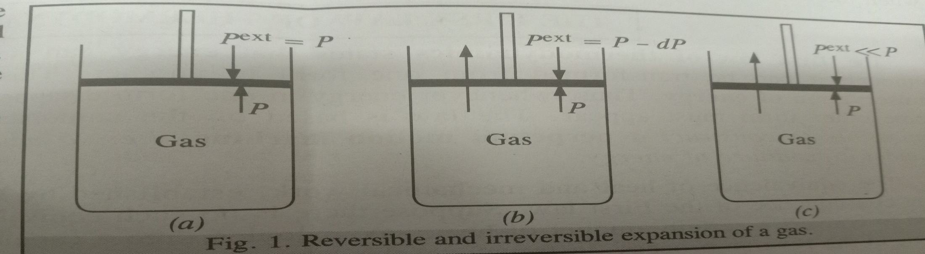
Work done in Reversible Isothermal Expansion:
Consider a gas enclosed in a cylinder fitted with a weightless and frictionless piston.
The cylinder is not insulated. It is supposed to be in thermal equilibrium with the surroundings so that the temperature of the gas remains constant all along.
The external pressure P on the piston is equal to the pressure of the gas within the cylinder (Fig. a). If the external pressure is lowered by an infinitesimal amount dP, i.e., it falls from P to P – dP (Fig. b), the gas will expand by an infinitesimal volume dV, i.e., the volume changes from V to V + dV.
As a result of expansion, the pressure of the gas within the cylinder falls to P – dP, i.e., it becomes again equal to the external pressure. The piston then comes to rest.

Slide 5
If the external pressure is lowered again second time by the same infinitesimal amount dP, the gas will undergo the second infinitesimal expansion dV before the pressure again equals the new external pressure.
The piston again comes to rest. The process is continued such that the external pressure is lowered by successive small amounts and as a result the gas undergoes a series of small successive increments of volume dV at a time.
It may be noted that since the system is in thermal equilibrium with the surroundings, the infinitesimally small cooling produced as a result of infinitesimally small expansion of the gas at each step, is offset by the heat absorbed from the surroundings and the temperature remains constant throughout the operation
Since during expansion, pressure decreases and volume increases, these two parameters are assigned opposite signs. The work done by the gas in an infinitesimal expansion is thus given by
dw = - (P – dP)dV = -PdV (1)
Ignore the product dPdV, as both the quantities are infinitesimal.

Slide 6
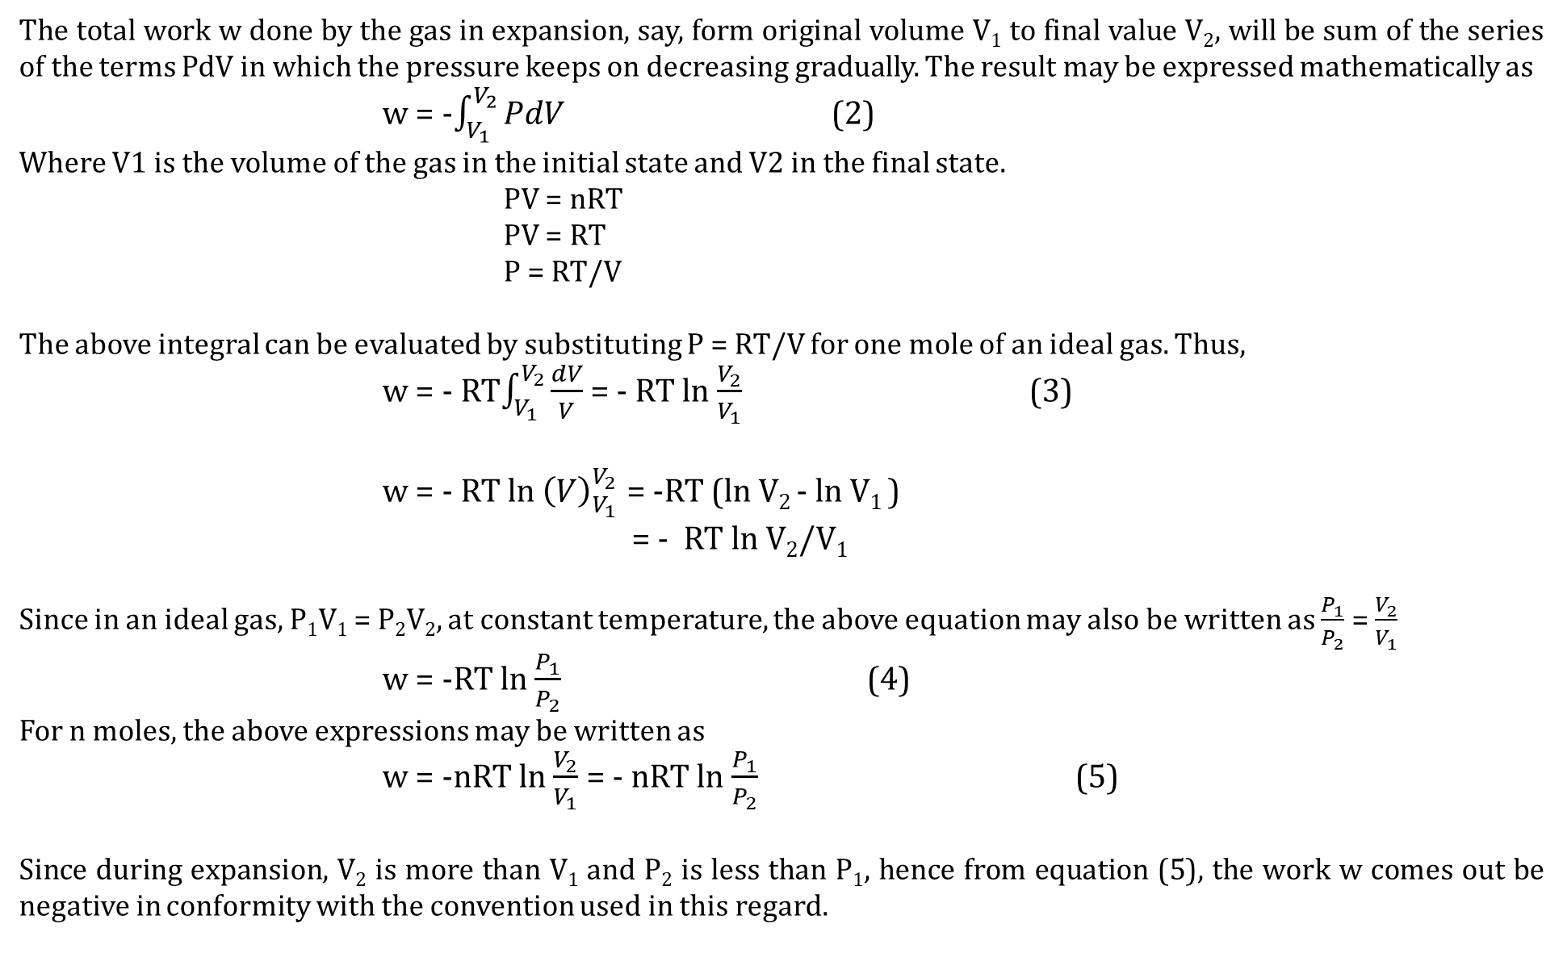
The total work w done by the gas in expansion, say, form original volume V₁ to final value V₂, will be sum of the series of the terms PdV in which the pressure keeps on decreasing gradually. The result may be expressed mathematically as
w = -$\int_{V_{1}}^{V_{2}}{PdV}$ (2)
Where V1 is the volume of the gas in the initial state and V2 in the final state.
PV = nRT
PV = RT
P = RT/V
The above integral can be evaluated by substituting P = RT/V for one mole of an ideal gas. Thus,
w = - RT$\int_{V_{1}}^{V_{2}}{\frac{dV}{V}}$ = - RT ln $\frac{V_{2}}{V_{1}}$ (3)
w = - RT ln ${\left(V\right)}_{V_{1}}^{V_{2}}$ = -RT (ln V₂ - ln V₁ )
= - RT ln V₂/V₁
Since in an ideal gas, P₁V₁ = P₂V₂, at constant temperature, the above equation may also be written as $\frac{P_{1}}{P_{2}}$ = $\frac{V_{2}}{V_{1}}$
w = -RT ln $\frac{P_{1}}{P_{2}}$ (4)
For n moles, the above expressions may be written as
w = -nRT ln $\frac{V_{2}}{V_{1}}$ = - nRT ln $\frac{P_{1}}{P_{2}}$ (5)
Since during expansion, V₂ is more than V₁ and P₂ is less than P₁, hence from equation (5), the work w comes out be negative in conformity with the convention used in this regard.

Slide 7
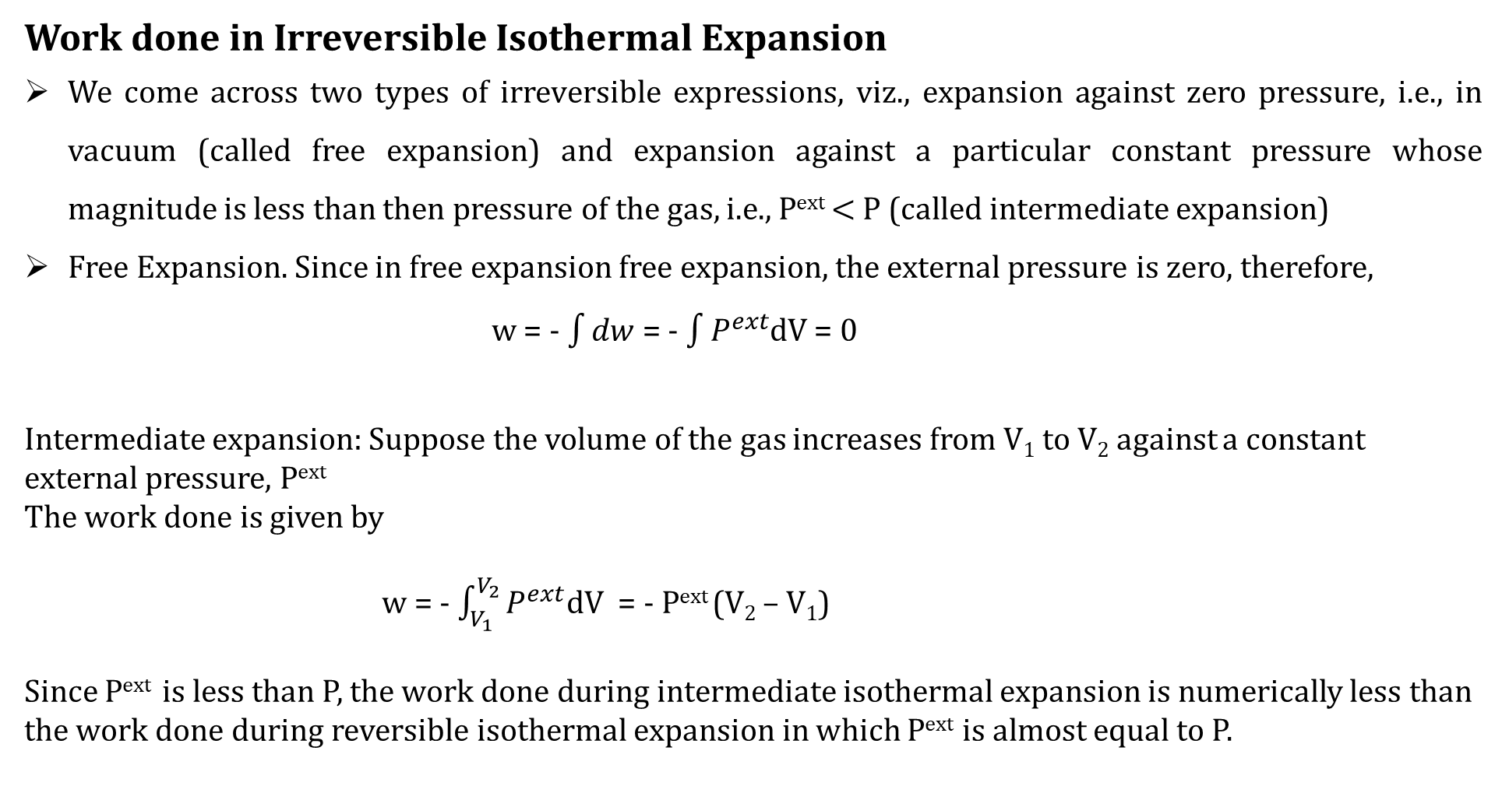
Work done in Irreversible Isothermal Expansion
We come across two types of irreversible expressions, viz., expansion against zero pressure, i.e., in vacuum (called free expansion) and expansion against a particular constant pressure whose magnitude is less than then pressure of the gas, i.e., P^{ext} $<$ P (called intermediate expansion)
Free Expansion. Since in free expansion free expansion, the external pressure is zero, therefore,
w = - $\int{dw}$ = - $\int{P^{ext}}$dV = 0
Intermediate expansion: Suppose the volume of the gas increases from V₁ to V₂ against a constant external pressure, P^{ext}
The work done is given by
w = - $\int_{V_{1}}^{V_{2}}{P^{ext}}$dV = - P^{ext} (V₂ – V₁)
Since P^{ext} is less than P, the work done during intermediate isothermal expansion is numerically less than the work done during reversible isothermal expansion in which P^{ext} is almost equal to P.

Slide 8
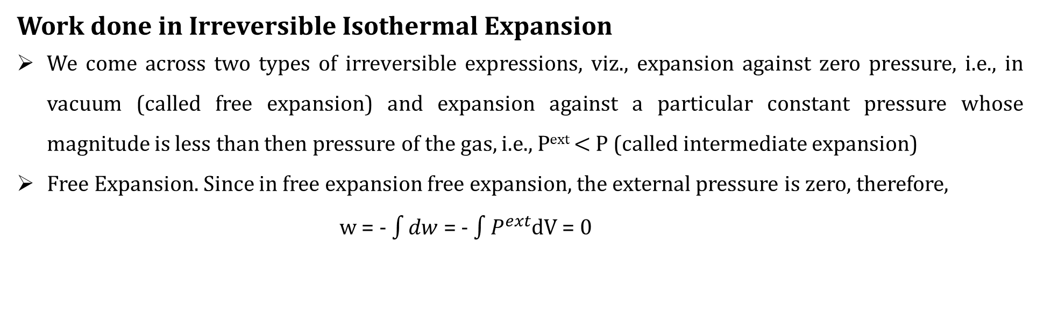
Work done in Irreversible Isothermal Expansion
We come across two types of irreversible expressions, viz., expansion against zero pressure, i.e., in vacuum (called free expansion) and expansion against a particular constant pressure whose magnitude is less than then pressure of the gas, i.e., P^{ext} $<$ P (called intermediate expansion)
Free Expansion. Since in free expansion free expansion, the external pressure is zero, therefore,
w = - $\int{dw}$ = - $\int{P^{ext}}$dV = 0

Slide 9
Thank you

