Slide 1
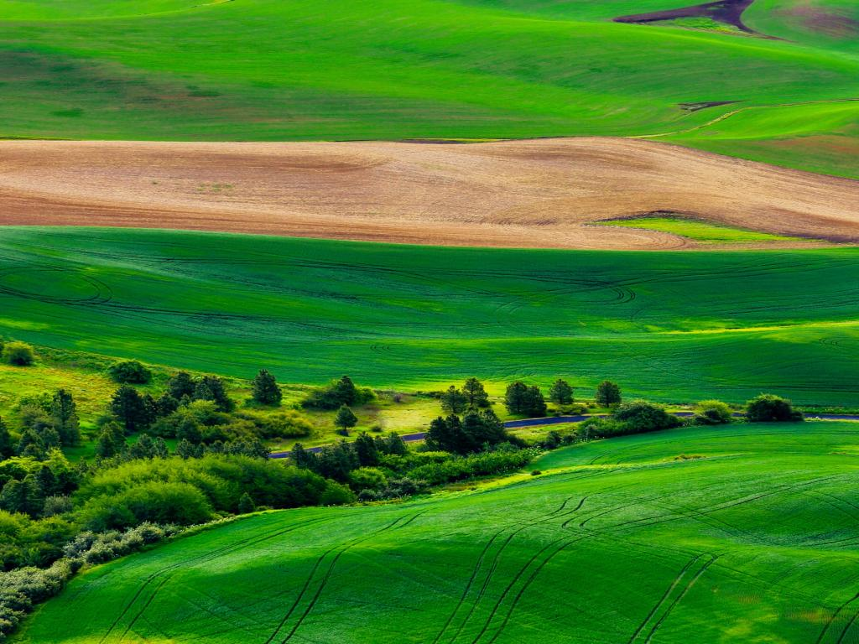
English Literature
The Origins
Presentation by,
G.Sowdambika
Guest Lecturer
English Department(SF)
C.P.A.College,Bodinayakanur

Slide 2
WHEN WAS THE ENGLISH LANGUAGE BORN?

Slide 3

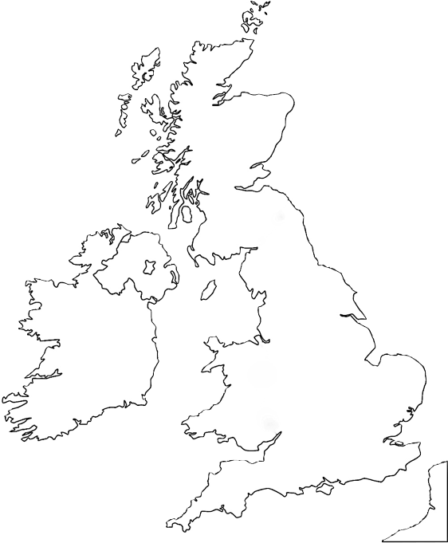
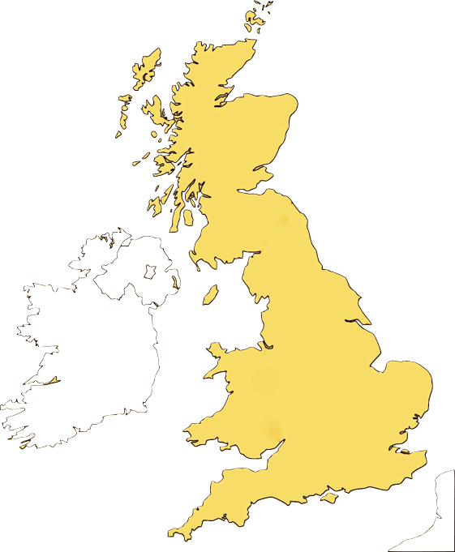
PRE-CELTIC BRITAIN
2000 B.C.
IBERIANS

Slide 4

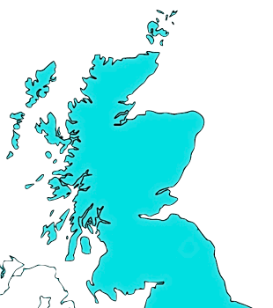

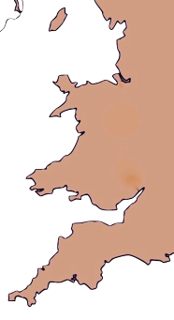
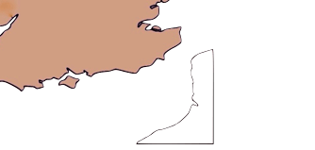
CELTIC BRITAIN
TWO CELTIC MIGRATIONS:
GAELS
Later called
‘Scots’ by the
Romans
- 7TH CENTURY B.C.
- 4TH CENTURY B.C.
BRITONS

Slide 5
CELTIC BRITAIN
THE CELTS
Were organised in clans and tribes.
Had religious and political leaders: the druids.
Were Pagans. Their religion was known as “animism” (Latin for “spirit”).
Their language was the Gaelic.

Slide 6
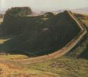
ROMAN BRITAIN
ROMAN EMPEROR Julius Caesar INVADED BRITAIN FIRST IN 55 AND THEN IN 54 B.C.

Slide 7
ROMAN BRITAIN
43 A.D.
EMPEROR CLAUDIUS CONQUERS BRITAIN
He was unable to subdue Scotland because he met with the resistance of
the Picts and the Scots

Slide 8
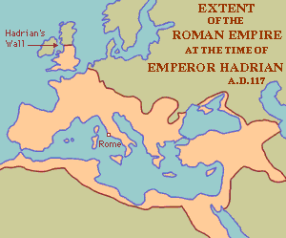
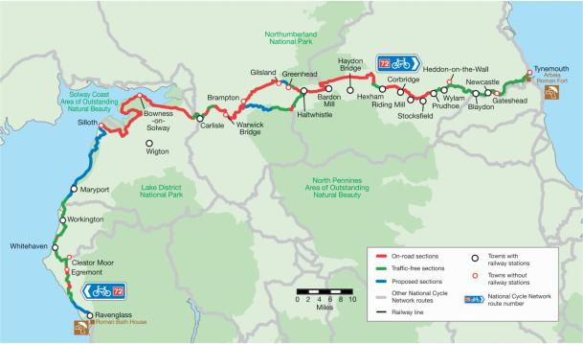
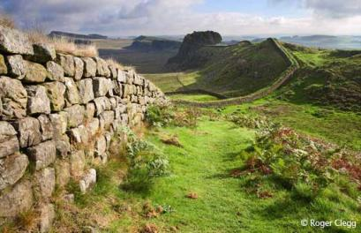
ROMAN BRITAIN
121 A.D.
EMPEROR HADRIAN ERECTS THE WALL

Slide 9
ROMAN BRITAIN
HADRIAN’S WALL:
AN EXTRAORDINARY FEAT OF ENGINEERING
73 miles long
8-10 feet wide
15 feet high
18 millions of specially prepared blocks of stone

Slide 10
ROMAN BRITAIN
THE ROMANS FINALLY WITHDREW IN
410 a.d.

Slide 11
ROMAN BRITAIN
WHAT DID THE ROMAN DOMINATION MEAN FOR BRITAIN?
Civilisation and a law system
Roads
Christianity (possibly, we have little archeological evidence of such early christianisation)

Slide 12
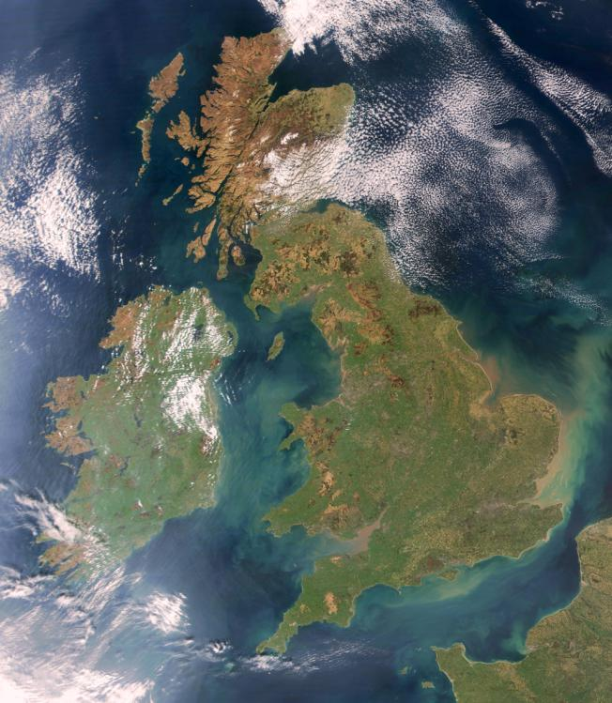
ROMAN BRITAIN
Several cities in Britain have a Roman origin, which can be guessed from the their names
Latin roots:
- Strata via (paved road)
- Castrum (camp)
- Portus (harbour)
- Colonia (military settlement)
- Vallus (wall)
Walton
Lancaster
Chesterfield
Colne
Lincoln
Other Latin borrowings are
such words as:
- Wine (‘vinus’)
- Cheese (‘caseus’)
- Noon (‘nona hora’)
- Dish (‘discus’)
Leicester
Stratford
Stratton
Colchester
Portland
Portsmouth

Slide 13
ROMAN BRITAIN
LONDINIUM
The origins of London
43 A.D. The Romans built a bridge across the river Thames.
They established a settlement on the north side of the bridge, called Londinium.
Londinuim quickly became an important trading centre (goods were transported by boats on the river).

Slide 14

ANGLO-SAXON ENGLAND
FIFTH CENTURY A.D.
GERMANIC INVASIONS
After the Romans left Britain, three Germanic tribes invaded the land
they were the Angles, the Saxons and the Jutes

Slide 15
ANGLO-SAXON ENGLAND
THE ANGLO-SAXONS
- Were uncivilized barbarians
- Were pagans
- Spoke a Germanic language
(four main dialects: Nurthumbrian, Mercian, Kentish and West Saxon)
Roman civilization was wiped out!

Slide 16
«Secretum illud quod sola reverentia vident, hoc deum appellant»
ANGLO-SAXON ENGLAND
Tacito, Germania
Quella cosa misteriosa che essi intuivano in timore e tremore, questo chiamavano Dio.

Slide 17
ANGLO-SAXON ENGLAND
OLD ENGLISH
English language is the result of the gradual fusion of the germanic dialects spoken by the Angles, Saxons and Jutes. The early form of English is called Old English.

Slide 18
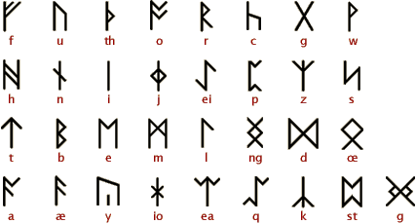
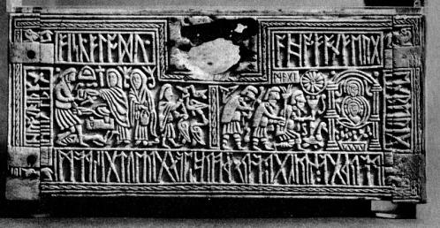
ANGLO-SAXON ENGLAND
Old English had a particular type of alphabet: the Futhark (or Futhork).
The letters of the alphabet were called Runes, from the English ‘Rûn’ (secret) and ‘Runa’ (magician).
(The Franks Casket, c. 700)
Old English had cases and inflections. The spelling and the pronunciation of Old English are so different from present-day English that, except for a few words, make it virtually incomprehensible to a modern reader.

Slide 19
ANGLO-SAXON ENGLAND
The ancient Germanic alphabet was largely supplanted by the Latin alphabet after England’s conversion to Christianity between the VIth and VIIth century; but it continued to be employed for inscriptions.
(The Ruthwell Cross, eighth century and its runic inscriptions which spell out passages from ‘The Dream of The Rood’)

Slide 20
ANGLO-SAXON ENGLAND
«NON ANGLI SED ANGELI»
The Venerable Bede is the author of the chronicle ‘Historia Ecclesiastica Gentis Anglorum’ (c. 731). Although it is not always reliable as historiographic source, yet our knowledge of the Anglo-Saxon period would be incomplete without it.
Bede reports that Gregory the Great, before becoming Pope, came across a crowd of English slaves and was captured by their fair hair and skin. Apparently, he commented by saying that they were ‘Angels rather than Angles’. Once Pope, he sent St. Augustine of Canterbury to England in 597 A.D. to bring Christianity to the Anglo-Saxons.

Slide 21
ANGLO-SAXON ENGLAND
DANISH INVASIONS
The Anglo-Saxons were invaded by the Danes (or Vikings) three times between the 8th and the 11th century. They were pagans and just wanted to exploit the land.
The famous Anglo-Saxon King Alfred (later named ‘the Great’) raised an army during the second invasion and defeated the Danes in the battle of Ethandune in 878 A.D.

Slide 22
ANGLO-SAXON ENGLAND
TO SUM UP:
Old English words have different origins:
The bulk of Old English vocabulary come from the Anglo-Saxon dialects, which gave ‘everyday words’
Latin had little influence in the first instance (the main evidence is in city names), but it introduced new words after the advent of Christianity. Most English words connected to the Chirstian religion and liturgy come from Latin
The Viking raids too left a mark in the language. Many terms connected to war have a Scandinavian origin

