Slide 1
English Literature
An Introduction
Presentation by,
G.Sowdambika
Guest Lecturer
English Department(SF)
C.P.A.College,Bodinayakanur

Slide 2
English Literature
* An Introduction *
Presentation for English
by Dr. Erjon Grori

Slide 3
Overview
In this class we will discuss
  Introduction to English Literature
  Literature Definition and Meaning
  Amis in Learning Literature
  Qualities of Literature
  Importance of Literature
  Why Study Literature
  History of English Literature
  Periods in the History of English Language & Literature
  Old English Literature Period
  An introduction to Beowulf
  Middle English Literature Period
  The Canterbury Tales
  Modern English Literature Period
  Shakespeare’s Development Of Early Modern English

Slide 4
Introduction to English Literature
English Literature is the literature written in English language. English Literature is not only the literature of a particular country but it also it is the literature of the world. No other literature is as popular as it because it is read and written in whole world. We can’t say it only the literature of England for instance – Robert Burns was Scottish, James Joyce was Irish, Joseph Conrad was Polish, Edgar Allen was American and Vladimir Nabokov was a Russian writer, but all have major place in the history of English literature.

Slide 5
Literature Definition and Meaning
If we go with the terminology of the word ‘Literature’, Literature has been taken from the latin word – Literae. The word Literae is the plural of letter. So literature is the art of written work in the form of prose, poetry, fiction or non-fiction. Literature may be divided by language and periods or era.
But we can understand it in the following words –
Literature is the knowledge and experience of human life written in the form of prose, poetry, fiction or non-fiction which can full fill anyone’s life with knowledge joy and happiness.”
“Literature is the composition of those golden words which may brighten our life as gold if we adopt them.”

Slide 6
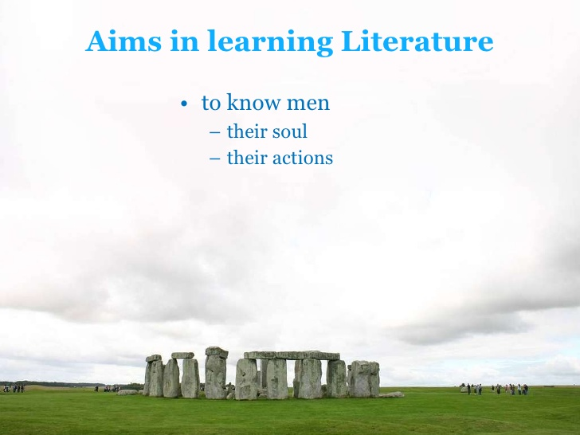
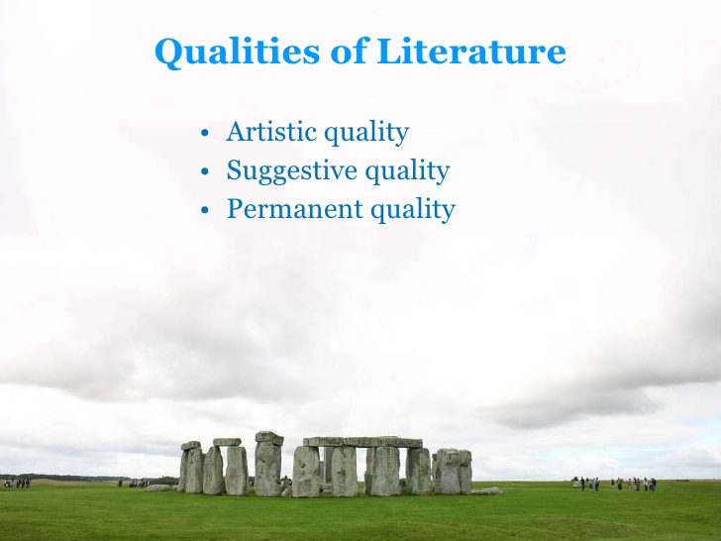
Importance of Literature
Literature preserves the ideals of a people; and ideals--love, faith, duty, friendship, freedom, reverence--are the part of human life most worthy of preservation.
Notes:
It is a curious and prevalent opinion that literature, like all art, is a mere play of imagination, pleasing enough, like a new novel, but without any serious or practical importance. Nothing could be farther from the truth.

Slide 7
Why Study Literature
1. Literature has aesthetic and cognitive value.
2. Literature has much influence on the English language.
3. Literature can breed the students’ sensitivity to the use of English.

Slide 8
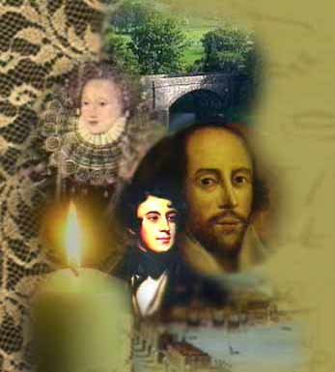
English Literature
English literature has been divided by the periods and time to time it got growth and development.
So take a glimpse of periods of English literature.
Growth | نمو / تطور
Glimpse | نظرة/ لمحة
Literature | أدب

Slide 9
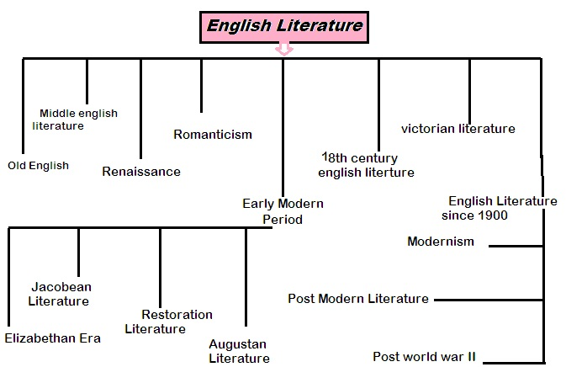

Slide 10
But we will get to look into all these
Periods in History of the English Language
Through Three main Periods
as follow.

Slide 11
Periods in History of the English Language
1. Old English (5-11th centuries)
*Beowulf
2. Middle English(1100-1500)
*The Canterbury Tales by G.Chaucer
3. Modern English(1500-)
*Shakespeare

Slide 12
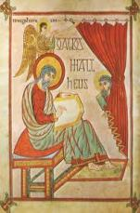
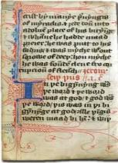


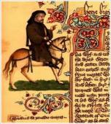
Old English Literature Period
The first time literature was written in old English so we use the term of old English literature when we start talking about it. I`m going to gather the old period in what I call best points.
Epic poem was the most popular achievement of this age.
Old English Literature is also called Anglo Saxon Literature.
The period of old English literature started form 7th century to 1066.
The major works are: Epic poetry, Hagiography, Sermons, and Bible translations.
Beowulf – the epic poem is the important work of old English and it has gained national epic award in England.
Most famous poets of the age were Caedmon, Bede, Alfred the Great and Cynewulf.
Caedmon was the most famous poet and called father of old poetry in 7th century. There is only one poem of nine lines available named Hymn

Slide 13
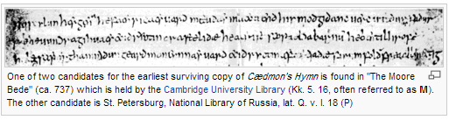
Now let us praise the Guardian of the Kingdom of Heaven
The might of the Creator and the thought of his mind,
The work of the glorious Father, how He, the eternal Lord
Established the beginning of every wonder.
For the sons of men, He, the Holy Creator
First made heaven as a roof, then the
Keeper of mankind, the eternal Lord
God Almighty afterwards made the middle world
The earth, for men.
-Hymn (Caedmon)

Slide 14
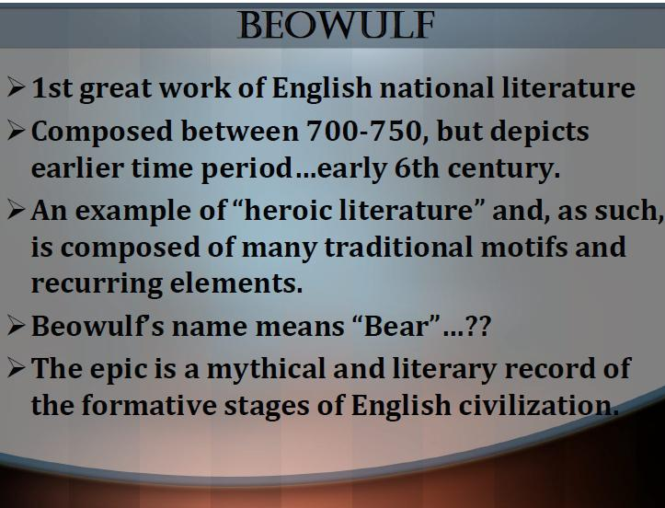

Slide 15
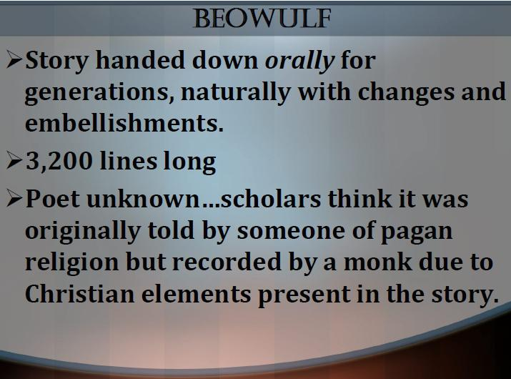

Slide 16
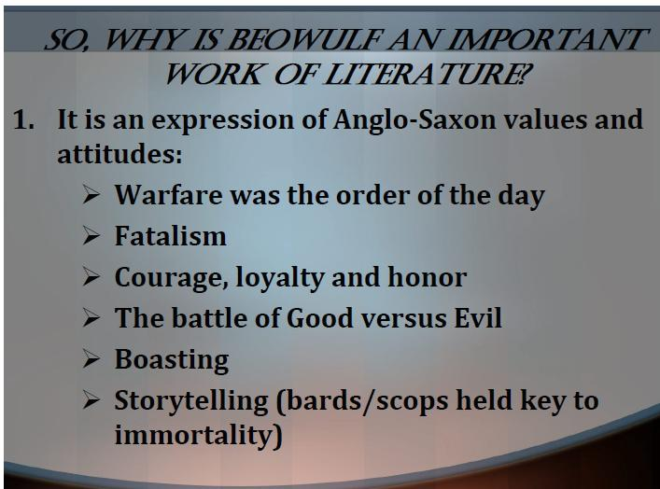

Slide 17
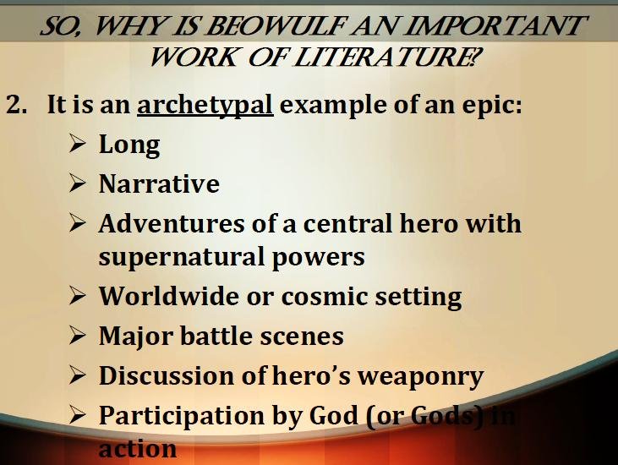

Slide 18
