Slide 1
Digital Electronics
R.BHUVANESHKUMAR
Assistant Professor
C.P.A College Bodinayakanur

Slide 2
Number Systems
Binary
Decimal
Hexadecimal
Octal

Slide 3
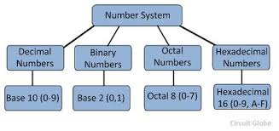

Slide 4
Binary Number System
Base : 2
Numbers : 0 & 1

Slide 5
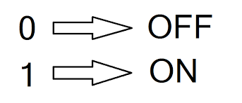
Binary States

Slide 6
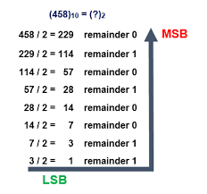
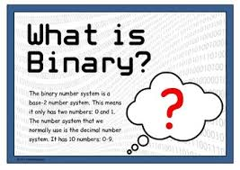

Slide 7
2^0 =1
2^1 =2
2^2 =4
2^3=8
2^4=16
2^5 =32
2^6=64
2^7=128
2^8=256
2^9=512
2^10=1024
2^-1 =0.5
2^-2 =0.25
2^-3=0.125
2^-4=0.0625
2^-5 =0.03125
2^-6=0.015625
2^-7=0.0078125
2^-8=0.00390625
2^-9=0.001953125
2^-10=0.0009765625

Slide 8
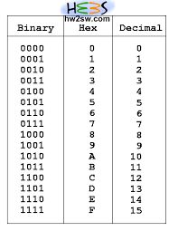
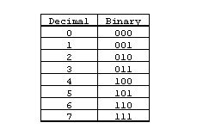

Slide 9
KARNAUGH MAP
Elegant way to simplify Boolean expression.
Sum of Product – method used.
K-Map

Slide 10
Types of K-Map
2 Variable -> 4 shells
3 Variables -> 8 Shells
4 Variables -> 16 Shells

Slide 11
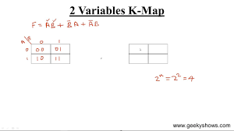
2 VARIABLES
4 Shells
Variables : A & B
Minterms : m ₀ ,m₁ ,m₂ ,m₃

Slide 12
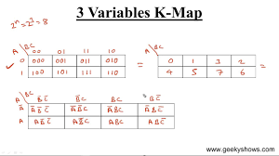
3 VARIABLES
8 Shells
Gray code format
Variables : A, B & C
Minterms: m ₀ ,m₁ ,m₂ ,m_{3 ,} m ₄ ,m5,m₆ ,m_{7 ,} m ₈ ,m₉ ,m₁₀ ,m₁₁ , m ₁₂ ,m₁₃ ,m₁₄ ,m_{15.}

Slide 13
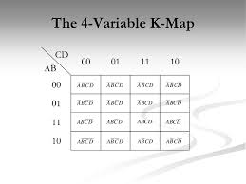
4 VARIABLES
16 Shells
Double change method
Variables : A ,B ,C and D
Minterms : m 0 ,m1 ,m2 ,m3 , m 4 ,m5,m6 ,m7 , m 8 ,m9 ,m10 ,m11 , m 12 ,m13 ,m14 ,m15.

Slide 14
THANK YOU

