Slide 1
Chromatography
Thin Layer Chromatography - t.l.c
Gas - Liquid Chromatography G.l.c

Slide 2
The general principle
Use – to separate and identify components of mixtures.
Several different types - paper, thin layer, gas-liquid.
All use the principle of “partition” - affinity between two phases, to separate mixtures of substances.
Stationary phase & mobile phase.
Compounds with greatest affinity for mobile phase travel further.

Slide 3
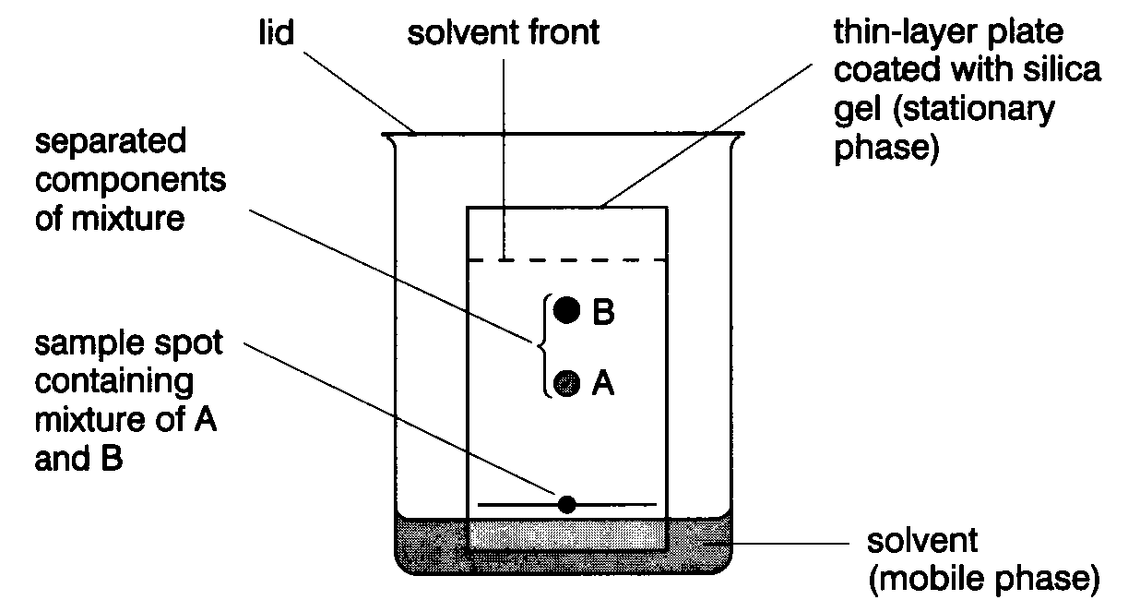
Thin Layer Chromatography - t.l.c.
Series of spots forms
Compare samples in mixture with known substances.
Measure R_{f} values.
Coloured compounds & colourless compounds.

Slide 4
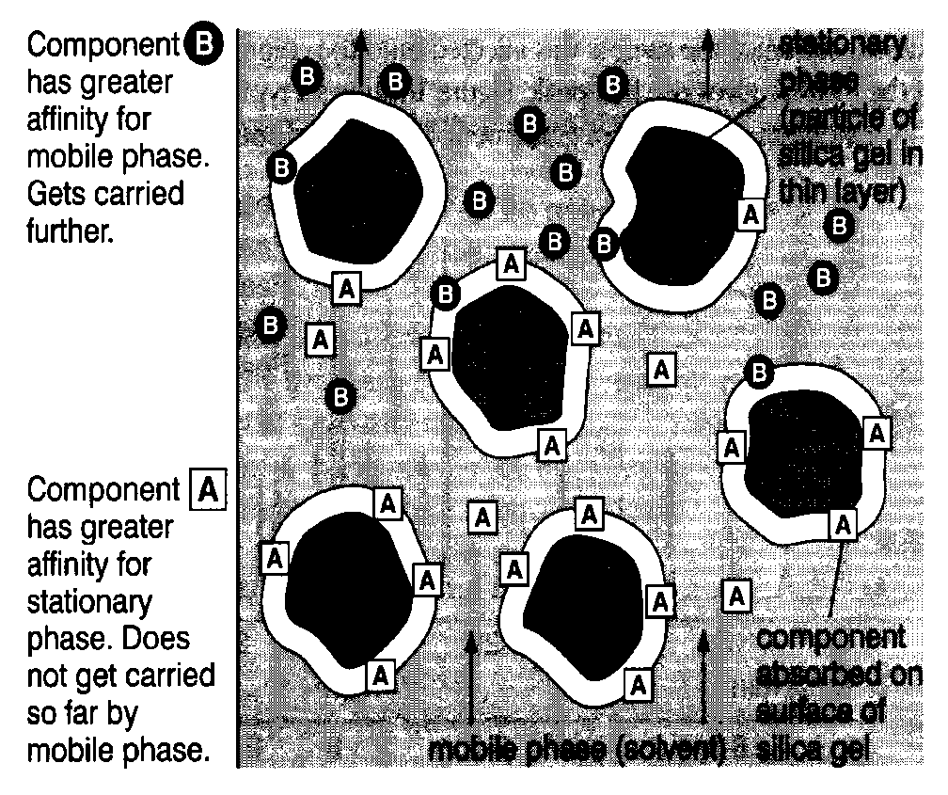
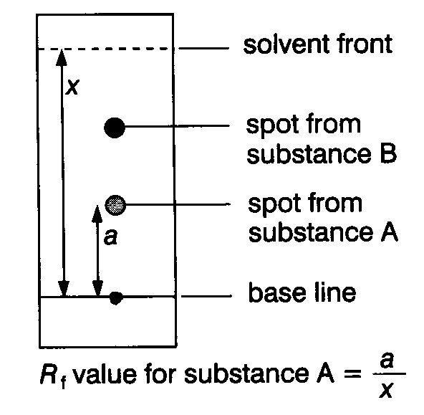
Separation and identification.

Slide 5
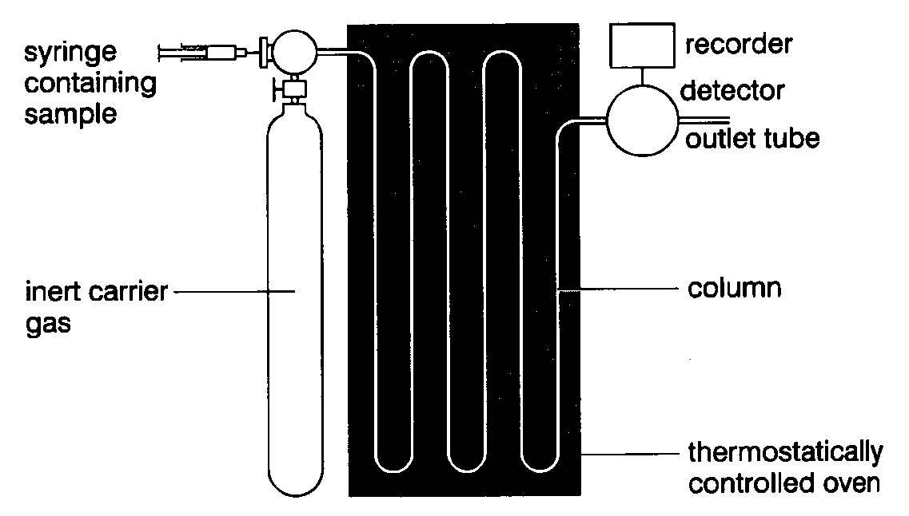
Gas - Liquid Chromatography G.l.c.
Sample introduced by syringe.
Column separates components.
(Heated in oven)
Detector monitors compounds emerging from outlet.
Recorder plots signals as a chromatogram.

Slide 6
What happens in practice.
Compounds that have high affinity for mobile phase emerge first, (most volatile).
Chromatogram charts recorder response against time.
Each component - separate peak.
Retention time – characteristic of the compound under given conditions.

Slide 7
Factors affecting retention time:
length of column
packing material
type of carrier gas
flow rate of carrier gas
temperature of column.

Slide 8
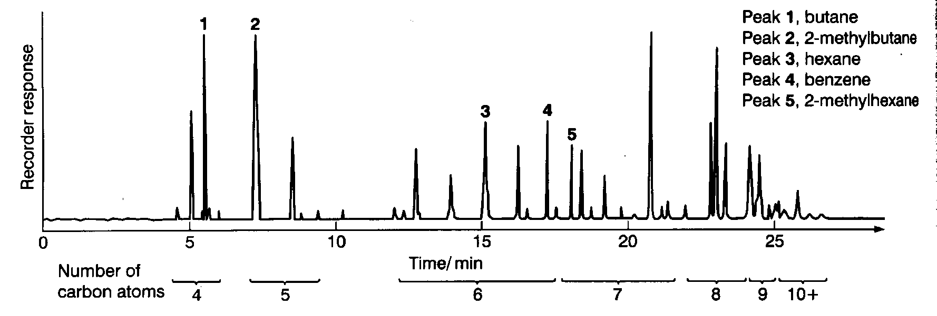
Interpreting the trace
Calibration – known compounds are added to the column and conditions kept constant.
Amount of substance – area under peak / peak height.
Relative proportions can be determined.

Slide 9
Uses of G.l.c.
Very sensitive - small quantities of substances detected, explosives, drugs etc.
Separation of pure substances for collection.
Can be connected to mass spectrometer for direct identification of substances.

