Slide 1

C–TOKENS PROGRAMM IN C
M.Poochelvi
Assistant professor in Mathematics
Department of mathematics[SF]
C.P.A.College

Slide 2
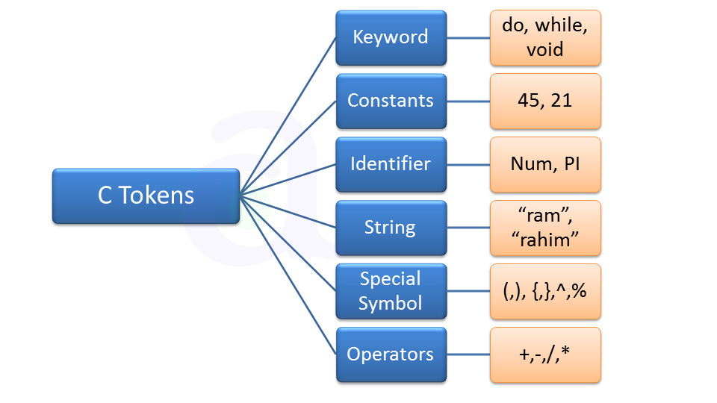

Slide 3
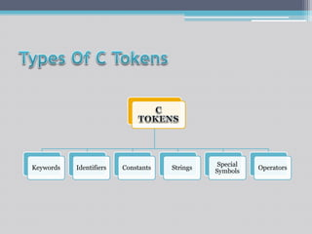

Slide 4
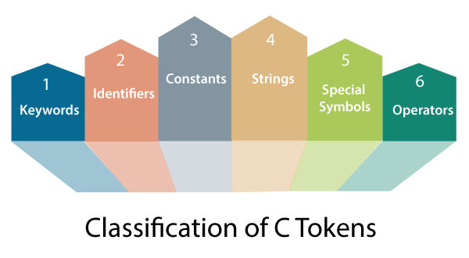
Tokens in C: In the C programming language, a program is composed of various tokens. Tokens are the smallest units of a C program and serve as building blocks for writing code.

Slide 5
Types of Tokens: There are six main types of tokens in C:
Keywords: Keywords are reserved words in C that have special meanings and
cannot be used as identifiers (variable names or function names). Examples include int, if, while, return, etc.
Identifiers: Identifiers are used to name variables, functions, and other user-defined items.
They must start with a letter (A-Z or a-z) or an underscore (_) and can be followed by letters, digits, or underscores.

Slide 6
Thank you

